Slide 1
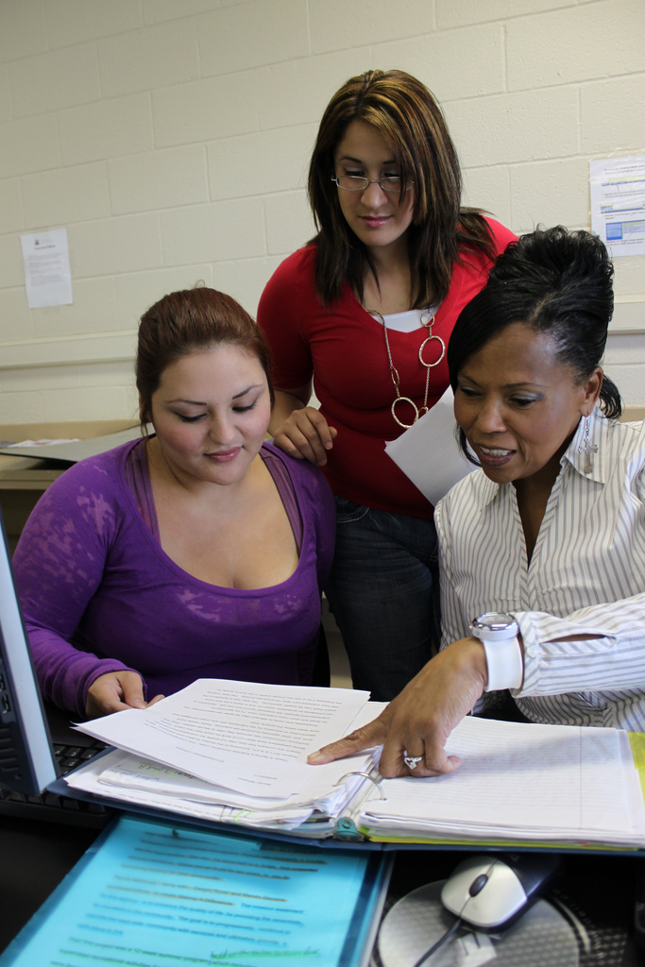
Defining Student Success under WIOA Texas AEL Content Standards (Part 2)
Anson Green
Director Adult Education and Literacy Texas Workforce Commission
April 6, 2017

Slide 2
Outline
Rollout Plan
Expectations
Content Standards Rollout Forum
Benefits
Role of Coaches
Your Questions

Slide 3
Rollout

Slide 4
Elements of the Rollout Plan
Content standards rollout forum
Pre-kickoff webinars
Rollout kick-off meeting on April 19
Phase 1 - Understanding content standards
Phase 2 - Planning for instruction
Phase 3 - Planning for implementation and sustainability
Phase 4 - Observing implementation

Slide 5
Rollout Plan

Slide 6
Texas AEL Content Standards in Four Phases: 2017-2018
Phase 1
Unpacking the Texas AEL Content Standards
Instructional Coaching
Phase 2
Instructional Coaching
Phase 3
Planning for Sustaining Standards-Based Instruction
Instructional Coaching
Phase 4
Observing Standards-Based Instruction
Instructional Coaching
Planning for Instruction with Standards-Based Lesson Plans

Slide 7
Activities
Phases 1, 2 and 3
Synchronous webinar for directors
Pre-Workshop Instructional coaches webinar
Face-to-Face instructional coaches’ workshop
Post Workshop virtual support for instructional coaches
Phase 4
Webinar for directors and instructional coaches

Slide 8
Regional Meetings
Up to seven face-to-face workshops for instructional coaches for phases 1 and 2.
Phase 3 - Face-to-face workshops will be in Austin at the TALAE conference (Exact date to be determined)
Phase 4 will not have a face-to-face workshop

Slide 9
Expectations

Slide 10
Expectations for Programs
Identification and support of instructional coaches
Alignment and evidence of implementation of content standards to instructional content by December 2017
Content standards implementation required in AEL contracts after July 2018
Support training of instructional coaches
On-going participation in the content standards rollout forum

Slide 11
Expectations for Directors
Participation in content standards rollout forum
Facilitate meetings or staff development around content standards webinars with key staff
Attend April 19 rollout meeting
Nominate candidates for instructional coach training
Support instructional coaches
Participate in webinars for updates and input for each of the four phases of the rollout

Slide 12
Expectations for Instructional Coaches
Participate In content standards rollout forum
Participate in intensive training and support through June 2018
Contribute to resource bank, including lesson plans and syllabi
Facilitate alignment and implementation of instructional content to content standards by December 2017

Slide 13
Content Standards Rollout Forum

Slide 14
Title one
You can access the Community of Practice by clicking on the “Connect” button and choosing “All Communities.”

Slide 15
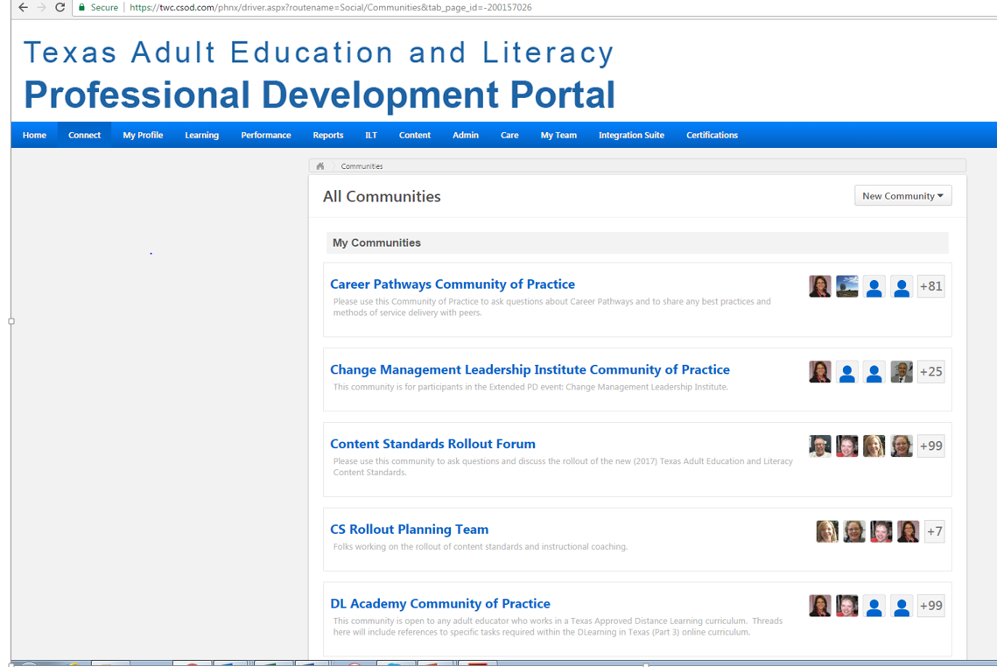
Title 2
Click on the Community you would like to participate in.

Slide 16
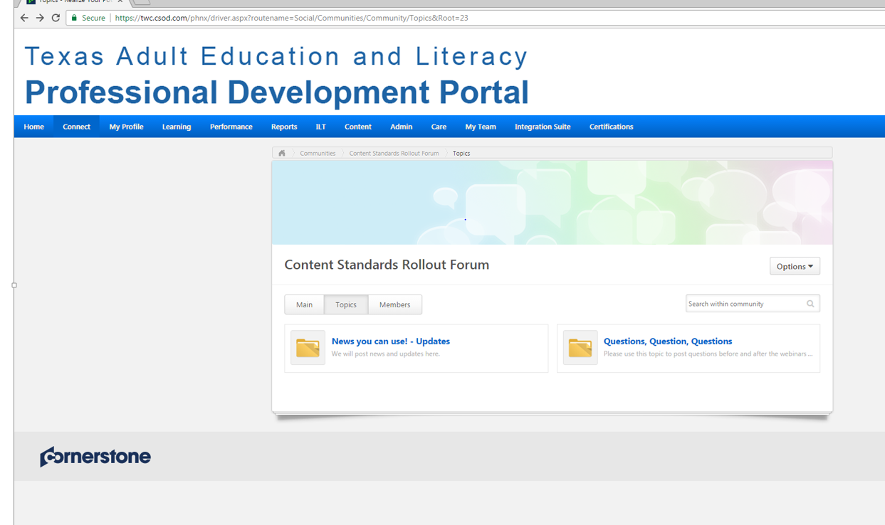
Title 3
The community is open to everyone, so there’s no joining. You’re already a member!
Just click on any of the “Topics” to follow along or ask your own questions.

Slide 17
PD Portal Questions?
pdportal@tamu.edu

Slide 18
Benefits of the Standards

Slide 19
Instruction
More explicit instruction in reading, mathematics and ESL
Development of program course syllabi
Better lesson planning
Better alignment of instruction to college and career training
Assessment better aligned to content standards

Slide 20
Program Enhancement
Overall improved performance
Improved local instructional leadership - Coaches can support teachers in areas other than content standards
Expansion of content to serve a broader range of students
Better recruitment strategies
Stronger relationships with business and workforce partners

Slide 21
Levels of Educational Attainment in Texas
Out of 17.5 million Texans aged 24 and above, 1.5 million (8.7%) have attained 9-12 grade levels but do not have a diploma or a high school equivalency certificate.

Slide 22
Higher-skilled ELL / Professionals
header
Placeholder 2
Highest Degree or Level of School Completed | US Based Schooling | Non-US Based Schooling
No schooling | 2,314 | 1,250
Grades 1-5 | 443 | 2,642
Grades 6-8 | 6,792 | 9,171
Grades 9-12 (no diploma) | 36,083 | 22,570
High School Diploma or alternate credential | 1,645 | 6,077
HSE (e.g.—GED) | 965 | 180
Some college, no degree | 1,156 | 3,183
College or professional degree | 0 | 7,598
Unknown | + | 10
 | 49,398 | 52,681
Source: OCTAE NRS, Statistical Section

Slide 23
Higher-skilled ELL / Professionals cont.
header
Placeholder 2
Highest Degree or Level of School Completed | US Based Schooling | Non-US Based Schooling
No schooling | 2,314 | 1,250
Grades 1-5 | 443 | 2,642
Grades 6-8 | 6,792 | 9,171
Grades 9-12 (no diploma) | 36,083 | 22,570
High School Diploma or alternate credential | 1,645 | 6,077
HSE (e.g.—GED) | 965 | 180
Some college, no degree | 1,156 | 3,183
College or professional degree | 0 | 7,598
Unknown | + | 10
 | 49,398 | 52,681
Source: OCTAE NRS, Statistical Section

Slide 24
Role of Instructional Coaches

Slide 25
Role of Instructional Coach
Content standards expert
Training and guidance to local program instructors for standards-driven instruction
Leadership for implementation
Develop capacity at local level, including both teacher development, observations and building instructional resources

Slide 26
Coach Qualities
Your comments:
Motivation and passion toward topic
Commitment to success
Flexibility
Desire to be a coach, not an assigned duty
Someone who can effectively model best practices
Someone who understands challenges of multi-level classes
Great people skills—Can adapt approach to instructions with different needs
Preparedness—Knowledge of content and what instructors need.

Slide 27
Your Questions

Slide 28
How long is the commitment for instructional coaches to participate in the rollout?
February – April 2017
-Introductory Webinars
-Establishment of Community of Practice—Content Standards Rollout Forum
-Content Standards Rollout Meeting
-Monitoring of implementation of contract requirement by TWC
May – June 2017
-Instructional coaches for each program identified
-Letters of commitment completed
-Progress report at AEL Summer Institute, June 20-23
July -- December 2017
-Phase 1, Understanding Content Standards
(webinars for directors & regional workshops for instructional coaches)
-Phase 2, Planning for Instruction
(webinars & regional workshops)
-Alignment of local instruction to content standards
January – June 2018
-Phase 3, Planning for implementing and sustaining standards-based instruction
(webinar & TALAE workshop)
-Phase 4, Observing Standards-Based Instruction
(support for instructional coaches)
-Alignment to occupations within key career clusters

Slide 29
How will TWC monitor progress toward Content Standards implementation?
Oversight of process by program specialists
Quarter 2 progress report

Slide 30
What will be the costs for programs to participate in the rollout?
PD funds for time, travel and substitutes

Slide 31
How many instructional coaches does each program need to have?
Each grantee should have at least 2
Each subgrantee should have at least 1

Slide 32
How will Career Pathways be worked into Content Standards?
New Project – Standards Alignment to Industry Clusters

Slide 33
Conclusion
Steps
Identify coaches
Review the information
Join the community of practice
Attend the April 19 meeting in Austin

