Slide 1
TEAMS Release 5.4.1
Deployment Date: 12/15/2020
Mahalia Baldini
State Director
TWC | AEL

Slide 2
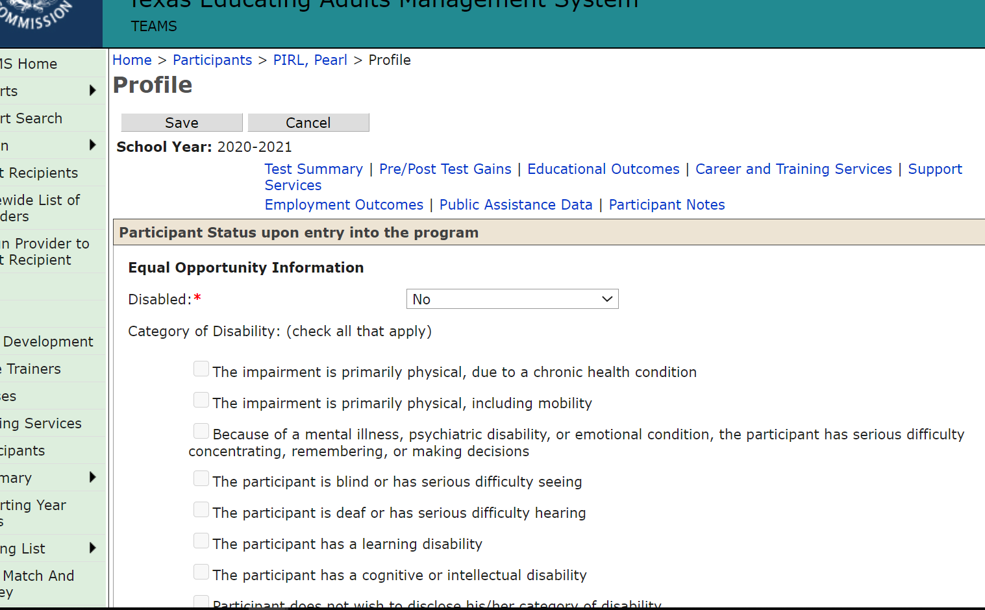
Objective: Two Enhancements
Update participant record to include new and modified PIRL elements
Align Educational Outcomes to Grant Recipients and Remove Duplicates

Slide 3
New PIRL Elements

Slide 4
Monitoring/ Auditing New Elements
For PY 20-21, Monitors will review the enrollment form and Release of Information for signatures only
For PY 21-22, well after final written guidance is released, they will be testing for all required PIRL elements
AEL Letter/guidance to be released early Spring 2021
PIRL = Participant Individual Record Layout
Includes items collected on enrollment forms BUT also includes ANY outcomes related to that student such as MSG, Credential, Employment, etc..

Slide 5
What Will Happen on 12/15/2020
Any students with enrollment forms collected prior to 12/15 that do not have the new elements included/collected should be entered into TEAMS prior to 12/15
Data entry deadline for all data (including profiles) for students who did intake/enrolled up to 11/30 is due by data entry deadline – 12/15/2020
What about students who came in between 12/1-12/15 ?
If you try to add a new profile after 12/15 even if the ‘enrollment date’ was technically before 12/15, TEAMS will want all the data elements entered.
Options
1. Try to get all the profiles created in TEAMS prior to 12/15
2. For new elements not collected, option for ‘No’, ‘Did not Disclose’, ‘Unknown’.

Slide 6
Two Documents
TEAMS Release Notes : Includes details on defects that are being corrected during the release. Will also contain prototype screen shots of what users can expect to see when the changes roll out.
Instructions for AEL Enrollment Form—details both new and modified elements that will need to be updated on local enrollment forms that will occur in TEAMS release 5.4.1 on the participants record/profile.

Slide 7
TEAMS Release Notes Headings

Slide 8
Instructions for AEL Enrollment Form
Not all the elements we collect are for PIRL or Joint PIRL
We also collect information for other state level reporting needs to fulfill legislative requirements
The document will signify if the element is a PIRL or Joint PIRL element
All elements in this document are required to be on the enrollment form and collected from potential students as part of the intake process

Slide 9
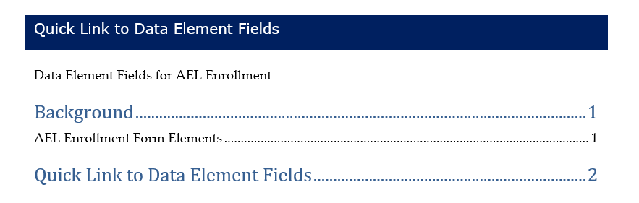
The Table of Contents is Your Friend
“Quick Links” will take you to more information on each element

Slide 10
Clearly Identifies New or Modified Elements

Slide 11
Forecasting For Future Guidance
We are including these items in the document to:
Provide proactive guidance on what elements we collect for Joint PIRL on the enrollment form, future guidance will also include:
  Data Validation of all PIRL being reported with Source Documentation
    MSG’s
    Credentials
    Employment
    Local Responsibility to monitor and validate what is being reported in TEAMS
    Monthly, Quarterly, and Annually

Slide 12
Add Grant Recipient Column to Educational Outcomes

Slide 13
Reason for the Change
To Show which Grant Recipient will be accredited with Educational Outcomes
  Creates transparency for how performance is calculated
  Allows for troubleshooting within the data
Based on services during the student’s period of participation:
  Gives credit to all Grant Recipients who served the student within the POP regardless of who entered the credit
  Denominator/Numerator alignment
  Transparency for who is serving students, creates ability to coordinate w/other Grantees

Slide 14
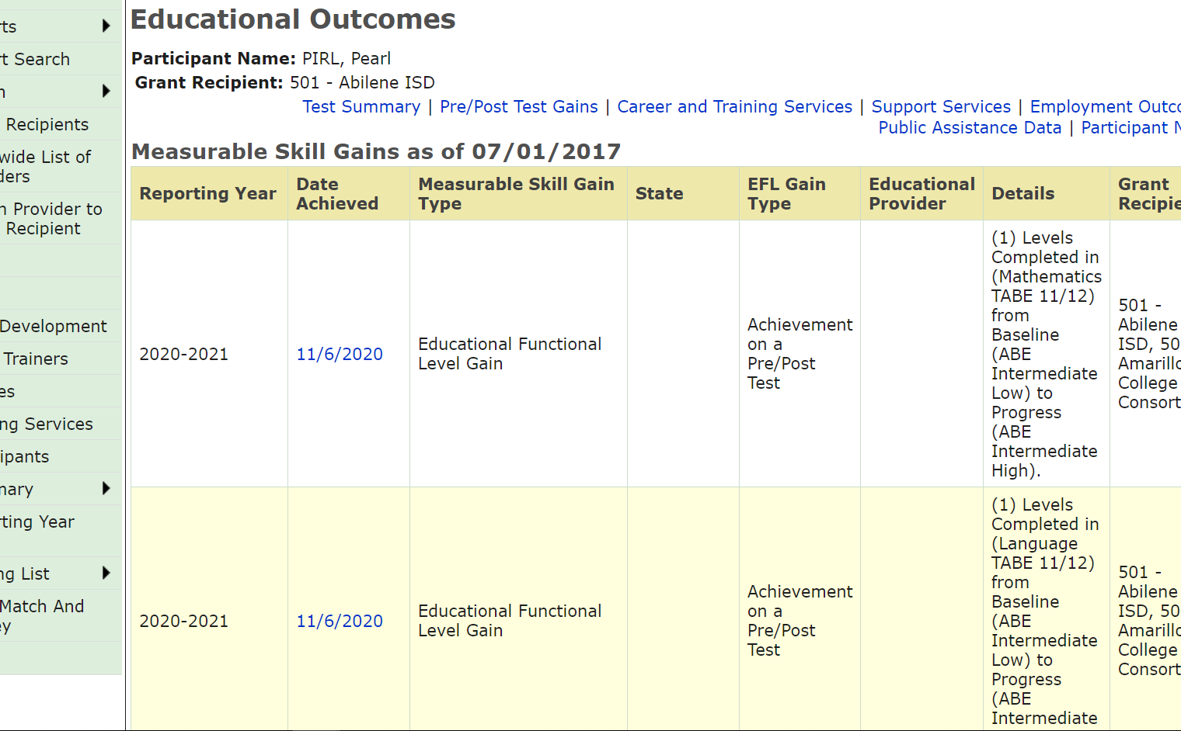
Educational Outcomes
Most performance is POP based, but applied within Program Year(s) for reporting

Slide 15
Additional Column

Slide 16
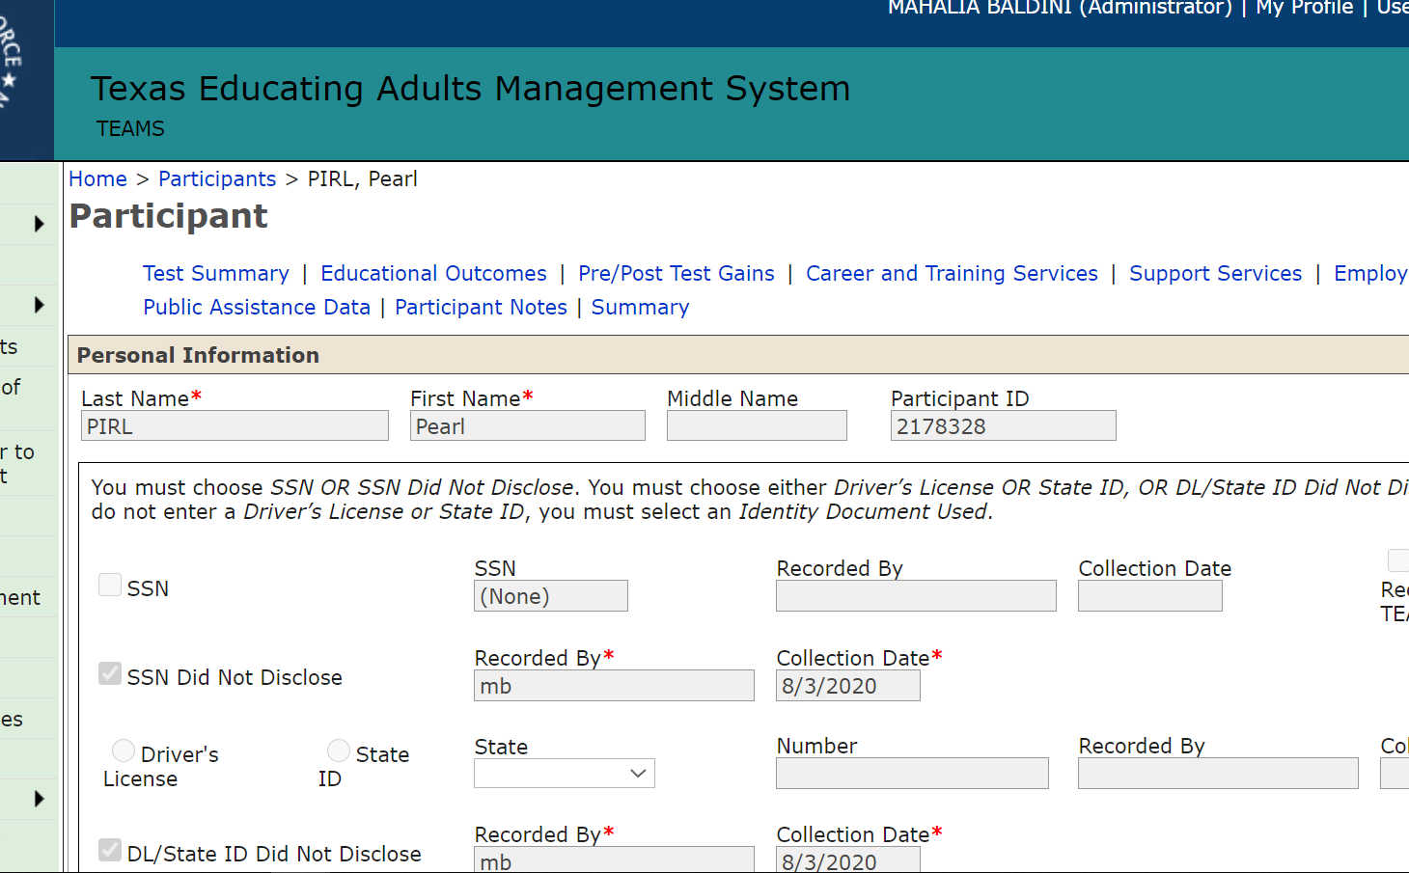
What Will This Look Like in TEAMS
Let’s Review in the TEST system to show what the changes will look like

Slide 17

THANK YOU!
Have a Question? Email Us!
TEAMS.TechnicalAssistance@twc.state.tx.us
Copy your Program Specialist

