Slide 1
May Day: Preparing for the Monitors
Howard College Concho Valley

Slide 2
Nicole Stevens
Director – AEL
Wednesday, June 21, 2017

Slide 3
Objectives
Evaluate all Aspects of Program
  Look for Weaknesses and Strengths
Team Morale Matters
Attend Training for Best Practices
  Implement New Ideas & Strategies
How to Implement Change
Be Prepared for Monitors

Slide 4

The Way Things Were

Slide 5
Structure – Courses
Needed updating/reorganizing
  Career Pathways & Transitions
    Not set up or running correctly
    Unable to capture targets
  High School Equivalency Courses
    Had people in classes that were not assigned
    Students attending multiple classes

Slide 6
Structure – Job Descriptions
Needed to go back to basics
  Instructors doing tasks that fall under administration
    Not covered by appropriate funding source
    Time & Effort not inclusive of responsibilities
  No clear “chain of command”
    Who oversees who, who has authority over what, and what are proper procedures to follow when dealing with colleagues?

Slide 7
Structure - Data
Student Files
  Instructor Files
    Program forms contained unnecessary PII
    Cheap folders created disorganization – no consistency
    Student folders copied when entering a different class
  Administrator Files
    Not adequately organized
    Sign-in sheets copied

Slide 8

Team Unity

Slide 9

Reliant on Others
All Forms
  Used pencil
Filing Systems
  One folder/student/class (copies)
  Data Entry staff files
ITEC Plan
  No one knew

Slide 10
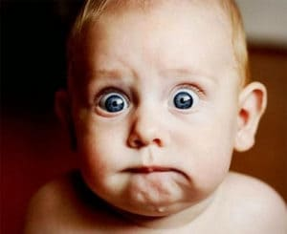
TWC Business Meeting:
September 2016

Slide 11

Devoured AEL Contract and
TWC Assessment Guide
AEL Contract
  Pulled out all requirements
  Called TWC with questions and clarifications
  Built SOP – very specific
Assessment Guide
  Who knew??
  Became my go-to book

Slide 12
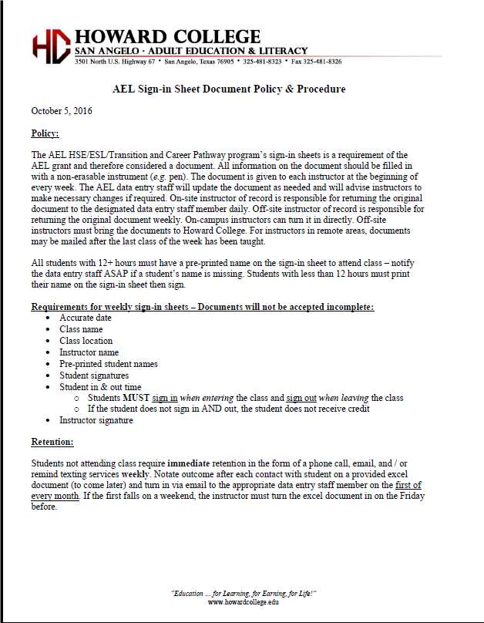
Implementing Changes
Policy Letters
  Implements required changes to previous practices
  Documents change in practice for monitors
  Establish pattern

Slide 13
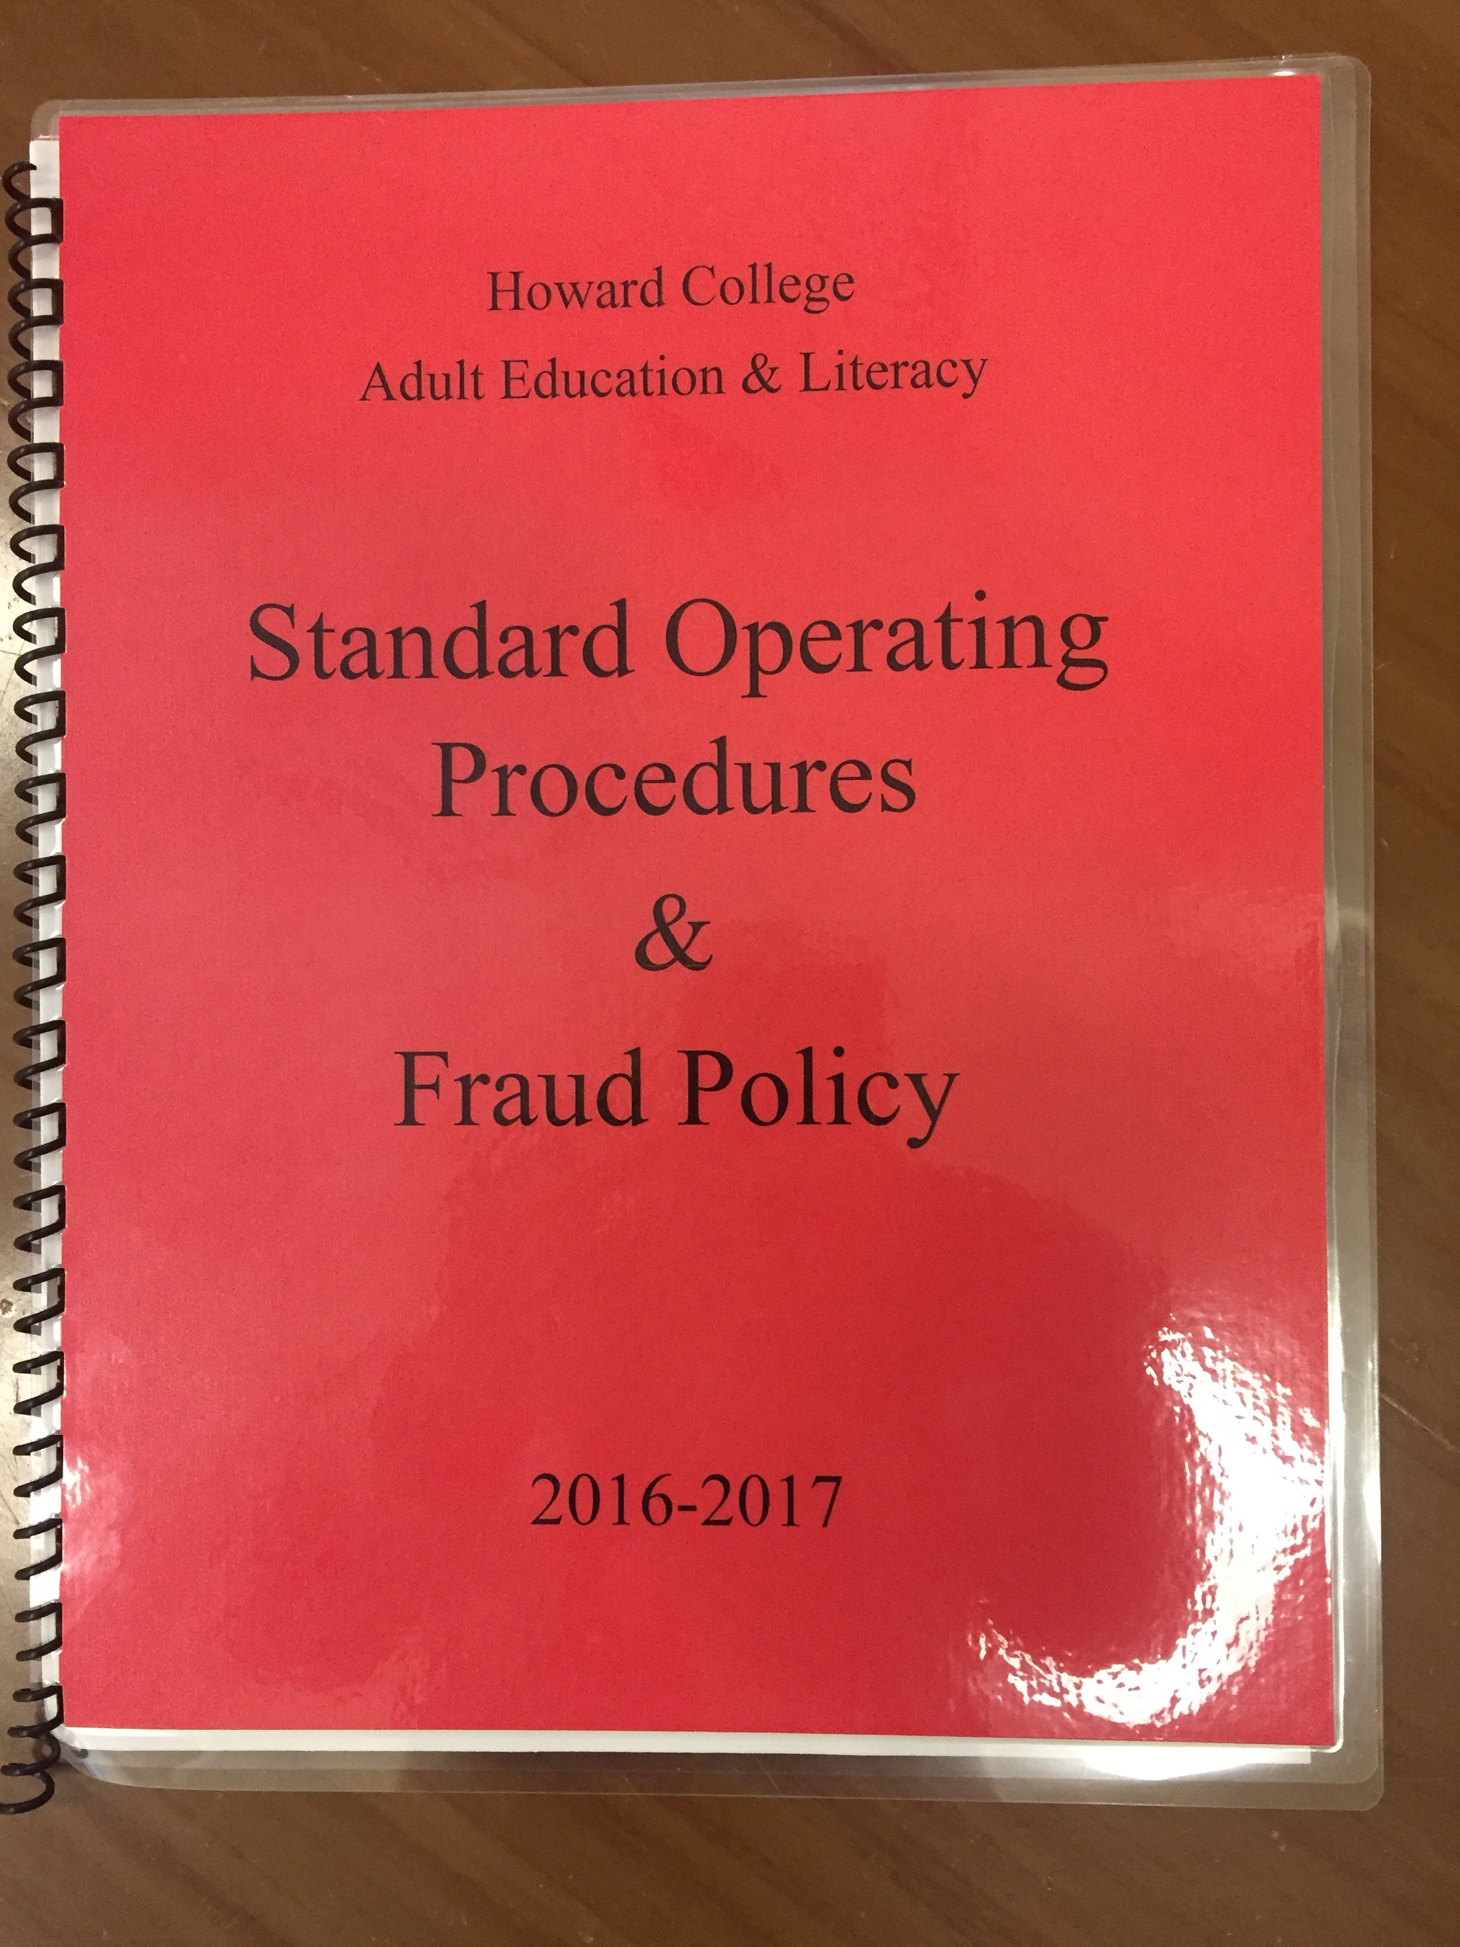
Standard Operating Procedures
(SOP)
Booklets
  Each instructor and staff member received one
    Responsible for contents
  Made amendments and updates as needed
    Submitted to TWC
    Distributed to instructors and staff

Slide 14
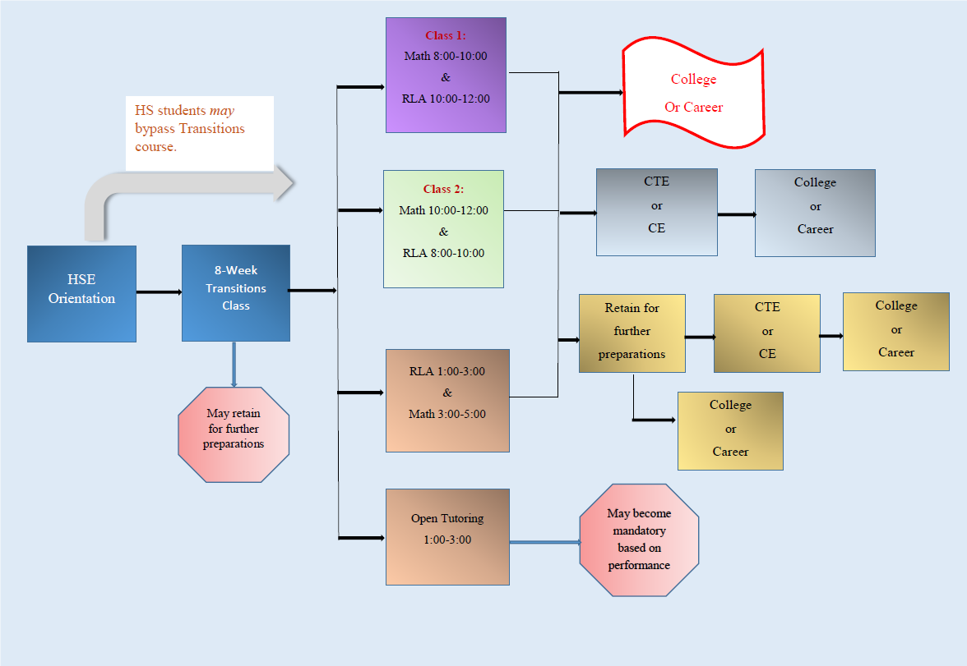
Course Structure
Tackle Tuesday Team
  Created new course schedule and structure
    Courses flow from Transitions to TxCHSE to further training/education
    Holds students more accountable – attendance
    Holds instructors more accountable – sign-ins and instruction

Slide 15
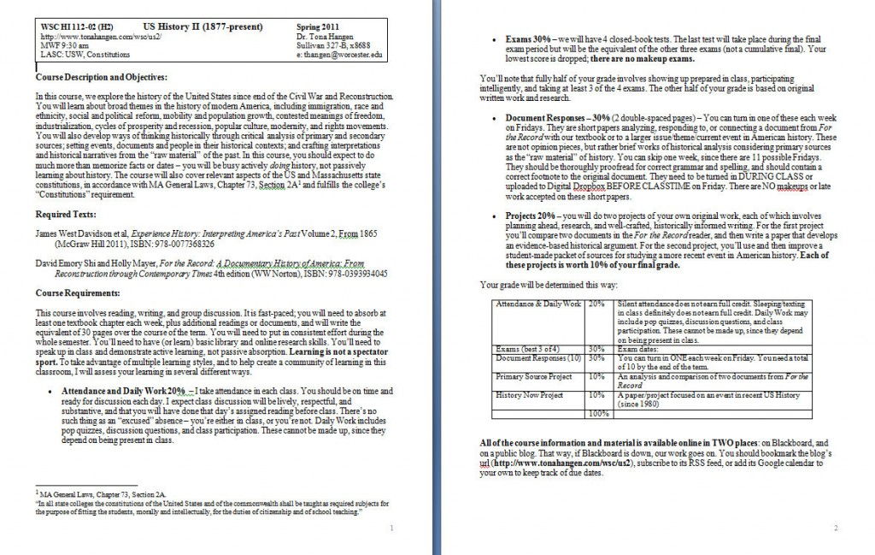
Curriculum
Tackle Tuesday Team
  Built new course curriculum to fit new rigor of courses
  Collaborated to create internal assessments for course advancement to better track students’ progress

Slide 16
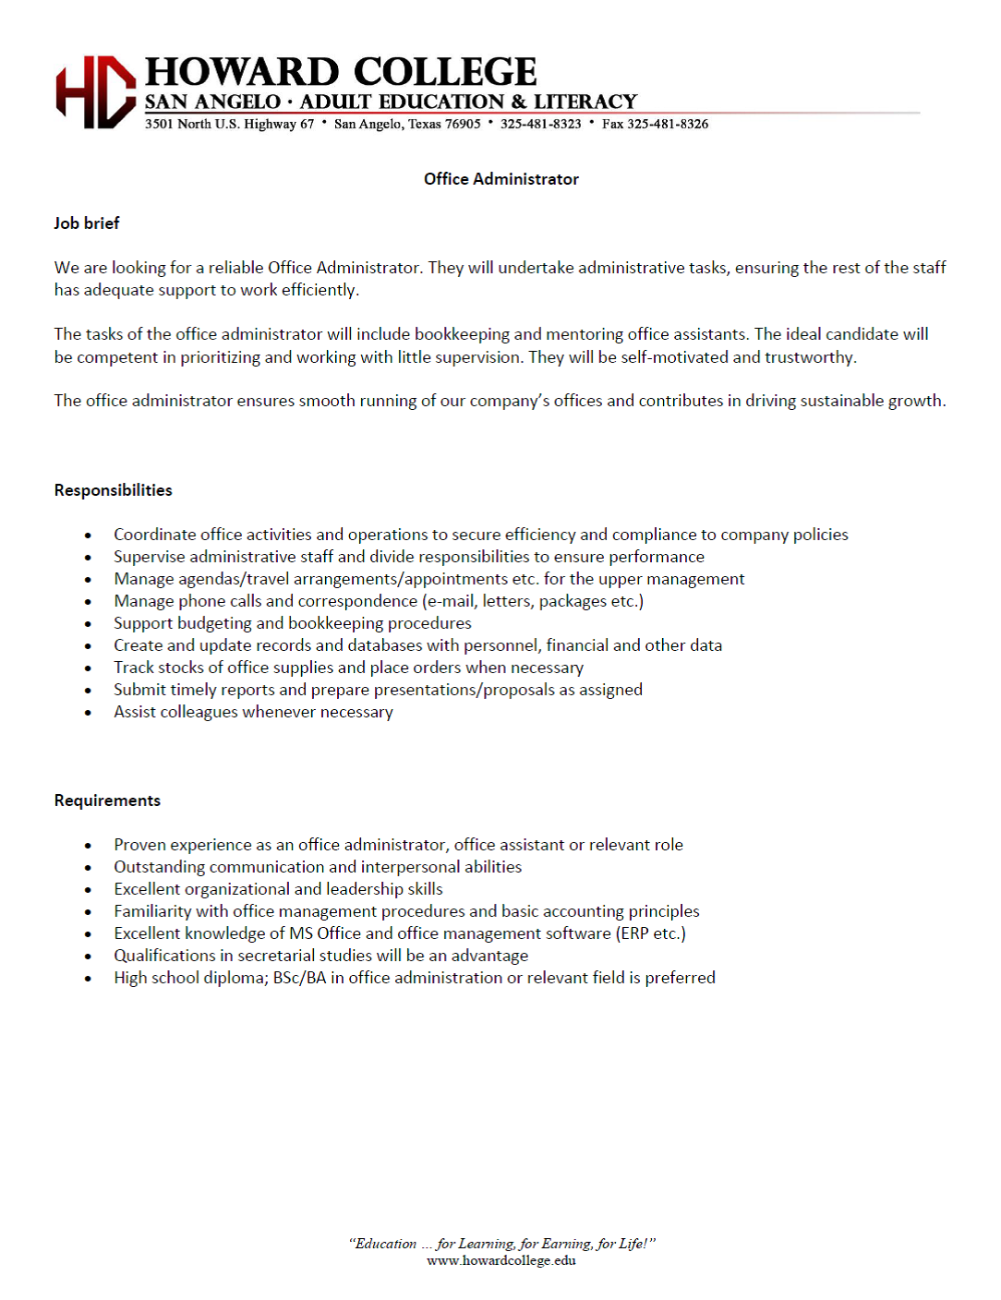
Job Descriptions
Duties
  Aligned instructor efforts with job descriptions
  Matched appropriate funding sources
Established appropriate lines of communication
  Supervisors
  Mandated email correspondence
    Encryptions

Slide 17

Professional Development
What PD Stands for:
  Poor Decisions
  Physically Draining
  Partial Disaster
  Pretty Dull
  Perpetually Dreadful
  Purpose Defeating
  Peace Defiant
  Purely Disappointing
  Plain Dumb

Slide 18
Professional Development
Source Content
  Increased quality of instruction
  Two instructors trained as trainers
Compliance Measures
  Extensive examinations:
    SOP
    Policy Letters
    Contract
    Assessment Guide

Slide 19

PD Training
Student Files
  Instructor Files
    Remove unnecessary PII
  Administrative Files
    More organized
  Career Navigator Files
    Organized and designed for student-tracking
Security
  All data secured with double barrier

Slide 20

Teamwork

Slide 21
Compliance Checks - Classroom
Quality of Instruction
  Curriculum Team
  Classroom Observation
    Formal & Informal
  End-of-Course Evaluations
    Student Feedback:
      Course Content
      Instructional Methods
      Suggestions

Slide 22
Compliance Checks - Data
TEAMS
  Check data when validating
  Run reports to look at students not progress tested
PII Security
  Check all locking cabinets
  Train on sending secure documents
Random Data checks
  Folders to TEAMS

Slide 23
Compliance Checks - Finance
Internal Records
  Excel Spreadsheets – checkbook register
  Binders
    Travel
    Purchases
    Payroll
Accounts
  Double balance system
    Monthly Account Reconciliation

Slide 24

Suggestion Box

Slide 25
Transparency
Let everyone know the “What” and the “Why”
  Better understanding
  Program buy-in
Form Think Tanks
  Ideas should not be just from the top down
  Get everyone involved in program improvement

Slide 26
Train
Explain
  Breakdown new policies or procedures
Visual
  Provide Visual examples when possible
    Dummy folders
    Checklists
Test knowledge
  Played Jeopardy
  Gave quiz with awards

Slide 27
Reach Out
TWC
  Contact your program specialist & manager for guidance
  Contact the monitoring side for clarifications if necessary
  Reach out to your monitors with questions or concerns to be as ready as possible for their arrival
Other Programs
  Get advice from other programs who have been monitored

Slide 28
Entrance Interview
Invite staff and instructors
  Provide welcoming reception for monitors
  Allows staff and instructors to hear grant standards
  Questions can be asked

Slide 29
Be Prepared
Be organized
  Information can be easily obtained
  Demonstrates patterns in daily activity
Be thorough
  Give detailed exposition on questionnaires
  Know your SOP

Slide 30
Remember…
Monitoring is an opportunity:
  To learn about requirements
  To improve practices
Ask questions throughout process
Call TWC if necessary

Slide 31
Contact Information
Nicole Stevens, Director
Howard College Concho Valley
nstevens@howardcollege.edu
325-481-8300 Ext. 3252

