Slide 1
CDER: An Overview of the System
AEL WIOA Summer Institute: June 20 - 23, 2017

Slide 2
CDER: Logging In
http://www.twc.state.tx.us
TWC Agency Information on right side of screen
TWC Financial & Grant Information
Systems and Related Forms on right side
Cash Draw & Expenditure Reporting (CDER) System
Logon with your Texas Workforce User ID OR
Request an Account

Slide 3
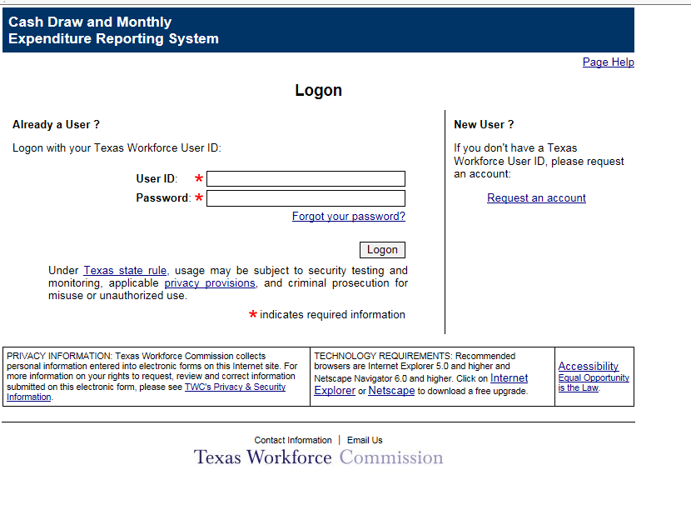
CDER: Logon Page

Slide 4
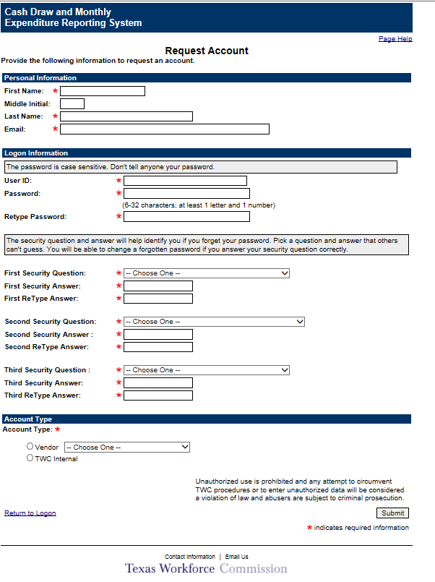
CDER: Request Account

Slide 5
Training Modules
Module 1: Navigation
Module 2: Searches
Module 3: Reports
Module 4: Preparing Cash Draws
Module 5: Preparing Adjustments
Module 6: Preparing Refunds
Module 7: Submitting Transactions
Module 8: Expenditure Reports
Module 9: Certifying Expenditure Reports
Module 10: Preparing Contract Closeouts
Module 11: Certifying Contract Closeouts

Slide 6
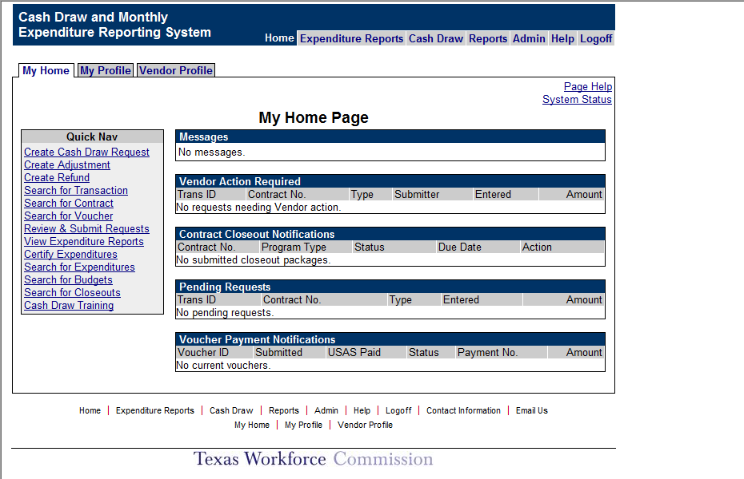
Home Page
The tabs at the top or links at the bottom of the page will take you to the individual components
System messages
Late Reports Notification
Vendor Action Required
(transactions that need attention)
Contract Closeout Notifications
Pending Requests
Voucher Payment Notifications

Slide 7
Navigation
All wording in blue and underlined is a link and when clicked will take users to another page.
Quick Nav allows users to go to the most common individual pages without having to go through the tabs.

Slide 8
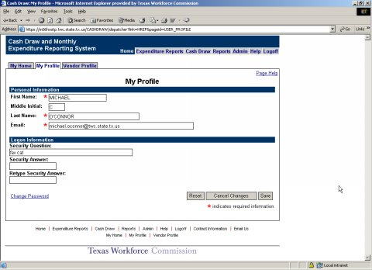
My Profile Page
Shows the information you entered when you requested an account. You can change your security question, answer and password.

Slide 9
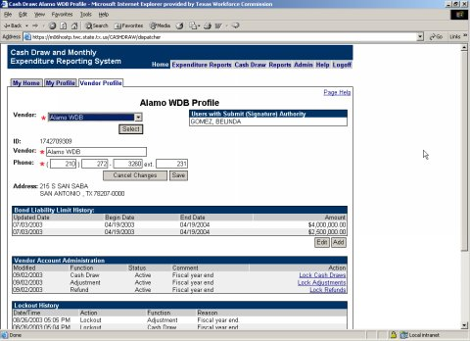
Vendor Profile Page
Vendor address info
Who has submit authority
Vendor bond liability limit and history
Lockout history
Email notification history are displayed here.

Slide 10
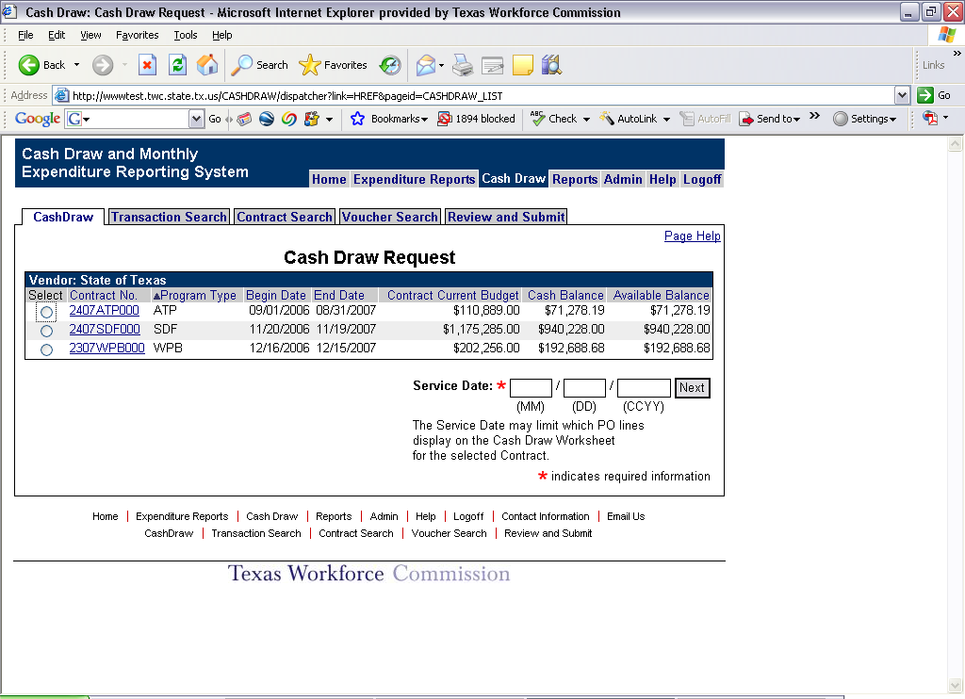
Cash Draw Request Screen

Slide 11
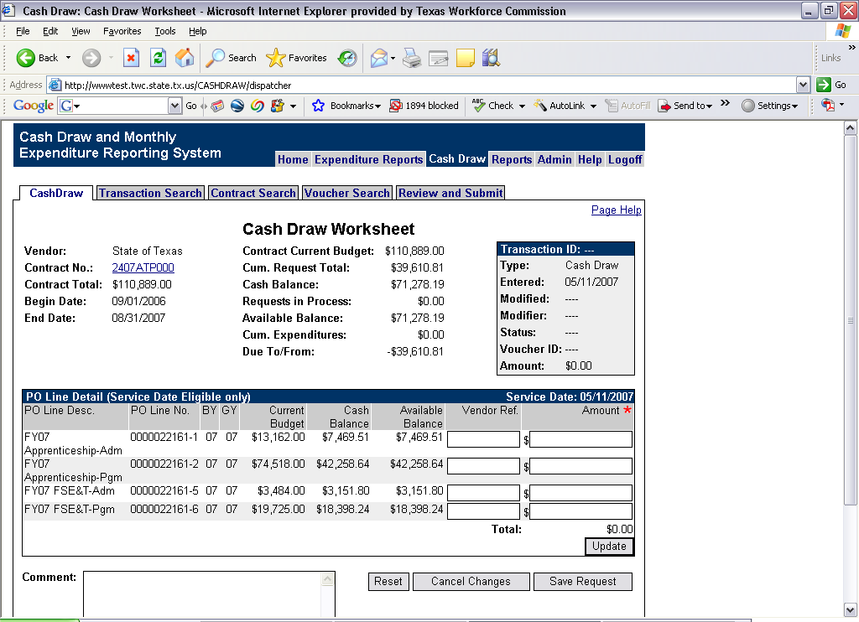
Cash Draw Worksheet

Slide 12
Cash Draw Requests
Only contracts with an Available Balance, prior to 90 days after contract end date and without a posted Final Expenditure Report will be available for Cash Draw Requests.
Vendors will select a contract from the list and enter a service date. The service date cannot be a future date.

Slide 13
Cash Draw Requests
The Cash Draw Worksheet will appear. Vendors will enter the appropriate amount on each contract line and save the request.
Each cash draw request can only be for one contract at a time. However, multiple cash draw requests can be entered on any given day.
Cash Draws are independent of expenditures reported.
Cash Draws are assigned a transaction number when saved.

Slide 14
Cash Draw Edits
The Service Date entered must be between the contract begin and end dates.
The Service Date entered and the current date determine which contract lines are available for draw requests.
If a contract with older funding exists or within a contract older funding exists, the system will prompt the user as to whether or not they want to use the older funding first.

Slide 15
Cash Draw Edits
The system will not allow cash draw requests for more than the available balance.
The system will not allow more than 20% of the total contract amount to be drawn on any given day.
The system will not allow the total of all draws submitted for a 3 day period to exceed the Vendor’s bond liability.

Slide 16
CDER: Overview of the System
CDER access requests:
cashdraw.ta@twc.state.tx.us
about reporting in Cash Draw & Expenditure Reporting (CDER): Email CAGER@twc.state.tx.us
Questions? tim.Alvarez@twc.state.tx.us

