Slide 1
Understanding Postsecondary Pathways for low skilled students
Adult Education and Literacy
Pre-Reqs-Co-reqs- What’s it all about?

Slide 2
Pre-Reqs, Co-Reqs: What’s It All About? Understanding Postsecondary Pathways for Lower Skilled Adults
Session Objectives:
Goals and objectives for student success (TWC AEL and THECB)
Models of service delivery that demonstrate collaboration between AEL and IHE for student success

Slide 3
AEL Presenters
AEL Providers
IHE CE and Workforce Development/ AEL Collaboration
Sandra L. Cortez, LCC Senior Director of Community Ed- Laredo College AEL
DE and AEL Pilot Projects
Alamo AEL Consortium:
Mary Helen Martinez, Alamo Colleges, Director College and Career Readiness
Wendy Christensen and Michelle Yzaguirre, Region 20 Educational Specialists

Slide 4
Framework for Discussion
TWC AEL State Director, Anson Green
THECB Director of DE and Adult Education, Suzanne Morales-Vale, Ph.D.

Slide 5
Building Pathways from CE to College and Careers
IHE CE and Workforce Development/ AEL Collaboration
Sandra Cortez, Laredo College AEL

Slide 6
Laredo College Community Education
Community Education
Director
Sandra Cortez
Sr. Vice President of Instruction and Academic Affairs
Adult Education and Literacy
Continuing Education
Workforce & Community Ed
Workforce Education Programs
Corporate Training
Skills Development Fund
Accelerate TX Programs
Community Programs
Customized Training
Skills for Small Business

Slide 7
College CE Pathways
Past Experiences with IET’s
Project VAST served 200 participants, 2013 - 77% completed
Project GROW served 120 participants, 2013 - 100% completed
Workforce Solutions SDF Eagle Ford Shale 50 participants, 2014 - 100% completed
THECB Accelerate Texas served 38 participants, 2015 - 85%
TWC Accelerate Texas serving 120 participants on going, have placed 85 in various program

Slide 8
College Collaboration
AEL Internal Partners
Continuing Education – Non-credit programs
Division of Workforce Education – Credit programs
Health Sciences Division – Credit programs
College Readiness – DevEd – NCBO’s, INRW’s
College Level Courses: English, Mathematics, Communication, and Language courses that fulfill general education requirements

Slide 9
Collaboration
AEL External Partners
Workforce Solutions for South Texas – Recruitment – Job placement
Texas Workforce Commission – AEL Program Support- Guidance, SDF, Other Grants
Vocational Rehabilitation – Referrals
United Independent School District –Referrals
Literacy Volunteers of Laredo – Referrals

Slide 10
IET Collaboration
Integrated Education & Training/Articulation
Jumpstart – 32 hours – Bridge to a career and/or post-secondary
Workforce Prep - Interview Skills, Soft Skills; Resume writing, Job search skills, Dress for success, Employer presentations
Student Success - Study Skills, Organizational skills, Critical thinking skills, College success and test taking strategies, College & Career presentations
HSE Basic Skills - 144 – 160 hours – Contextualized to workforce skill
Workforce Skills Training – depends on the occupation – hours articulated from CEU’s to SCH’s
TSIA Preparation – 80 hours

Slide 11
Academic Collaboration
Articulation MOU (Non-credit to Credit)
1st meeting was with VP for Instruction & Dean of Workforce
Health Sciences Dean
Department Chairs or Directors
This was a first, we needed buy-in from administration

Slide 12
Benefits
Student Benefits
College Benefits
Workforce skills
Soft Skills
Academic Success Skills
Employment
Self-sufficiency
Higher education
Non-traditional student
Enrollment
Revenue generation
Contact hours

Slide 13
Occupational Skills Awards
Occupational Skills Awards Articulations
Occupational Skills Awards Articulation internal MOU serves as the guidelines for converting Continuing Education Units (CEUs) to Semester Credit Hours (SCHs) through the Workforce & Health Sciences Divisions.
CEU courses are eligible for articulation only if the minimum competencies required by Workforce and Health Sciences are met.
CE Workforce & Career Services Coordinator petitions the articulation by completing the PETITION FOR ARTICULATED COLLEGE CREDIT REQUEST FORM after student completes and passes class. Coordinator request approval the Continuing Education Director, Division Department Chair(s); Division Dean.
Classes are mirrored by CE or students co-enroll in Workforce Division courses
CE-IET students must achieve a final average of 70 or above for courses to be articulated
Enrollment & Registration Services (ERS) will transcript a letter grade corresponding to the approved CEU course final average and apply the SCHs upon approval of the petition
IET students enrolled in career pathway programs are exempt from any LCC transcription fees

Slide 14
Applied Accounting Stackable Credentials

Slide 15
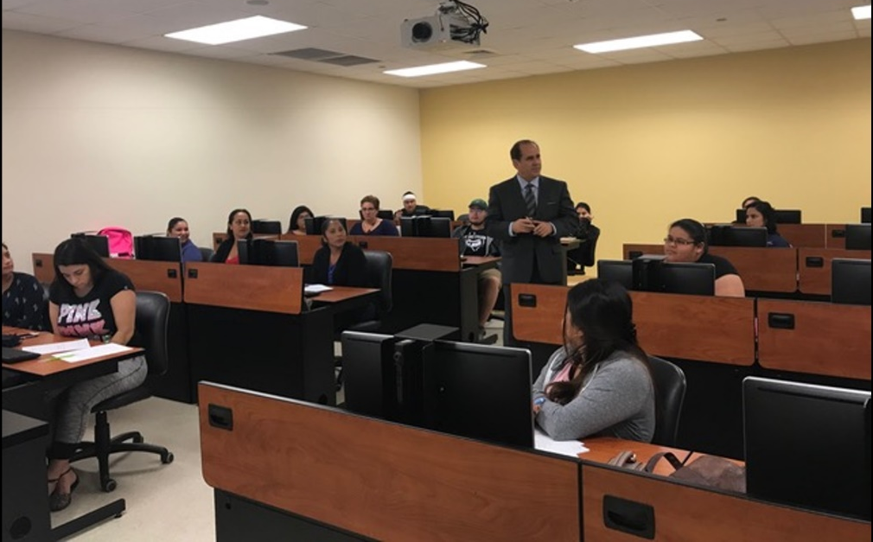
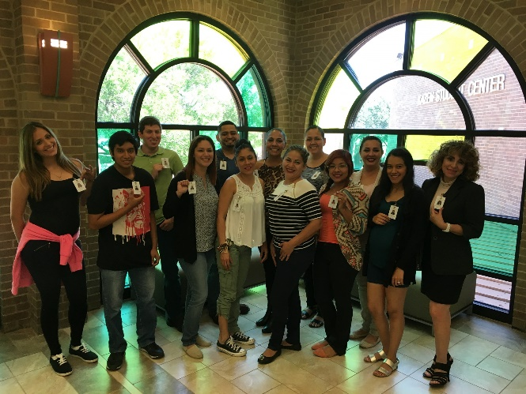
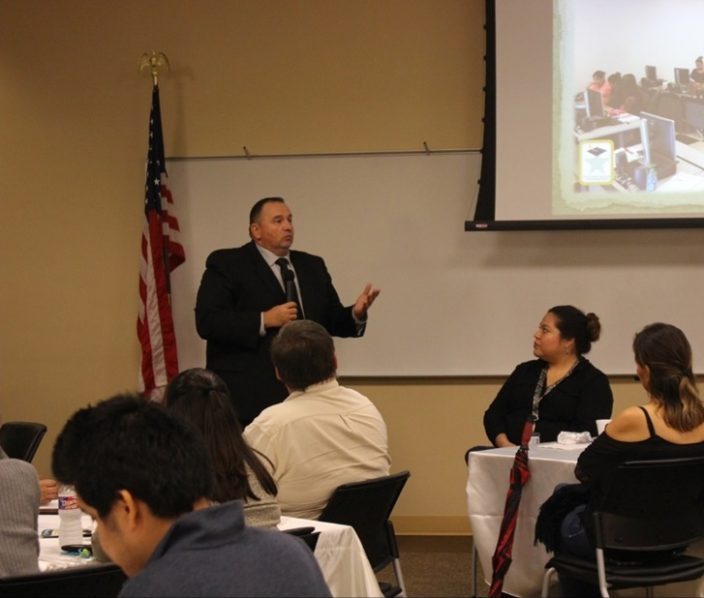
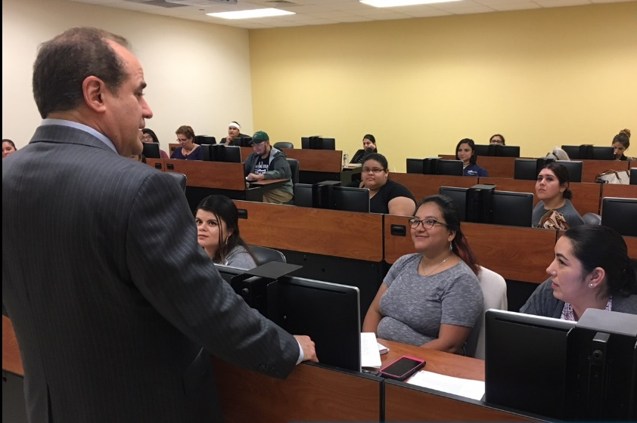
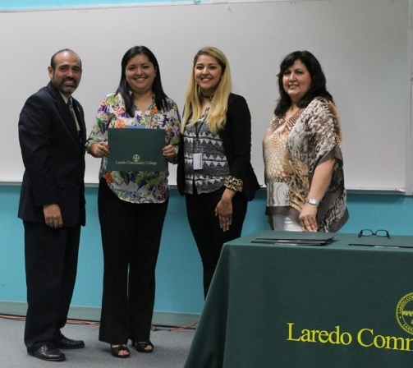
Events

Slide 16
Consortium Next Steps
We will serve TSIA ABE levels 1-3 in the Fall
Hoping to be selected for the TX- Peer Mentoring Network

Slide 17
Education Service Center, ESC- 20 ALAMO AEL Consortium and Alamo Colleges District for Student Success
AEL Alamo Consortium
Michelle Yzaguirre, Educational Specialist
Wendy Christensen, Educational Specialist
Alamo Colleges District
Mary Helen Martinez, Director College and Career Readiness

Slide 18
Collaboration AEL (ISD) & IHE
Background
2015- Present – An Update
Partners (Northwest Vista College (NVC) and NISD AEL)
From Strategic Plan to Implementation Design

Slide 19
Characteristics of Collaboration
Characteristics that Support Collaboration
Understanding systems
Being flexible
Willingness to revise
Being open to providing a new service
Asking questions
Remembering the goal…Student Success

Slide 20
A Unique Collaboration: NVC & NISD Fall 2018 Pilot
*Alamo Colleges District *AEL Alamo Consortium *Northwest Vista College *NISD Adult Education & Literacy

Slide 21
Overall Goals for the Pilot
Increase success rate of students entering postsecondary
Provide academic support
Provide seamless student experience

Slide 22
What was the Design?
Notes:
Looking for some image about the circuitous route– or maybe the movie poster for THERE WILL BE BLOOD!)
☺

Slide 23
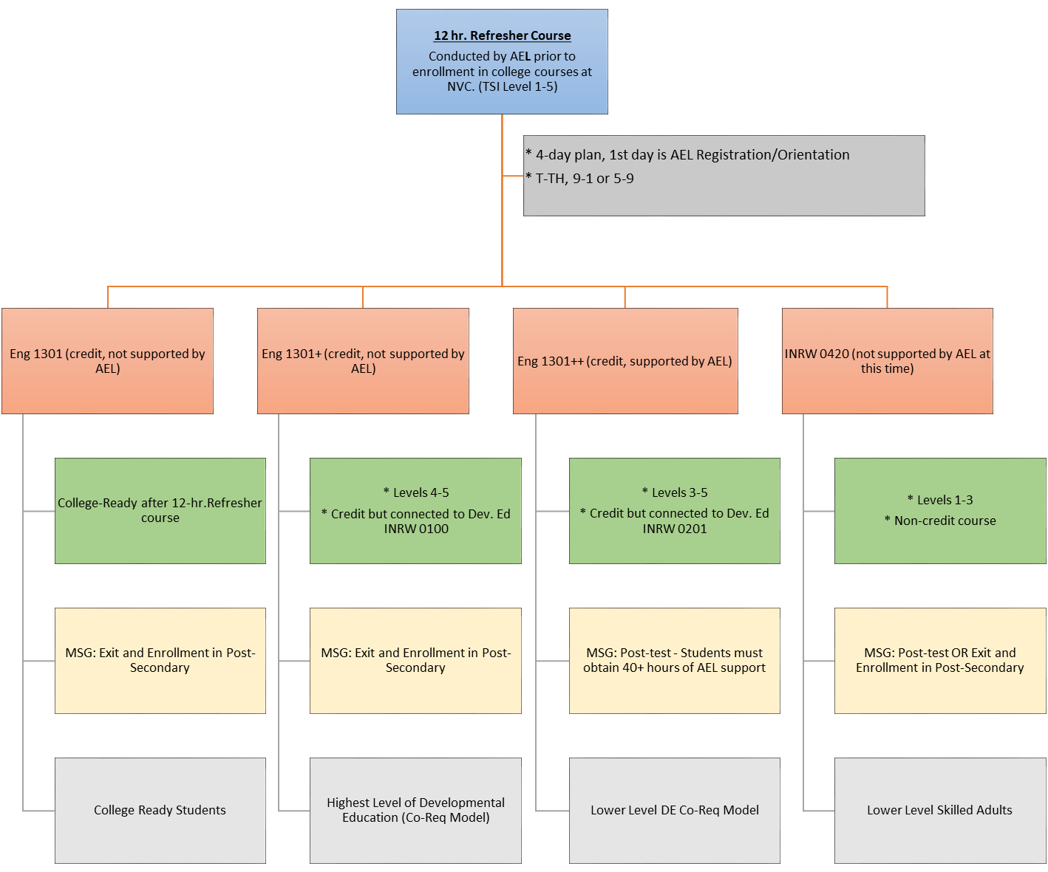
Overview
Fall 2018
Notes:
Plato offered to students to accumulate more hours
NISD Hired NVC teachers as SI
SI offers supplemental 1 hour workshops built into the curriculum
Students are in the post-secondary credential denominator because the students are enrolled in college and actively coordinated with AEL.

Slide 24
Refresher to College
12 hr. Refresher Course Conducted by AEL prior to enrollment in college courses at NWV.*
(TSI Level 1-5)
* 4-day plan, 1st day is AEL Registration/Orientation
* TTH, 9-1 or 5-9
Northwest Vista College @ Alamo Colleges

Slide 25
Refresher to College Group 1 & 2
ENG 1301 (credit, not supported by AEL)
12 hr. Refresher Course Conducted by AEL prior to enrollment in college courses at NWV.*
(TSI Level 4-5)
ENG 1301+ (credit, not supported by AEL)
Level 4 & 5 – Students Co-enrolled in INRW 0100
Highest level of DE (Co-Req Model)
Students are high school/HSE complete and enter postsecondary at next enrollment during AEL PY. 90 days without AEL services, participant can be reported with an MSG- TYPE 1B.
Northwest Vista College @ Alamo Colleges

Slide 26
Refresher to College Group 3
Lower Level DE Co-Req Model
ENG 1301++ (credit, supported by AEL & DE)
12 hr. Refresher Course Conducted by AEL prior to enrollment in college courses at NWV.*
(TSI Level 3-5)
ENG 1301 with DE INRW 0201
Students enter college at next enrollment
Students are still receiving AEL services
AEL support is done through supplemental 1-hr. workshops built into the curriculum and Distance Learning (DL)
Students will be post-tested after 40 hours of AEL instruction. Gain will be reported as an MSG- TYPE 1a.
Northwest Vista College @ Alamo Colleges

Slide 27
Refresher to College Group 4
INRW 0420 (not supported by AEL at this time)
12 hr. Refresher Course Conducted by AEL prior to enrollment in college courses at NWV.*
(TSI Level 1-3)
Lower levels of low skilled students
Students who scored L1-3 on TSIA
INRW 0420 is a non-credit course
Institution is providing the instruction
There is a cost to the student for this course
Possible future collaboration with AEL
Northwest Vista College @ Alamo Colleges

Slide 28
Challenges
Different Data Management Systems
Diverse terminology
Performance Measures vary between systems
Continuous commitment to the pilot

Slide 29
Next Steps
Analyze the data
Offer services to INRW 0420
Explore CE & CTE options

Slide 30
Questions?
Notes:
The blank slides in this presentation are there to show you the layout options. Feel free to delete slides you do not want or to change the layout of the slides (right click then choose Layout from the menu).
To change the slide background picture or TWC logo on this slide, go to View > Slide Master

