Slide 1


Implementing ELL Career Pathway Programs
Adult Education

Slide 2
Mission Statement-
Bridging student success through purposefully connecting, partnering, and merging transition and IET courses through Adult Education Programs.
  Connecting
  Partnering
  Merging

Slide 3
ELL Selection-IET Courses & Students
Connecting- establishing selections

Slide 4
Career Pathway- IET Selection
Research what jobs are high-demand occupations within your local community
What programs are offered at your local college
What jobs are students currently employed/interested

Slide 5
Student Selection Criteria
Survey students
Interview students
  Must obtain a SS#
  Background check will be performed
  Inquire about commitment- 1mo, 2mo, 3mo etc...
Have students successfully meet state/federal targets- Progress test?
Prepare a presentation about Transition and IET- be clear
Notes:
Survey- What jobs are they interested and or currently work.
Interview- We inform students if they are in the process of accessing a SS# they are eligible with verification, Background check
Students were informed there are pros and cons, so they could weigh their options

Slide 6
Comparisons
Growth
Growth
Growth
Hospitality & Food Management
$43.5 Million
$45 Million
Notes:
Amarillo TX, has an influx of Hotels and Restaurants. The convention Embassy hotel will generate revenue and in return bring jobs for the food service and hospitality industry. Amarillo College wants to be the breeding grounds to produce quality and qualified staff to serve as hotel managers. Not the house keepers.
Ann had a question on this slide
43.5 plus 45 million?

Slide 7
ELL IET Training Occupations
Certified Nursing Assistant
Phlebotomy
EKG
Medical Assistant
Patient Care Tech
Welding
Truck Driving
Technical Core Courses
Hospitality & Food Management
Administrative Assistant
Notes:
After performing student surveys, it was revealed many students were in the healthcare field and food service industry.

Slide 8
What’s The Purpose of Transition
Produce better prepared students
Reduce student failure rates
Accelerate student completion to certificate or degree
Limit students from tapping into financial aid too soon for a remedial course
Meet AEL transition/IET state and federal targets- is the Icing on the CAKE

Slide 9

Example of Common Student
Enrolls into College
Struggles
Fails Course
RE-takes the Course
Passed BUT wasted Time and $$$$$
Notes:
Example of a common student

Slide 10

Transition Student
Transitions Course
Better Prepared
Enroll into chosen IET Program
Successful Passes First 2 College Courses
Notes:
Common path for a transition student
Because you take transition courses AEL provides one hour Classroom support
Increase success rate for first 2 college courses

Slide 11
Transitions SUCCESS
Struggling Student Better
Good Student GREAT Good Student

Slide 12

On Ramp - Transition⇒ IET
Partnering- Contextualizing is Key

Slide 13
On-Ramp Courses- Transition Course
Workforce Integration
Digital Literacy
College Ready Integration
College Resource Integration
Notes:
We know laying a foundation is key- enormous amounts of time are spent on-Ramping IET courses. We believe integration truly begins through strong bridge courses. IET courses are for supporting our students.

Slide 14
On-Ramp Course- Workforce
Workforce Integration
Career Exploration
Digital Literacy Integration
PowerPoints
College Ready Integration
Vocabulary
Librarians
Resume Writing
Microsoft Word-Formatting MLA/APA
Amarillo College’s Online System-Blackboard
Discussion Post
Online Test/Quizzes
Emailing
Uploading Assignments
Thumb Drive Skills
Storing & Retrieving Documents
Note Taking Skills
Team Building
Student Collaboration (PP presentation)
Academic Reading
Reading Guides(ELA students)
College Resource Integration
Intense Writing Skills
Data Base- Research
Work Citing Skills
Financial Aid Specialist
FASFA
Advising Specialist
Continued pathways
Job Search
Tutoring Resources
Writer’s Corner
Math Lab
Conversational Skills
Time Management
Notes:
Career Exploration is vital- Students explore and should be able to explain in detail what IET course they will enter after completion of their transition course.
Tried and true resume Writing-Career center gives students information on resume writing

Slide 15

On-Ramp Course- Digital Literacy
Workforce Integration
Career Exploration
Digital Literacy Integration
PowerPoints
College Ready Integration
Study Skills
Librarians
Resume Writing
Microsoft Word-Formatting MLA/APA
Amarillo College’s Online System-Blackboard
Discussion Post
Online Test/Quizzes
Emailing
Uploading Assignments
Thumb Drive Skills
Storing & Retrieving Documents
Test Taking Strategies
Note Taking Skills
Team Building
Student Collaboration (PP presentation)
Academic Reading
Reading Guides(ELA students)
College Resource Integration
Intense Writing Skills
Data Base- Research
Work Citing Skills
Financial Aid Specialist
FASFA
Advising Specialist
Continued
Job Search
Tutoring Resources
Writer’s Corner
Math Lab
Conversational Skills
Notes:
Digital literacy- You have to incorporate! All the way down to thumb drive usage- do not take for granted what you know, assume students know nothing
If you have the ability to introduce students to your local college’s online system-implement
Assume nothing- we go as detailed as how to navigate a thumb drive

Slide 16
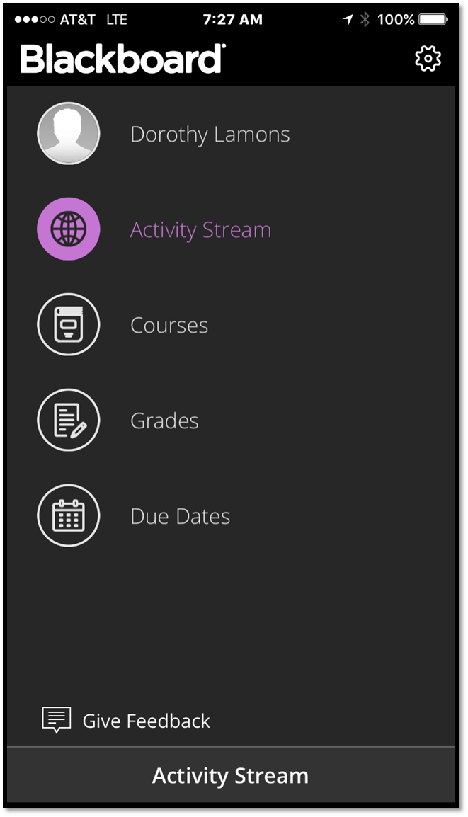
On-Ramp Course- Digital Literacy
Workforce Integration
Career Exploration
Digital Literacy Integration
PowerPoints
College Ready Integration
Study Skills
Librarians
Resume Writing
Microsoft Word-Formatting MLA/APA
Amarillo College’s Online System-Blackboard
Discussion Post
Online Test/Quizzes
Emailing
Uploading Assignments
Thumb Drive Skills
Storing & Retrieving Documents
Test Taking Strategies
Note Taking Skills
Team Building
Student Collaboration (PP presentation)
Academic Reading
Reading Guides(ELA students)
College Resource Integration
Intense Writing Skills
Data Base- Research
Work Citing Skills
Financial Aid Specialist
FASFA
Advising Specialist
Continued
Job Search
Tutoring Resources
Writer’s Corner
Math Lab
Conversational Skills
Notes:
Digital literacy- You have to incorporate! All the way down to thumb drive usage- do not take for granted what you know, assume students know nothing
If you have the ability to introduce students to your local college’s online system-implement
Assume nothing- we go as detailed as how to navigate a thumb drive

Slide 17
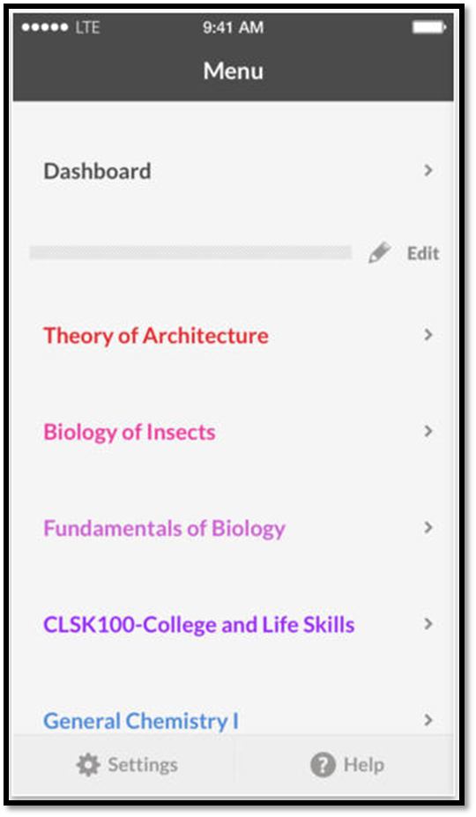
On-Ramp Course- Digital Literacy
Workforce Integration
Career Exploration
Digital Literacy Integration
PowerPoints
College Ready Integration
Study Skills
Librarians
Resume Writing
Microsoft Word-Formatting MLA/APA
Amarillo College’s Online System-Blackboard
Discussion Post
Online Test/Quizzes
Emailing
Uploading Assignments
Thumb Drive Skills
Storing & Retrieving Documents
Test Taking Strategies
Note Taking Skills
Team Building
Student Collaboration (PP presentation)
Academic Reading
Reading Guides(ELA students)
College Resource Integration
Intense Writing Skills
Data Base- Research
Work Citing Skills
Financial Aid Specialist
FASFA
Advising Specialist
Continued
Job Search
Tutoring Resources
Writer’s Corner
Math Lab
Conversational Skills
Notes:
Digital literacy- You have to incorporate! All the way down to thumb drive usage- do not take for granted what you know, assume students know nothing
If you have the ability to introduce students to your local college’s online system-implement
Assume nothing- we go as detailed as how to navigate a thumb drive

Slide 18
On-Ramp Course- College Ready
Workforce Integration
Career Exploration
Digital Literacy Integration
PowerPoints
College Ready Integration
Vocabulary
Librarians
Resume Writing
Microsoft Word-Formatting MLA/APA
Amarillo College’s Online System-Blackboard
Discussion Post
Online Test/Quizzes
Emailing
Uploading Assignments
Thumb Drive Skills
Storing & Retrieving Documents
Time Management
Note/Test Taking Skills
Team Building
Student Collaboration (PP presentation)
TSI Prep
Reading Guides(ELL)
College Resource Integration
Data Base- Research
Work Citing Skills
Financial Aid Specialist
FASFA
Advising Specialist
Continued pathways
Job Search
Tutoring Resources
Writer’s Corner
Math Lab
Intense Writing Skills (ELL)
Conversational Skills (ELL)
Academic Reading
Rapid Review-Math
Notes:
Vocabulary- Duty, Skill, Task

Slide 19
On-Ramp Course-College Resources
Workforce Integration
Career Exploration
Digital Literacy Integration
PowerPoints
College Ready Integration
Vocabulary
Librarians
Resume Writing
Microsoft Word-Formatting MLA/APA
Amarillo College’s Online System-Blackboard
Discussion Post
Online Test/Quizzes
Emailing
Uploading Assignments
Thumb Drive Skills
Storing & Retrieving Documents
Note Taking Skills
Team Building
Student Collaboration (PP presentation)
Academic Reading
Reading Guides(ELA students)
College Resource Integration
Intense Writing Skills
Data Base- Research
Work Citing Skills
Financial Aid Specialist
FASFA
Advising Specialist
Continued pathway
Job Search
Tutoring Resources
Writer’s Corner
Math Lab
Conversational Skills
Time Management
Notes:
Use your current college resources provided- don’t reinvent the wheel
We utilize many resources our community college offers- We let the experts come teach

Slide 20
Contextualizing is Key- IET
Implement
Speaking activities
Writing activities
Conversational activities
Support
In class IET support
Support Labs on all AC campuses
Adapt to current student schedule
Listening activities

Slide 21
Partnering Support Class- IET
IET Course Access
。Teaching Assistant (TA)
。Instructor allowed enrollment for AEL students only (first 2 courses)
。Assist with grading
Close Contact With Course Instructor
。Give updates on students
。Give student feedback
Assist Course Instructor
。Assist with building classroom assignments
。Attend classes daily with students
Notes:
Partner with IET Course Instructors- TA

Slide 22
IET Support & Integration
Content Provided Through-
Support Content Provided-
Adult Education & Literacy
Developmental Education
College/Training Program Partners
In Class Student Support
Prepare Mock Exams for
Students
Prepare Additional Assignments for Students
Initiate Student Study Groups
Notes:
We truly believe supporting IET classes has been our best success-
We have instructors attend class like a student and assist students as needed during class
Our Instructors have been TA in the IET course
They assist with grading and making assignments.

Slide 23

Professional Development
Notes:
Continuous improvement

Slide 24
What Scholarship
Opportunities Are Available?
Merging- Accelerate Texas ⇒ Level I
Certificate Program

Slide 25
Funding Sources ➨ Student Success & Completions
Transition Course
Preparatory
IET Course
Not Pell Eligible
Completion of level I certificate program
Accelerate Texas funding- Eligible students first two classes
Ability To Benefit
Must pass AXT funded classes C ↑
Funded- AEL
TxCHSE
Completion of FASFA
ELL
Notes:
AEL Funds the Transition Preparatory course
We use this to prepare students, address and decrease barriers and vet those who are serious about changing their lives.
This may lead to Accelerate Tx guided pathway funding for eligible students
Completion of two courses will now allow those who were not qualified for Pell eligible- especially important to those who are not
Pell funds will fund Completion of Certificate program
ATB funds will fund non-eligible students only if they qualify

Slide 26
Prerequisites for Accelerate TX Funding-
Attend trans course 85%
Class overall grade 75
100% completion of all trans assignments

Slide 27
Why Level I Certificate Program?
Students become gainfully employed quickly ➨ Marketable Skill
  2 or 3 Semesters
Many of Amarillo College certificates are stackable
  Student may be 15 to 20 hours away from an A.A.S Degree
Students can earn more money with certificate vs only HS/GED/Work experience

Slide 28
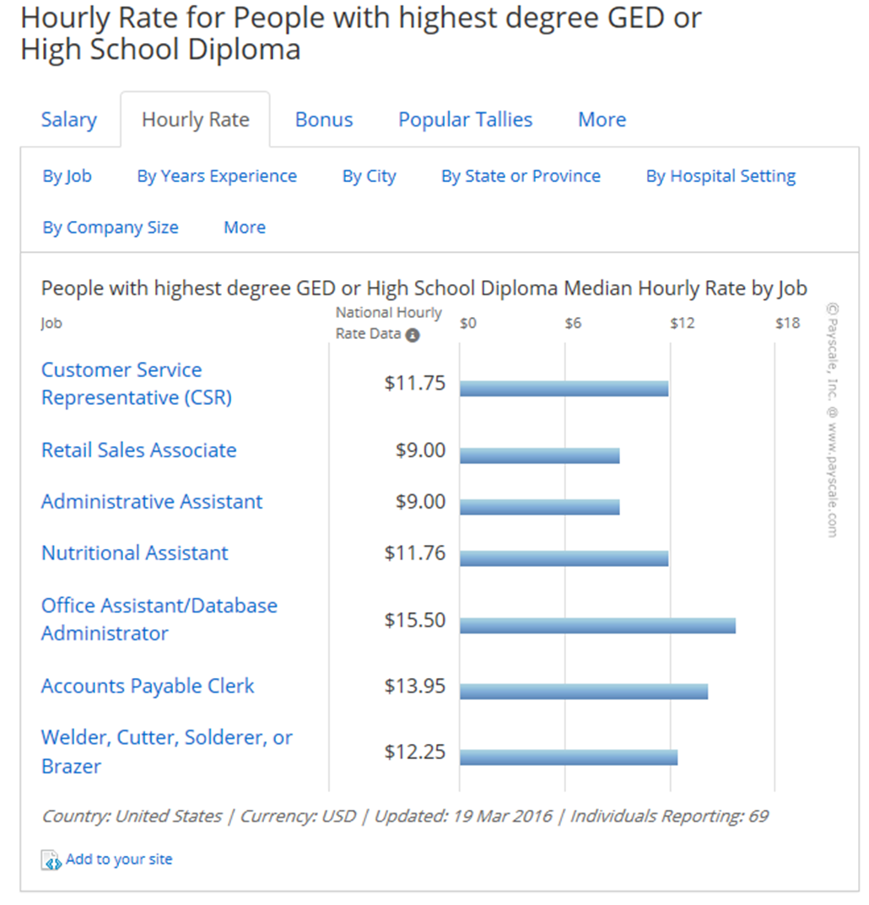
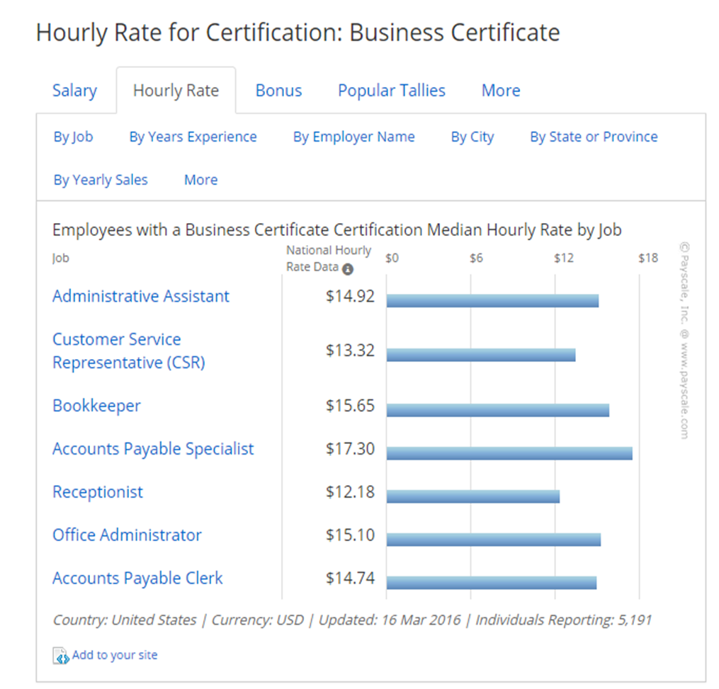
HS Diploma/GED VS Certificate
Notes:
Show students what a household income looks like with only a High school Diploma

Slide 29
AC- Level I Certificates
Technical Programs
Automotive Technology
Aviation Maintenance Technology
Healthcare Programs
Health and Medical Administrative Services
Business Programs
Office Administration
Diesel Technology
Industrial Technology
Hospitality & Food Management
Administrative Assistant and Secretarial Science
Dental Assisting / Assistant
Medical Assistant

Slide 30

Adult Education ELL IET Success

Slide 31

Breaking Tradition at the State Level= >Diversity
79 % ↑
IET/Trans 109 Students 2015/2016
IET/Tans 61 Students 2014/2015
Notes:
Has opened doors of opportunity to serve a diverse group of students while successfully meeting TWC targets

Slide 32
Updates- Current Results
Hospitality and Food Service Management: C.N.A.

Slide 33
Current- ELL IET
CNA total 23
Hospitality & Food
12
10 Passed ➨to next course
2 Dropped Course
1o Intensive 8 week remediation
11 Moving into Clinical
2 referred back to ELL classes

Slide 34
English Language Learners (ELL) Pilot 2015/2016- Hospitality/Food IET
Spring - 12
10 Passed first Course
5 Passed two Courses
2 Dropped Course
Summer I- 10
3 currently retaking Fall I, 2 lost SB
Fall I - 8
5 Enrolled using ATB Funding
TBC- Should complete Level I certificate Spring I
Notes:
AC recently made changes to classes which caused students to complete level one certificate in the spring.

Slide 35

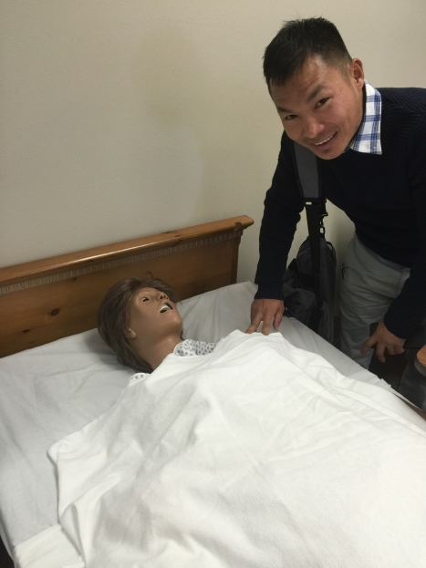
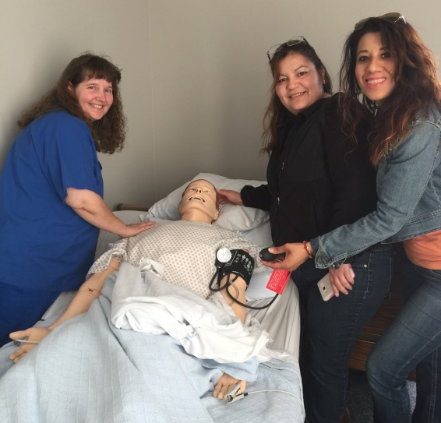
CNA Cohort

Slide 36
-EL Civics Pilot 2015/2016- CNA IET
Spring I 23
11 Moved into Clinical
1o Intensive 8 week remediation
2 referred back to ELL classes
Clinical Results 21
19 Completed
2 lost SB
State Board Certificates 9
10 scheduled testing Sept. 19

Slide 37
Don’t you want to know?
What happened to the 2

Slide 38
Innovation- Is Happening
Fall back
State board Exam
CNA
Clinical
Resident Care Assistant Program
Situational Barriers
-Reality Check-

Slide 39
Areas For Growth
Implement TABE score during student selection
  Evaluate level of Advanced ELL
  Career Navigator & Instructor collaboration
    Selecting students
Identify students during intake- ITEC Plan
  Current Professions
  Desired Professions
  High Advanced TABE Clas-E
    Predicated GED score

Slide 40
Thank You
Adult Education
Dr. Tamara Clunis- Dean of Academic Success
ttclunis@actx.edu
Jacqui Jones- Program Director
j0544603@actx.edu
Michelle Lamons- Director of Instruction
dmlamons@actx.edu
Carol Summers- ELL Coordinator
cbsummers@actx.edu

