Slide 1
Integration with Workforce Solutions and Career Services
Dallas Workforce Solutions
Southeast Workforce Solutions
Rural Capital Workforce Solutions

Slide 2
System focus, not just co-location
Required-partner programs under WIOA and state law are “system partners”
Focus is on providing customers with access to partner programs whether they are co-located in a Workforce Solutions Office or not
Goal is bringing the most value to customers by leveraging organizational strengths and services as an interconnected system
MOU and infrastructure costs apply to all, whether there is co-location or not

Slide 3
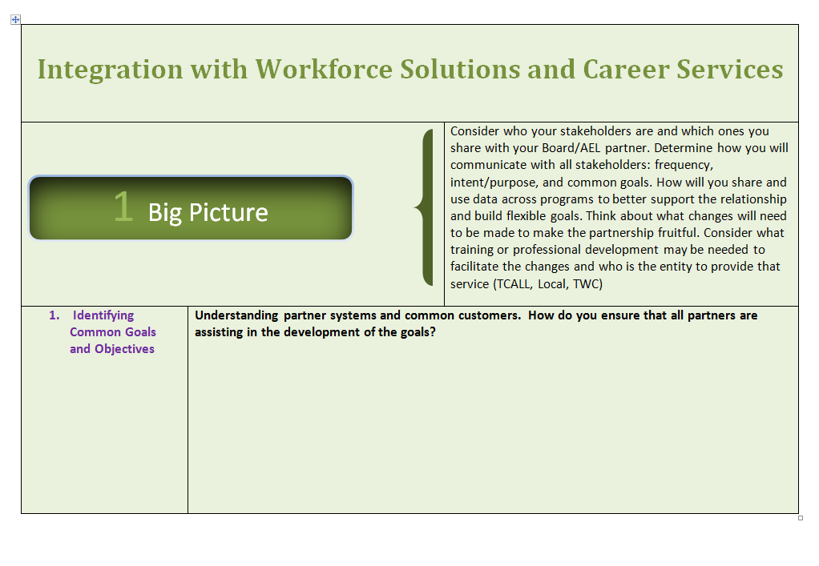
Handout

Slide 4
Dallas Workforce Solutions
Demetria Robinson
Shanna Livers
Cue Awesome Presentation!

Slide 5
Handout

Slide 6
Rural
Capital Workforce Solutions
Jenna Akridge
Montie May

Slide 7
Referral/Tracking System &
Co-enrollment
Rural Capital Area
Jenna Akridge
Director of Contracts & Programs
Workforce Solutions Rural Capital Area
jenna.akridge@ruralcapital.net
Montie L. May
WIOA & TAA Program Operations Manager
Workforce Solutions Rural Capital Area
montie.may@ruralcapital.net

Slide 8
Primary Partners for Referral
Community Action Inc. of Central Texas (AEL)
Vocational Rehabilitation (VR)
Workforce Solutions Rural Capital Area (WSRCA)

Slide 9
Keep in Mind…
"The more elaborate our means of communication, the less we communicate.“
Joseph Priestley
“The single biggest problem in communication is the illusion that it has taken place.”
George Bernard Shaw

Slide 10
Purpose of Referral
Start the conversation
Build personal relationship with the customer
Establish staff-to-staff personal accountability
Ensure “timely” follow through

Slide 11
Program Information for Partners
“People are tempted to tell you everything with accuracy.
Don’t do this!
Give just enough information.”
Malcolm Gladwell, The Tipping Point

Slide 12
Pre–Work for Referral Process
Work groups developed:
Fact Sheets for Customers (1 page per partner)
Desk Guides for Staff (1 page per partner)
Referral Form
Work in Texas (WIT) Registration Instructions
Notes:
Each work group had 9 members:
3 DARS
3 Community Action
3 Workforce Solutions
Sharing System Services work group wrote the Fact Sheet and Desk Guide for each program. Schedule for self instruction, webinars, training and coaching by supervisors.
Sharing System Customers work group developed process that a customer referral would be initiated by WIT registration with an additional one page referral form.
PPT for WIT training developed. Schedule for self instruction, webinars, training and coaching by supervisors.
Work groups identified who (which positions in each organization) will have access to the other partners’ management systems.
Documenting actions taken on customer referral will be entered into TWIST case notes by WSRCA, DARS and AEL staff.
AEL and VR must visit workforce centers for tour and training.
Points of contact are important to build the needed relationship among staff.
System Customers work group is determining the referral tracking process.

Slide 13
Pre–Work for Referrals (con’t)
Identify points of contact (POC)
PII protection
Schedule training on forms & procedures
Identify partner staff for access to WIT, TWIST, TEAMS, PIRL
Schedule partners to visit workforce centers

Slide 14
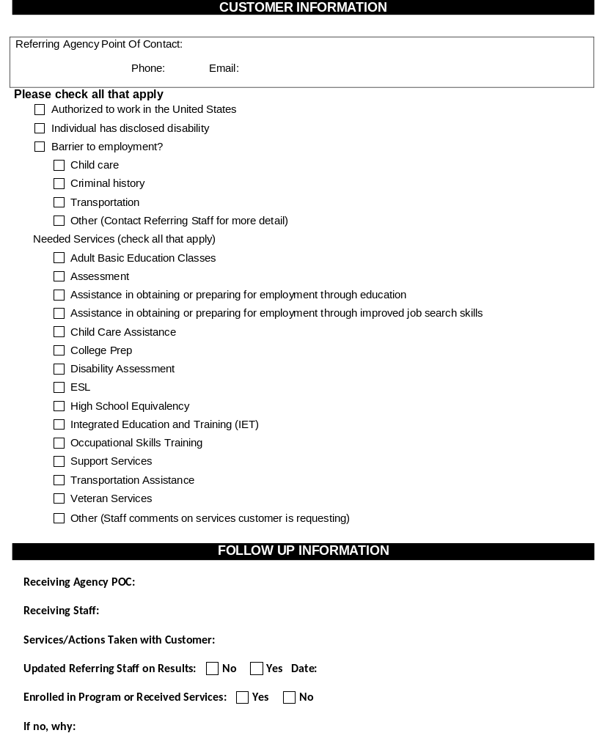
Referral Form
Referral Form

Slide 15
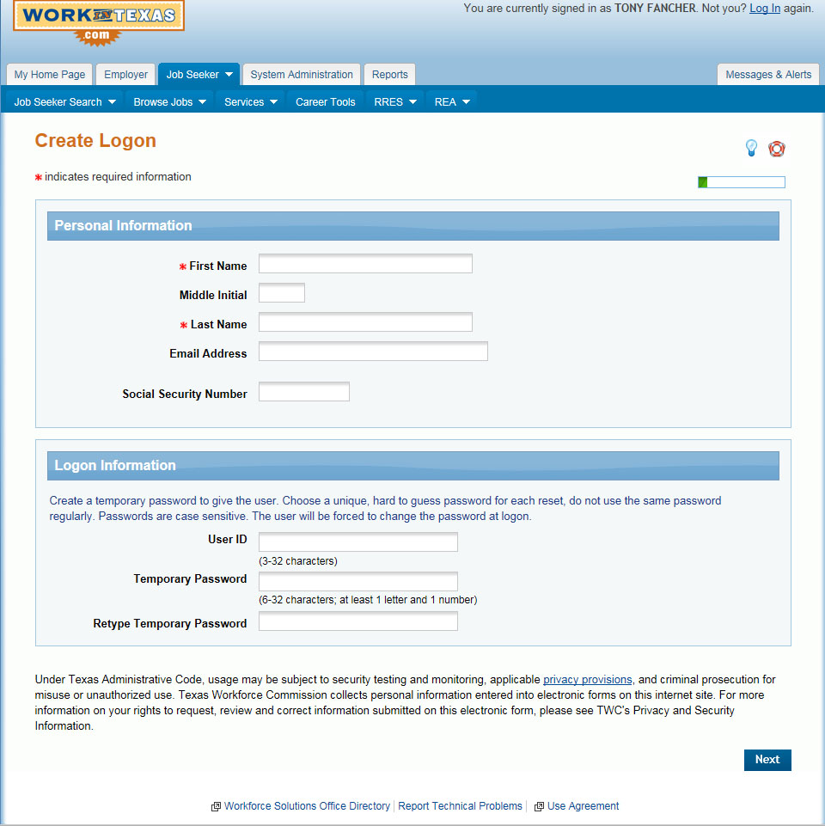
Work in Texas (WIT) Registration
Fill out all red asterisks. *
If they have only an email address for contact purposes, please fill this out.
If you have their SSN, please fill this out too.
Creating a User ID is recommended, but not required.

Slide 16
Referral Tracking Log
Purpose
The Referral Tracking Log is not a case management tool!
It is to measure the effectiveness of the referral system.

Slide 17
Referral Tracking Log
What are we tracking?
  Number of referrals
  Response in 2 business days
  Service requested
  Service received
  Co-enrollments
Again, why are we tracking?
  To ensure effectiveness

Slide 18
Tracking Log Data Elements
Customer Name (Last Name, First Name)
WIT ID
Referral Date
Referring Staff
Referring Entity
Service Requested For Customer
Receiving Entity
Receiving Staff
Date Receiving Staff Contacted Customer
Customer Received Service Requested On Referral
If No, What Other Service Did Customer Receive
Was Customer Enrolled in Receiving Agency
Date Reported Back to Referrer

Slide 19
Co-enroll or not?
Delivery of services to customers is the purpose of the referral.
Co-enrollment is not always the answer.
Do not have to be co-enrolled to receive services.
Our goal is for the customer to obtain employment.
Notes:
Define Co-enrollment – case management VS universal customers

Slide 20
Co-enrollment and IET
Traditional co-enrollment
IETs are a method of planning for co-enrollment
Sharing cost and resources
Notes:
Traditional co-enrollment – in the past – lead by customer initiated agency contact

Slide 21
ETPS / IET
ETPS
(Eligible Training Provider System)
IET
(Integrated Education and Training)
Training program must be:
For target occupation
Approved by Board
Certified by TWC
On the State wide list
Can focus on one or more occupations in an industry cluster
Can be a target or demand occupation
Must include workforce preparation, basic skills contextualized to occupational credential
Be submitted to TWC
Notes:
Explain why we want our class size training to be IET’s that are intros to several related occupations.
Why we are buying a class instead of paying individual tuition?
Not restricted to ETPS
Transportation
Include AEL and DARS and other partners (contiguous board areas, CBOs)

Slide 22
IET Initial Planning Steps
Location
Space (with proper equipment)
Based on LMI
Provider for technical content
Provider for adult education
Customer interest
Other partners to sponsor students (AEL and VR, contiguous board areas, CBOs)

Slide 23
Class Size
Class Size Training Check List
Decisions/Tasks | Responsible Staff | Notes
Location
Industry cluster
Training provider
Funding source
Negotiate contract amount
Signatory for agreement
Point of Contact for each partner
Point of Contact for front line staff for coordination
Development of marketing materials – brochures, email blast, posters
Marketing class to partners (Workforce, AEL, DARS, other boards, etc.)
Registration of students with training provider
Tracking completers and student outcomes
Who gets Completer and EE info
Who sends out Completer and EE info

Slide 24
IET Classes by June 2017
10 classes
Maximum # of students – 123
Total cost - $191,830
Community Action buying classes and providing the adult ed instructor
Training Providers – local community colleges and private training providers
Literacy Council of Williamson County providing space in Georgetown

Slide 25
IET Classes for 2016-2017
January
CNA in San Marcos
CNA in Marble Falls
February
HVAC in Georgetown
Medical Office Support in San Marcos
March
CNA in San Marcos
CNA Aide in Round Rock
Maintenance & Repair in Georgetown
April
2 CNAs in San Marcos (day & evening)
Intro to Office Occupations in Elgin

Slide 26
Next Steps in Rural Capital
Refine referral process
Work group to design common orientation
Continue staff training
Strengthening pipelines for sharing customers
Assist partner agencies to meet performance expectations – VR and AEL

Slide 27
In the end…..
Put the customer first
Do no harm
Provide a quality hand off
Say what we will do and do what we say

Slide 28
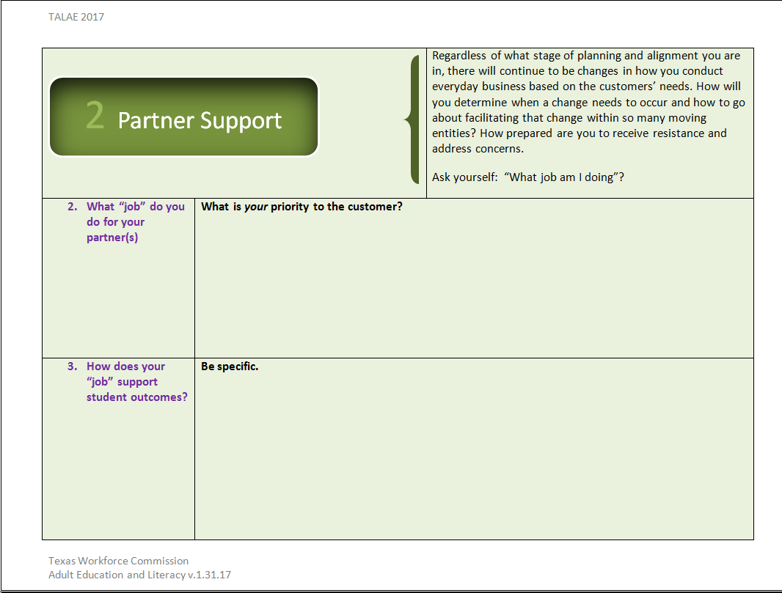
Partner Support

Slide 29
Southeast Texas Workforce Solutions
Pamela Wise
Brenda Schofield
Terrya Norsworthy

Slide 30

Collaboration and Integration
Collaboration and Integration
Region 5 Education Service Center
and
Workforce Solutions Southeast Texas
TALAE February 1, 2017

Slide 31


Where we started…
High School Equivalency (HSE)classes with former provider and…
The need of something better:
  Accountability
  Reliability
  Consistency and Structure
  Delivery and Support
  Region 5 ESC receives AEL grant in July 2014
Notes:
Where we started in Southeast Texas
We are a three county WDA – Jefferson, Orange and Hardin County
Our largest workforce center was served by the largest school district
which was in crisis, taken over by the state.
Majority of employers in manufacturing, construction, health care require
At minimum a high school diploma or its equivalent.

Slide 32



Teamwork begins!
What does Southeast Texas need:
Where will services be delivered?
How do we INTEGRATE service delivery to:
  Help customers get their HSE?
  Go on to higher education – CAREER Pathway
  Get a portable credential or certificate
  Get a JOB
Notes:
About Southeast Texas: Jefferson, Orange and Hardin County comprise the workforce development area (WDA)
Home to largest petroleum refinery in North America
3-4 LNG site; one LNG to be first to export in XXX years
3 Ports – Port of Beaumont top 5 in the nation;
Deepening/widening project approved by Congress
Building largest methanol plant in US
ExxonMobil expansions
Solution driven by executive board staff
Partner w/AEL provider, integrate service offerings
Outreach, seamless, accessible

Slide 33
Partnership Challenges
Needed Outreach:
  Advertise/educate customers and the public about adult education co-location in workforce center environment
  Advertise/educate customers and public about additional easily-accessible AEL classes located throughout Southeast Texas.
  Advertise/educate customers and the public about additional AEL services available…not just High School Equivalency anymore!

Slide 34
Solutions
  Launched social media campaign utilizing Job BRIEF, an electronic newsletter, Facebook, TWITTER, and LinkedIn
  Provides link to AEL website via Workforce Solutions SETX website
  Main telephone number to Workforce Solutions takes messages and transfers calls to AEL
  Advertised in newspaper/ flyers/multi-media
  Region 5 attended several meetings with Board and contractor staff to discuss issues and communicate effective resolutions.
  Face-to-face orientation for clients/ potential AEL students
  Developed Memorandum of Understanding

Slide 35
Work It!
Memorandum of Understanding (MOU)
Purpose: establish guidelines for cooperative working relationship
Provide program services to youth/out-of-school adults
Adult Basic Education and Literacy
ASE and HS equivalency classes
English as a Second Language
Other services including Digital literacy, Financial literacy, Family literacy
Transition to Employment/Higher education
Memorandum of Understanding

Slide 36
MOU—SETX Responsibilities
Provide adult education information to job seekers at all three Workforce locations where students are co-enrolled
Provide info on job placement & employment-related services including job-search, utilizing Work in Texas.com for job matching, resume preparation, interviewing techniques
Provide access to current labor market info which identifies targeted occupations, skills required for high demand/ high wage jobs, and local, regional, and national employment trends.
Provide space and lab equipment for AEL classes in all three workforce centers

Slide 37
MOU- AEL Responsibilities
Provide AEL orientation, assessment, and instruction in all three Workforce Centers.
Provide TABE testing for all workforce customers: This helps AEL recruit new students and helps Workforce customers to gain knowledge of available classes and services.
Coordinate services for joint customers
Added value of coordination: AEL staff, trained by Workforce Solutions staff, enters participant activities, case notes, services, and outcomes into the TWIST system.

Slide 38
MOU-Joint Responsibilities
Coordinate outreach
Secure confidentiality of records in accordance with applicable laws
Share assessment and cross-referral of clients
Share pertinent information; Exchange documentation, data, and information
Continue monthly work sessions with AEL, WFC contractor, Board, etc. to exchange information, assess activities, outline training and service delivery for common customers

Slide 39
Outcome of MOU Activities
Activities ensure an integrated, coordinated approach to service delivery that results in shared costs, reduction in duplication of services, and expanded enrollment of AEL customers into WIOA.
fully integrated into service
CO-LOCATED
Workforce Solutions Centers:
Beaumont
Port Arthur (includes ESL)
Orange

Slide 40
Partnership Grants
Southeast Texas Innovative Partnership Grant
Child Development Associate Credential

Slide 41
Southeast Tx Innovative Partnership Grant
Training included:
Automotive
Logistics Technician
Building Construction/Maintenance
Commercial Driving (CDL)
Child Care Professional
Medical Billing/Coding
Welders
Phlebotomist
Pharmacy Tech
Paid tuition for 28 AEL students to attend local workforce training classes
acceptance included student application, essay and teacher evaluations
Provided Paid Work Experience for students who successfully completed training
Students remained co-enrolled in AEL while attending training classes and/or participating in Paid Work Experience
AEL provided remediation; training was provided by community colleges:
Lamar Institute of Technology (LIT)
Lamar State College Port Arthur
Southeast Texas Career Institute

Slide 42

Child Development Associate Credential
Through a grant from TWC, Workforce Solutions SETX Board provided funds for…
75 participants to earn a CDA Credential
Participants were co-enrolled in AEL classes and in the Child Care Associates program at LIT. This added 75 students to AEL’s enrollment for the year.
Participants received incentive of $1000 upon completion of CDA credential

Slide 43
Benefits of Integration
AEL Provider—Region 5 ESC
Board Partner—Southeast Tx Workforce Solutions

Slide 44
AEL Integration Benefits
Over 220 students are currently enrolled in Workforce Center classes
95% of tested students made a GAIN on progress test
Integration assists AEL to meet/exceed annual enrollment targets:
75% of annual AEL target was met by Dec 31st.
Career Pathways annual target has already been met and almost doubled
Transitions target has already been met and more than doubled
Joint participation/grant procurement:
Coming soon: Announcement of grant from a
Fortune 500 company and matching grant from
TWC to bring an exciting Workforce/ AEL
opportunity to Southeast Texas

Slide 45

WSSETX Integration Benefits
Better outcomes on training completion and certification through enrollment in AEL & Career Pathway classes
Transition classes prepared more customers for Higher Ed success and job placement
Better job placement: As a result of shared services, customers are better-prepared to find GOOD PAYING jobs.
More individuals moved into employment with skills and education garnered through successful AEL/ESL completion
Employer Confidence: Partnership with Region 5 AEL allows employers to be confident that we are their ally in creating a competitive workforce to answer the need for job-ready, skilled workers.
Attendance/ Success at Workforce Solutions Job Fairs:
Many AEL students have obtained jobs on-the-spot
and through subsequent interviews

Slide 46
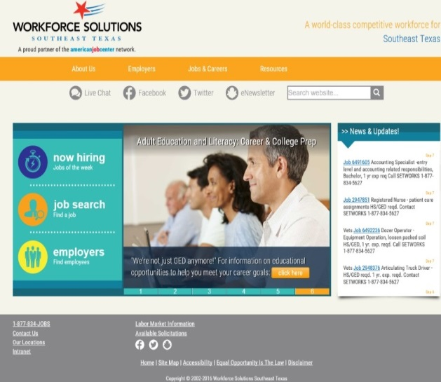
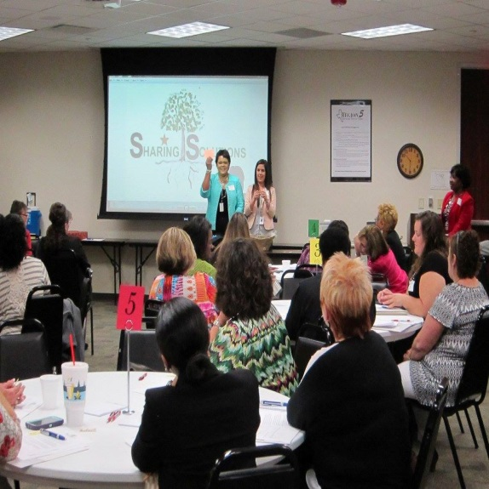
Workforce Outcomes: SUCCESS
INTEGRATION = Increase in Awareness for AEL and Workforce
The partnership with Region 5 helped to implement Sharing Solutions, our region-wide professional social services group which is comprised of 40+ representatives from various agencies (private and non-profit), education and training institutions. We are able to convene, discuss our challenges as service providers and develop ways to more effectively help those in need in our communities
Actual: 176

Slide 47
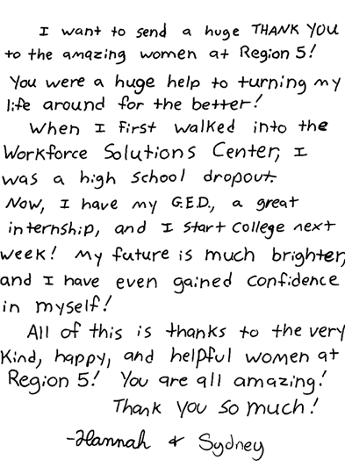

Customer Outcomes

Slide 48
Contact Information
Pamela Wise Workforce Solutions Southeast Texas
pamela.wise@setworks.org
Brenda Schofield Region 5 ESC
bschofield@esc5.net
Danielle Grundy Region 5 ESC
dgrundy@esc5.net

Slide 49
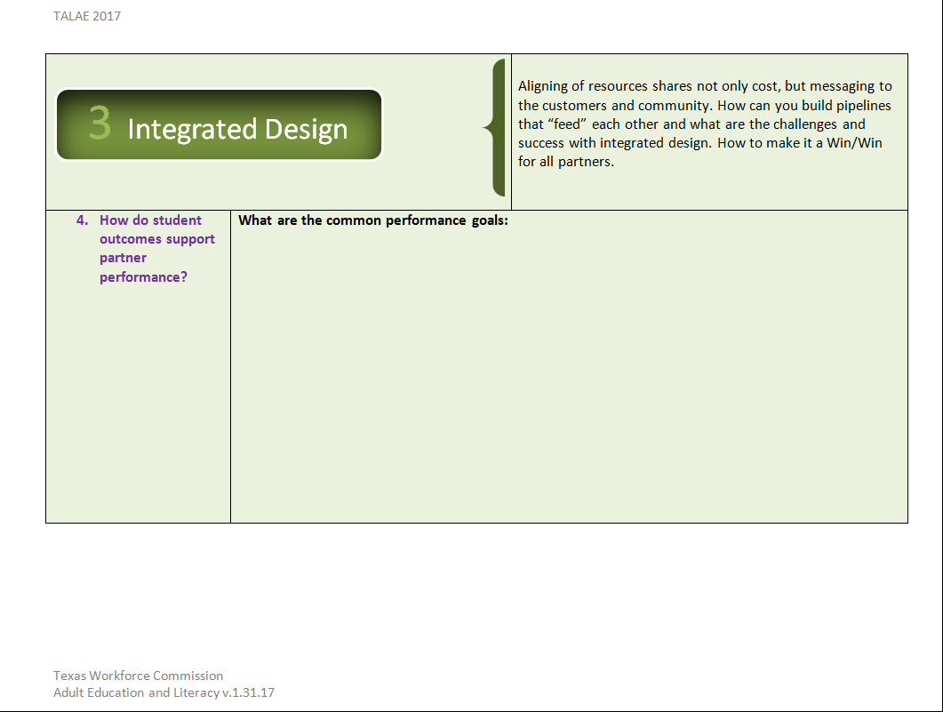
Integrated Design

