Slide 1
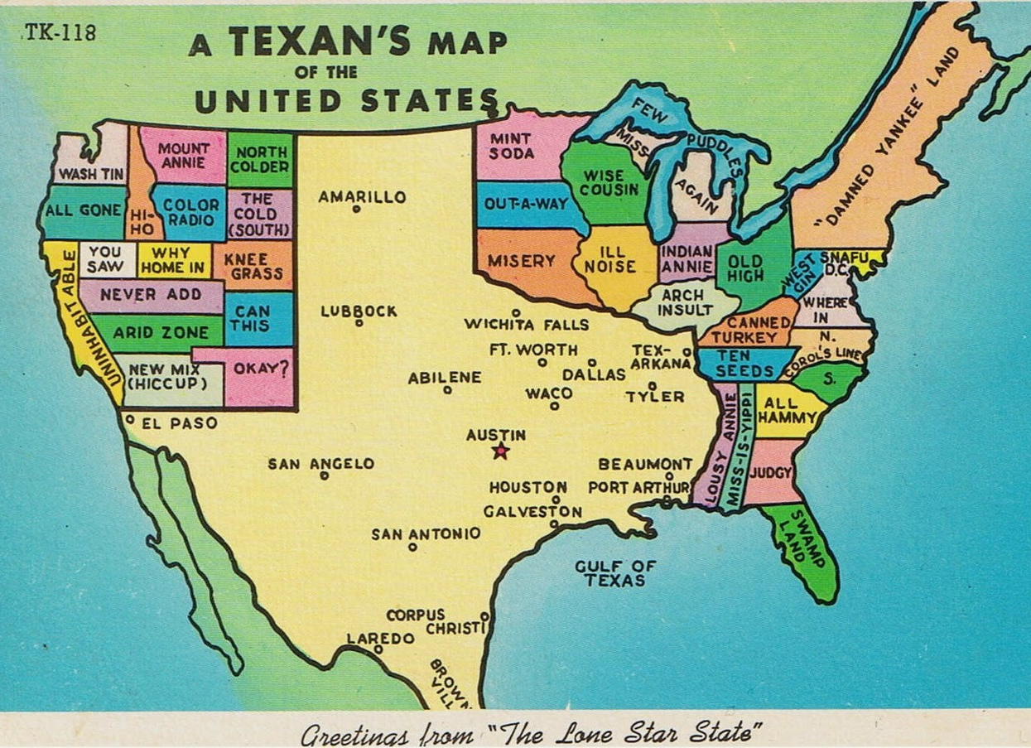
AEL BUSINESS MEETING
@ THE TWC WORKFORCE FORUM
Welcome!

Slide 2


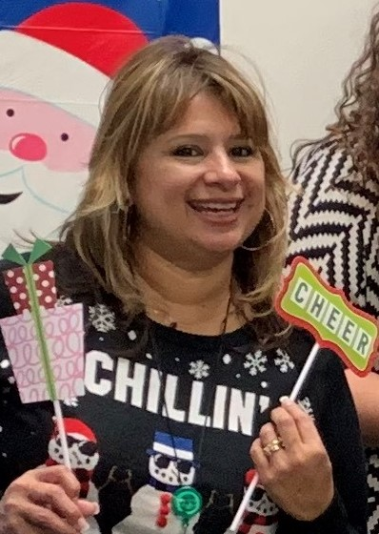
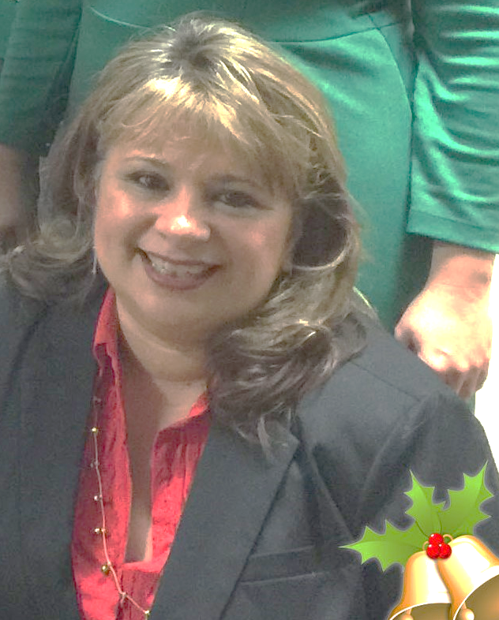
Thank you Blanca!

Slide 3

State of the State
&
Legislative Updates

Slide 4

Standards 2.0
American Society for Training and Development

Slide 5
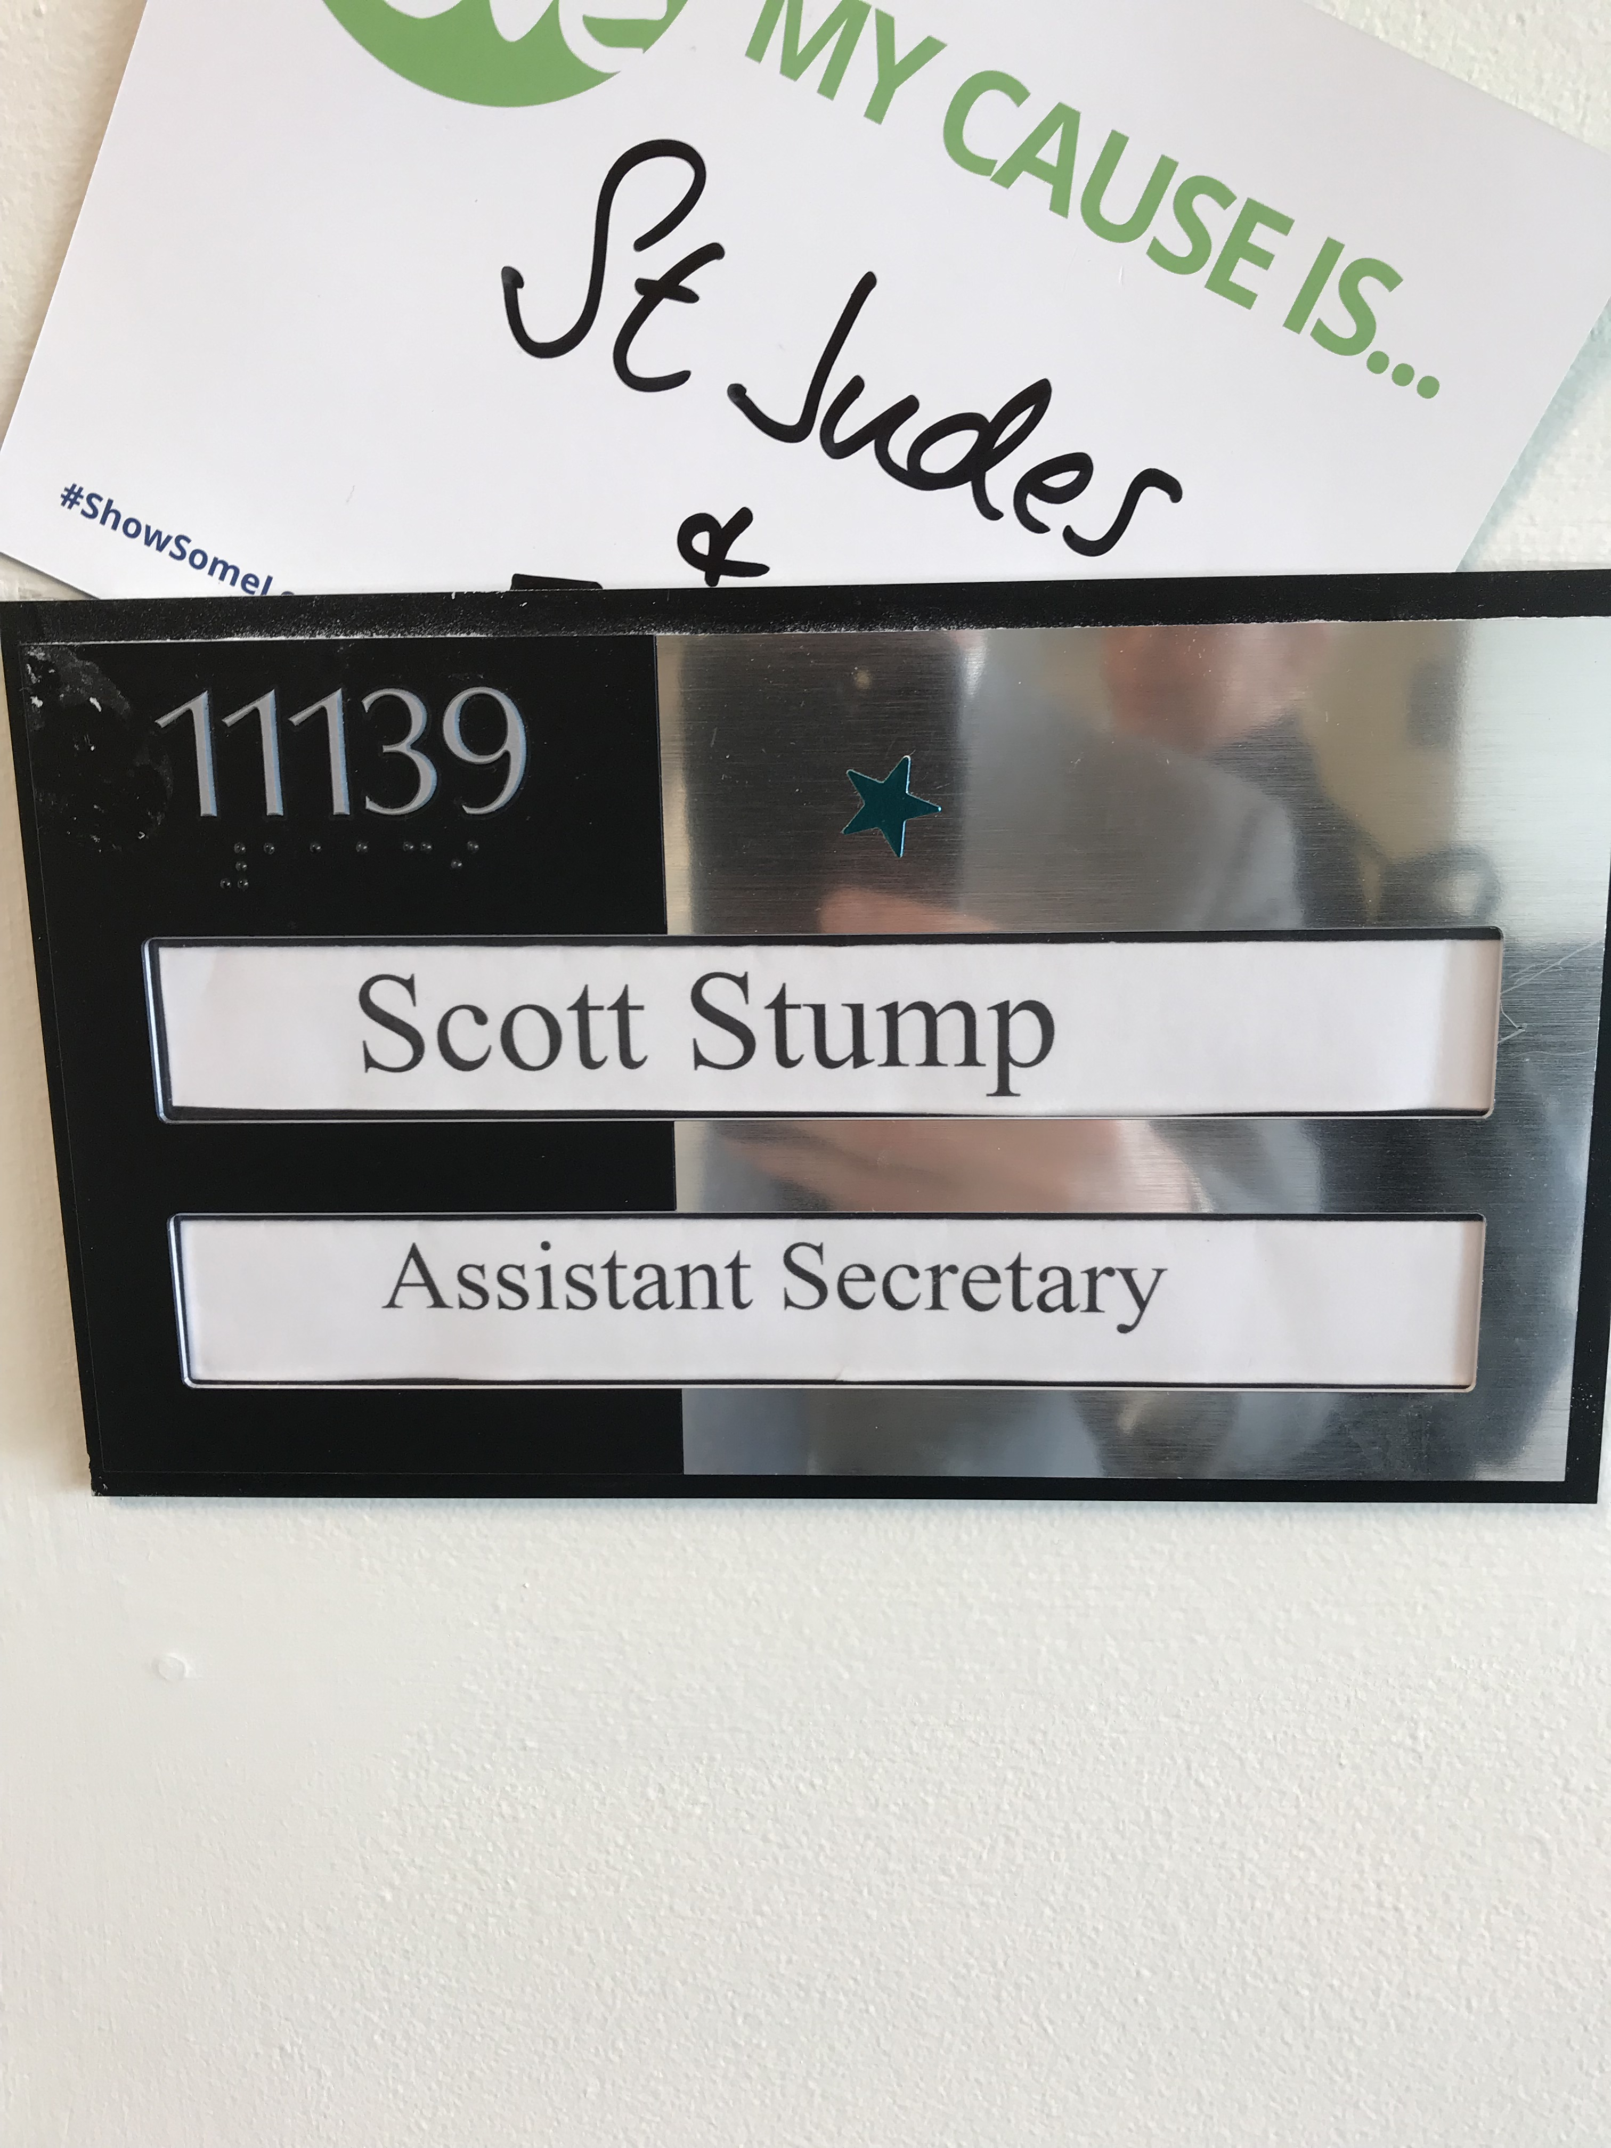
Texas at the Top!

Slide 6
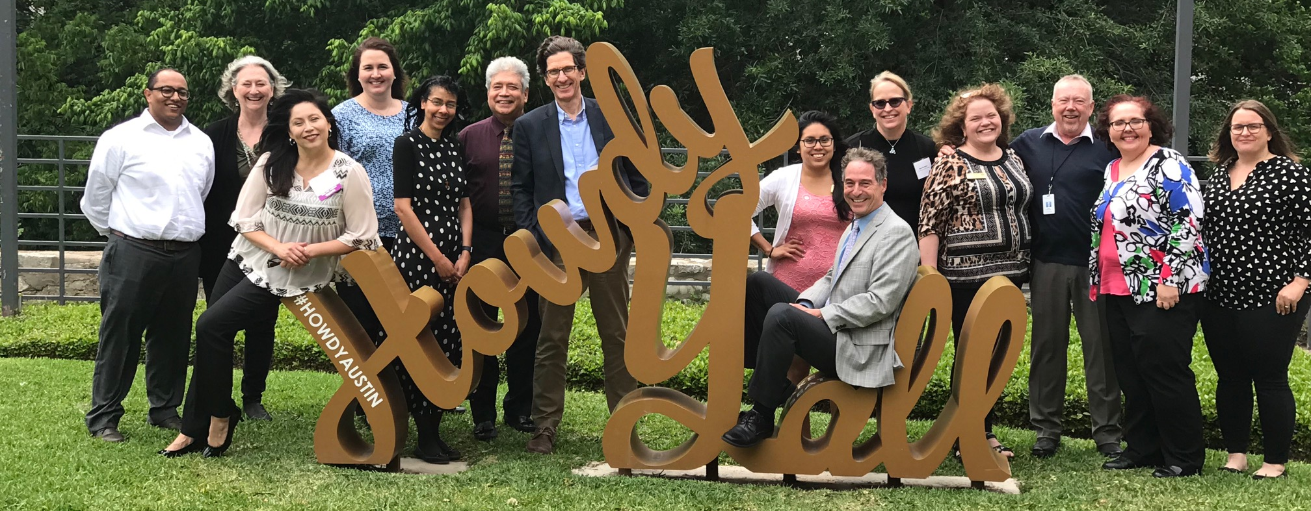

Skilled Immigrant Integration Program

Slide 7

Socorro ISD/ Far West Consortium
National Skills Coalition

Slide 8
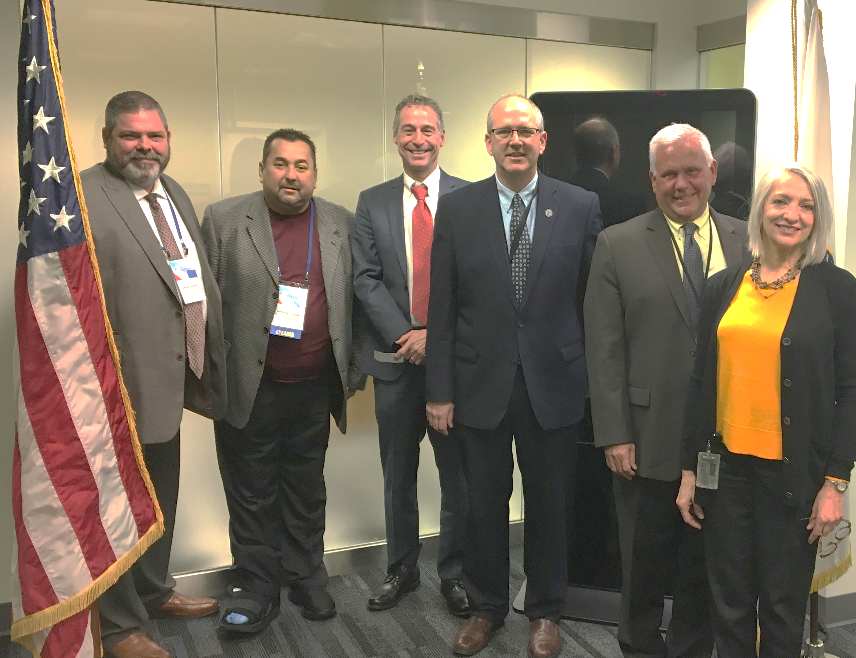
Socorro ISD/ Far West Consortium
National Skills Coalition

Slide 9

Community Action Inc.
National Skills Coalition

Slide 10
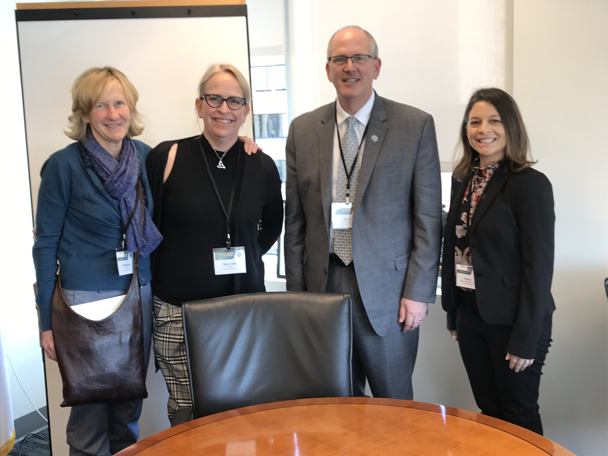
Ability to Benefit
Austin Community College with Assist. Secretary Stump

Slide 11
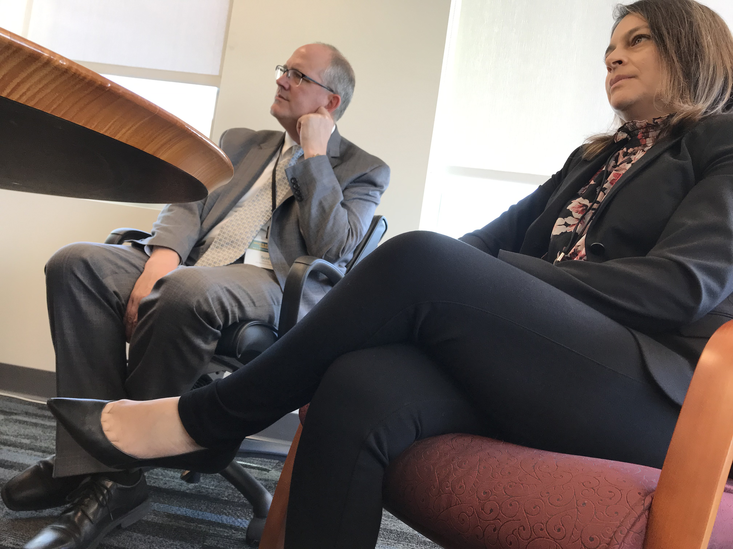
Ability to Benefit
Austin Community College with Assist. Secretary Stump

Slide 12
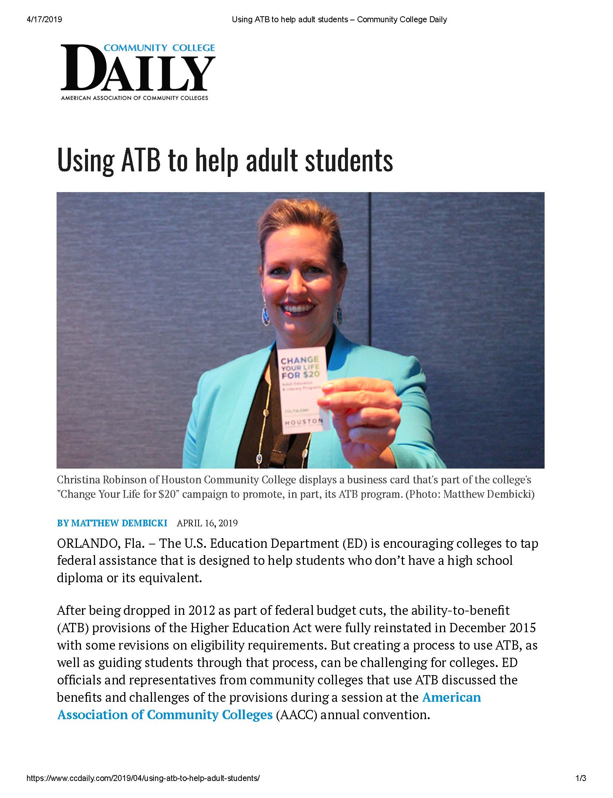
Standards 2.0
American Association of Community Colleges

Slide 13
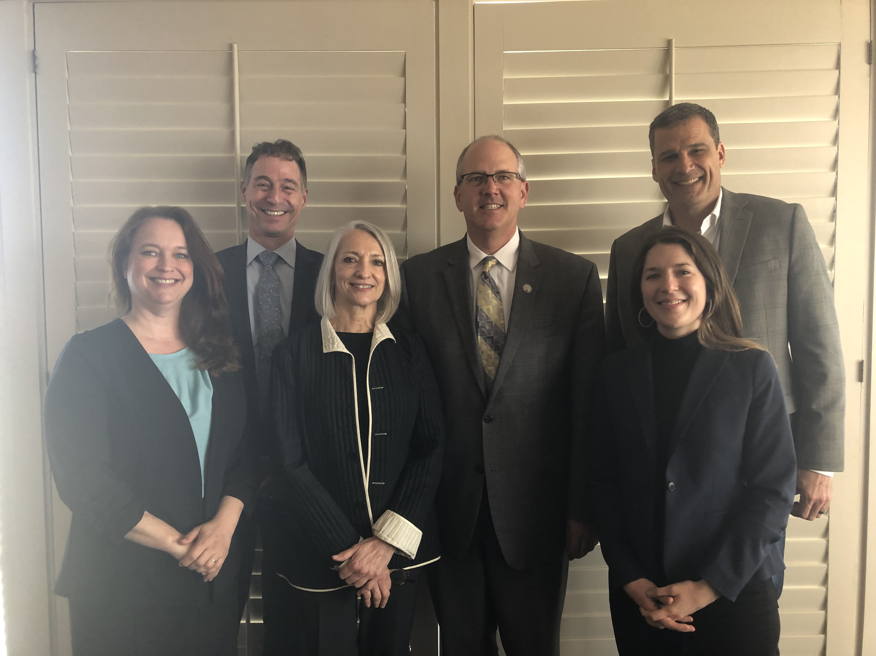
Tyson Upward Academy!
Amarillo College
Literacy Council of Tyler
Angelina College
Panola College
Workforce Solutions Greater Dallas
Tarrant County Workforce Board
Houston Galveston Area Council
Region 20 Education Service Center
Grayson College
Region 9 Education Service Center

Slide 14

Select Assessment Guide & TEAMS Updates
Anson Green
Mahalia Baldini
Texas Workforce Commission
Adult Education and Literacy

Slide 15
Getting your questions addressed today
Objective: Share future development and get your feedback
We have between 8:45 – 10:15
A lot of content to cover!
  Provide any questions and/or comments in the SurveyMonkey link below.
  https://www.surveymonkey.com/r/PY19-20assessmentguidefeedback

Slide 16
The A-TEAM
“Awesome”
“Accountability”
“A+”
“Accurate!”
Wendy Christensen | Region 20 Education Service Center (former)
Sharon Dehn | Workforce Solutions Dallas
Eduardo Honold | Socorro ISD
Christina Mason | Workforce Solutions Tarrant County
Bill Medina | Harris County Department of Education
Denise Orand | San Jacinto College
Christina Robinson | Houston Community College
Terri Schiemenz | Community Action Incorporated of Central Texas
Ashley Trevino | Grayson College
Kathy Dowdy | Austin Community College
Liz Moya | TCALL

Slide 17
Major Revisions
1) Assessments Permitted for Use in Texas
2) Testing in at Least One Domain Before Placement
3) Individuals to be Tested
Timely Testing Requirement
Staff PD Clarifications
Distance Learning Curricula Process

Slide 18
Where You Will Find Guidance
Assessment
Guide
AEL Guide
2019-2020 Revision

Slide 19
Consolidation of Letters
AEL 02-16
AEL 02-19
AEL Guide
AEL 04-16
AEL
07-18
AEL 05-18
Assessment
Guide
AEL
07-18
AEL 01-18
AEL 01-18

Slide 20
-Federal Regs.
-Pretesting
-MSG 1
-PD Reqs.
-DL Guidance
Assessment
Guide
AEL Guide
MSGs 1a–5
HSE and
Postsecondary Credentials

Slide 21

Policy Update 1: Assessments Permitted for Use in Texas
Page 1
of Your Handout

Slide 22
Update 1
Assessments Permitted for Use in Texas
ABE Tests
TABE 9-10 & GAIN discontinued 6/30/2019
TABE 11&12 (through 2024)
NEW: CASAS Reading GOALS (through 2025)
NEW: CASAS Math GOALS (through 2022)
ESL Tests
BEST Literacy & BEST Plus 2.0
TABE CLAS-E
NEW: CASAS Life and Work Listening Assessments (through 2021)
NEW: CASAS Reading Assessments, which include Life and Work (through 2021)

Slide 23

Policy Update 2: Testing in at Least One Domain Before Placement
Page 1
of Your Handout

Slide 24
Testing in at Least
One Domain Before Placement
Option to stagger delivery of pretests
across the different content domains of a test series
Discretion in selecting which content domain to first administer
Objective: Reduce potential test fatigue and place participants quickly into immediate educational services

Slide 25
Testing in at Least
One Domain Before Placement, 2
If first test does not establish basic education eligibility,
must administer a test in another domain to determine eligibility
Must complete testing in the remaining domains no later than the first 12 contact hours or within five class days of direct instruction

Slide 26
Testing in at Least
One Domain Before Placement, 3
Hours accrued during the pretest to determine eligibility shall not be recorded as contact hours
After eligibility has been established the remainder of the tests in the pretest sequence can count towards direct contact hours

Slide 27
Testing Hours in TEAMS
Future Automation in TEAMS
Hours for the remainder of the tests and post-testing will automatically accrue direct hours in TEAMS, one hour for each domain
Providers should not log contact hours for the remainder of the tests after basic education eligibility is established or post tests.

Slide 28
Testing in at Least
One Domain Before Placement, 4
Providers retain the option to do all tests, or more than one test in a test series prior to placing the participant in a class
See Considerations When Testing Initially in One Domain (page 2)
    Providers also have the option to select which domain(s) they test an individual in prior to placement
    Domain should be based on the individual’s objectives, class curriculum, or other criteria

Slide 29
Testing in at Least
One Domain Before Placement, 5
Placement level (DOS) will be established after the last test in the test series is taken, or after 12 contact hours, whichever comes first.

Slide 30
Testing in at Least
One Domain Before Placement, 6
All test scores for each domain must be dated on the exact date that the test in that domain was completed

Slide 31
Exemptions from Testing in
All Domains /Subject Areas
Exceptions: The participant:
has a documented Texas Success Initiative Assessment (TSIA) score and only requires the subject area where he or she needs remediation
has passed a section(s) of the Texas Certificate of High School Equivalency TxCHSE and only requires testing in subject areas he or she has not passed
is enrolling in an IET program at the time of the pretest, and only content domains most relevant for the IET are needed to measure the success in the IET
has another documented reason for only administering one domain of the pretest, such as a specific participant goal or objective

Slide 32
Exemptions Documentation
Providers must retain documentation of the reason for not administering all domains of the pretest in the participant file

Slide 33

Policy Update 3: Individuals to be Tested
Page 4
of Your Handout

Slide 34
Individuals to be Tested
CUSTOMER: A general term that refers to anyone accessing AEL services.
REPORTABLE INDIVIDUAL (or just INDIVIDUAL) is a customer someone has begun but not completed eligibility for AEL services either (lacks a pretest to determine basic education eligibility or has not completed 12 direct contact hours.).
A PARTICIPANT is an individual who has completed eligibility and has entered a period of participation by earning 12 direct contact hours.
Notes:
Providers should be aware that customers may engage in AEL services with the same provider or different providers in an area or across the state, and any information in TEAMS on that participant will follow the customer to another provider. This information can be valuable in determining the participant’s next steps in service, as well as testing requirements, hours within a POP, performance calculations, and data collection requirements.

Slide 35

Policy Update 4: Timely Testing Requirement
Page 5
of Your Handout

Slide 36
Timely Testing Requirement
Starting in PY 2019-2020, tests are valid for no more than 90 days.
Participants must be post-tested within 90 days, unless the student does not have sufficient hours for testing based on the test publisher’s guidelines (Minimum and recommended hours will be defined in the assessment guide.)
The test score of a former student who has exited will not be carried forward (exit means 90 days has passed)
Notes:
Providers should be aware that customers may engage in AEL services with the same provider or different providers in an area or across the state, and any information in TEAMS on that participant will follow the customer to another provider. This information can be valuable in determining the participant’s next steps in service, as well as testing requirements, hours within a POP, performance calculations, and data collection requirements.

Slide 37
Testing Participants at the Start of a Program Year
Because a participant’s contact hours and testing hours carry forward from one PY to the next, NOT ALL PARTICIPANTS need to be tested at the start of a program year
Notes:
Providers should be aware that customers may engage in AEL services with the same provider or different providers in an area or across the state, and any information in TEAMS on that participant will follow the customer to another provider. This information can be valuable in determining the participant’s next steps in service, as well as testing requirements, hours within a POP, performance calculations, and data collection requirements.

Slide 38
Participant Testing Needs
Testing need can be understood at least three different ways:
Participants Crossing Program Years with Enough Hours to Posttest
Participants Crossing Program Years without Enough Hours to Posttest
Participants with Expired Tests Crossing a Program Year
Notes:
Providers should be aware that customers may engage in AEL services with the same provider or different providers in an area or across the state, and any information in TEAMS on that participant will follow the customer to another provider. This information can be valuable in determining the participant’s next steps in service, as well as testing requirements, hours within a POP, performance calculations, and data collection requirements.

Slide 39
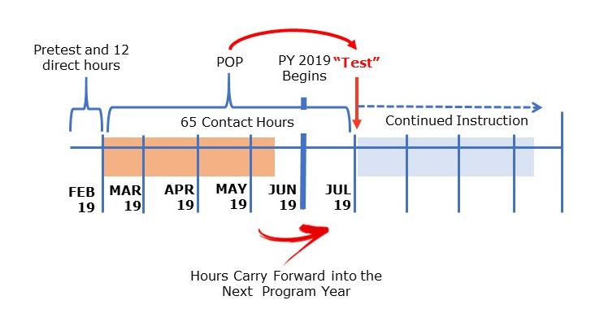
Participants Crossing Program Years With Enough Hours to Posttest
Notes:
Providers should be aware that customers may engage in AEL services with the same provider or different providers in an area or across the state, and any information in TEAMS on that participant will follow the customer to another provider. This information can be valuable in determining the participant’s next steps in service, as well as testing requirements, hours within a POP, performance calculations, and data collection requirements.

Slide 40
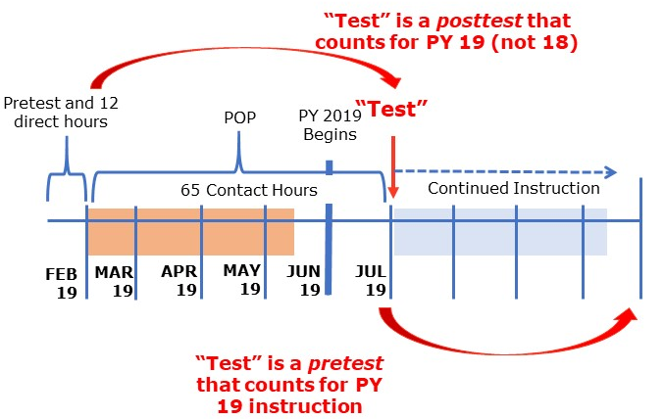
“Test” as Pre and Posttest

Slide 41
Participants Crossing Program Years WithOUT Enough Hours to Posttest
A participant:
with an active POP in a Texas AEL program (any program, not just yours)
who continues into a new program year
who has not accrued enough hours to test
should not be retested at the start of a new program year
UNLESS it has been 90 days or more since the last test
Notes:
Providers should be aware that customers may engage in AEL services with the same provider or different providers in an area or across the state, and any information in TEAMS on that participant will follow the customer to another provider. This information can be valuable in determining the participant’s next steps in service, as well as testing requirements, hours within a POP, performance calculations, and data collection requirements.

Slide 42
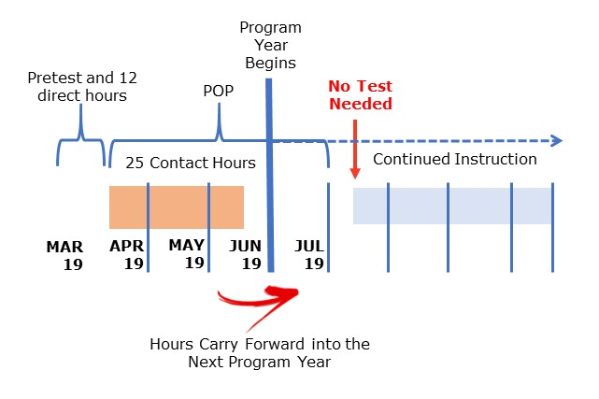
Participants Crossing Program Years WithOUT Enough Hours to Posttest
Notes:
Providers should be aware that customers may engage in AEL services with the same provider or different providers in an area or across the state, and any information in TEAMS on that participant will follow the customer to another provider. This information can be valuable in determining the participant’s next steps in service, as well as testing requirements, hours within a POP, performance calculations, and data collection requirements.

Slide 43
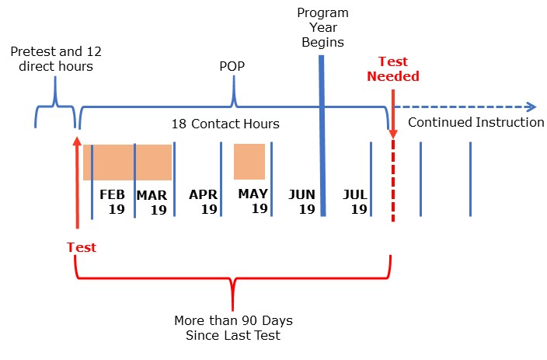
Participants Crossing Program
Years Without Sufficient Hours to Test
Key Point
Test is over 90 days old. When participant returns in the new program year, provider should counsel the student on her/his ability to commit to attendance and / or offer distance learning options.
A new test must be administered.
Notes:
Providers should be aware that customers may engage in AEL services with the same provider or different providers in an area or across the state, and any information in TEAMS on that participant will follow the customer to another provider. This information can be valuable in determining the participant’s next steps in service, as well as testing requirements, hours within a POP, performance calculations, and data collection requirements.

Slide 44
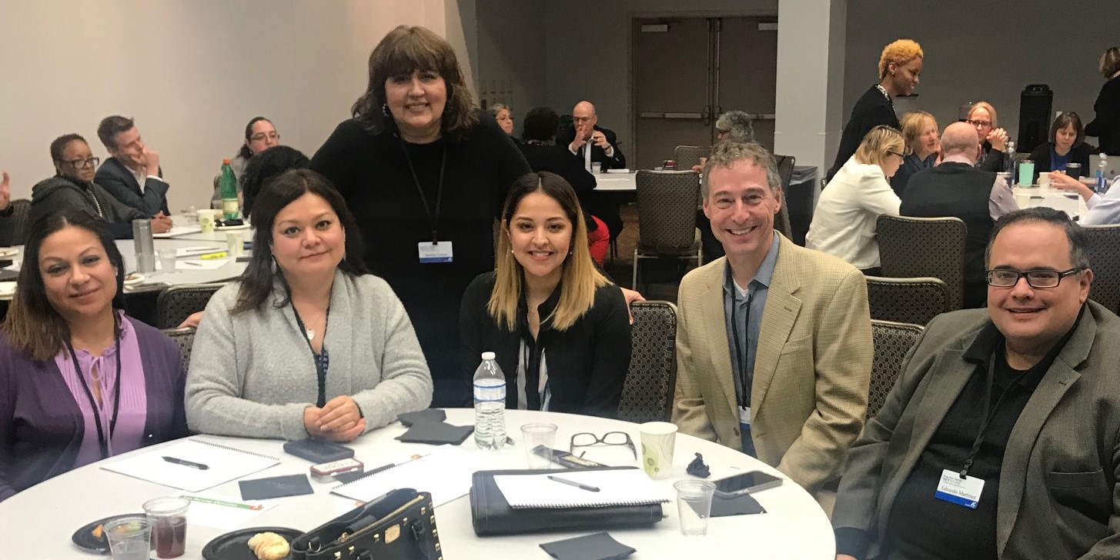
Policy Update 5: Staff PD Clarifications
Page 8
of Your Handout

Slide 45
Staff PD Clarifications
Overall staff qualifications and training requirements are governed by AEL rule TAC §805.21.
Staff may have multiple roles in the assessment process or other duties, like instruction.
Term in TWC Rule | Types of Positions
“staff that oversee program assessment services” | test supervisors
proctoring staff | test proctors and test administrators

Slide 46
Testing Supervisors
PD Role and Duties
Works with PD Coordinator to ensure program staff are properly trained to administer the tests.
Works with Lead for Performance Accountability to ensure scoring and reporting of student scores into TEAMS is accurate
May serve as the assessment point of contact for the consortia.
Serves as assessment subject matter expert for the AEL program
Attends initial Assessment Training of Trainer event to build capacity for training test administrators in the AEL program
Trains program staff on assessment administration

Slide 47
Proctors / Test Administrators
PD Role and Duties
Administers assessments in compliance with publisher and TWC AEL guidelines, including following test security, training of staff, testing facility management, and more
Complies with scoring and TEAMS reporting policies and guidelines

Slide 48

Policy Update 6: Distance Learning Curricula Process
Page 6
of Your Handout

Slide 49
New DL Product Acceptance
Each new DL curriculum must first meet criteria established by TWC.
Curriculum providers must certify that a that their product meets these criteria by submitting Certification of Requirements for Distance Learning Curricula.
Once accepted, the DL curriculum is added to the List of Distance Learning Curricula Authorized to Enter Proxy Hours in TEAMS.

Slide 50
Getting your questions addressed today
Objective: Share future development and get your feedback
We have between 8:45 – 10:15
A lot of content to cover!
  Provide any questions and/or comments in the SurveyMonkey link below.
  https://www.surveymonkey.com/r/PY19-20assessmentguidefeedback

Slide 51
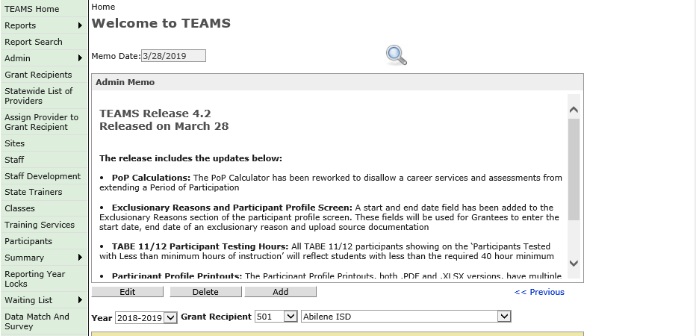
TEAMS Updates
Next Release is coming 4/30/19 !
Introducing “Full Release Notes”
Future Releases currently in progress

Slide 52
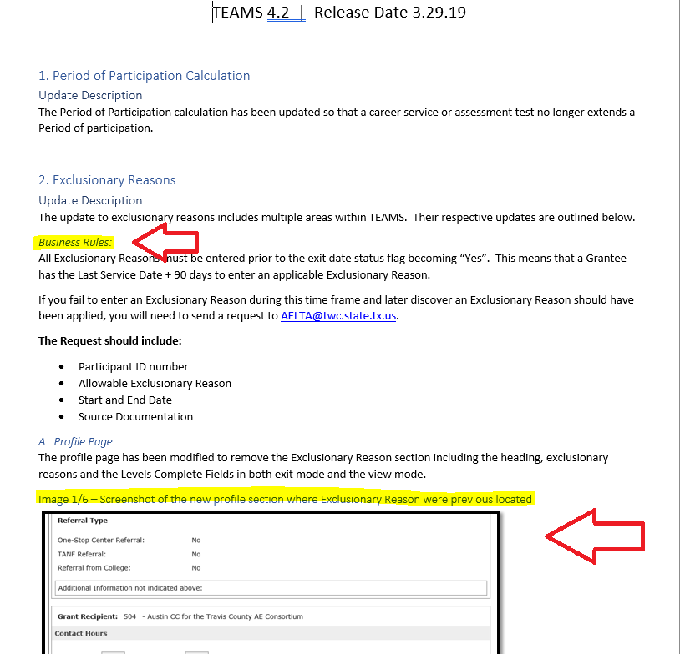
Full Release Notes
To provide you with a description of all the bug fixes or modifications being released
Screen shots when applicable
Detailed business rules and notes to help assist staff in using new features

Slide 53
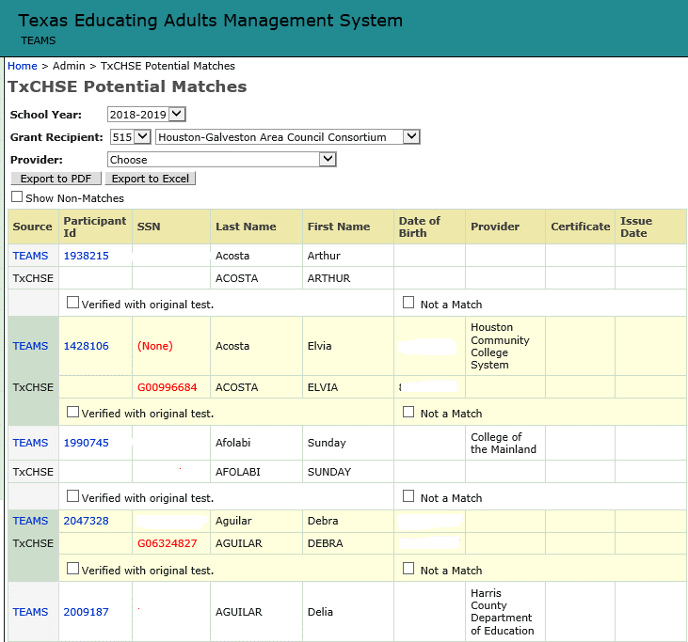
Release 4.3 4/30/2019
What is in it?
Changes to the Potential Match:
Added filter option by Provider
Added a Participant ID column
Added an export feature

Slide 54
Reasons for the Change
A Direct Match only occurs when:
These four elements match EXACTLY:
SSN
First Name
Last Name
Date of Birth (DOB)
Everything else is placed as a “Potential Match”
We get more Potential Matches than Direct Matches
WHY?

Slide 55
This Puts Alot of Responsibility On YOU to…
Develop a process for whose job/responsibility it is to review and clear the Potential Match report—at least monthly
Report any Data Fixes that are hindering the match (inaccurate SSN or DOB) to AELTA@twc.state.tx.us
Ensure you know exactly how the participant is reporting themselves when testing, talk to them, provide instructions when possible
Stay in contact with participant’s who are going to be sitting for HSE exams
We match nightly with TEA, so there could be new potential matches daily

Slide 56
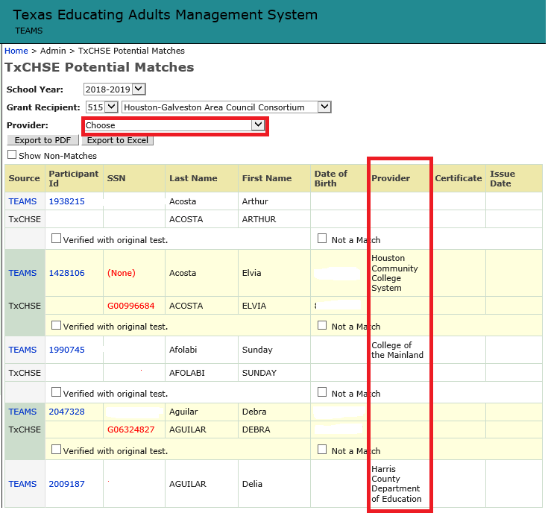
Filter by Provider
Allows you to filter initially for your specific Provider prior to exporting either a PDF or Excel format
Based on the last contact hour
This allows for easier follow-up in large consortia

Slide 57
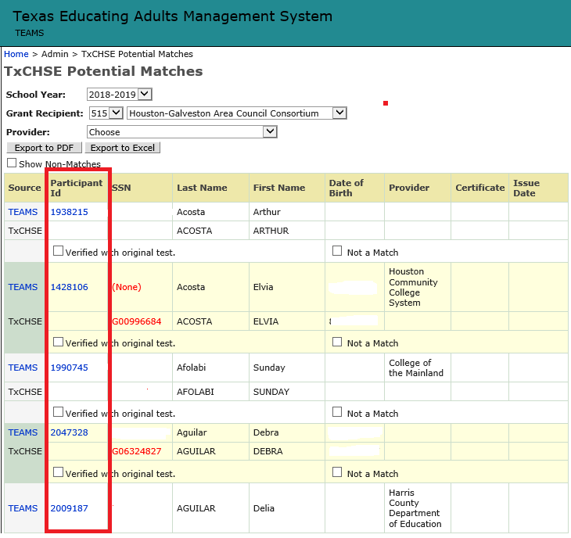
Participant ID
Secures SSN when sharing exported information
Provides an easy unique identifier when you have participants with same or similar names

Slide 58
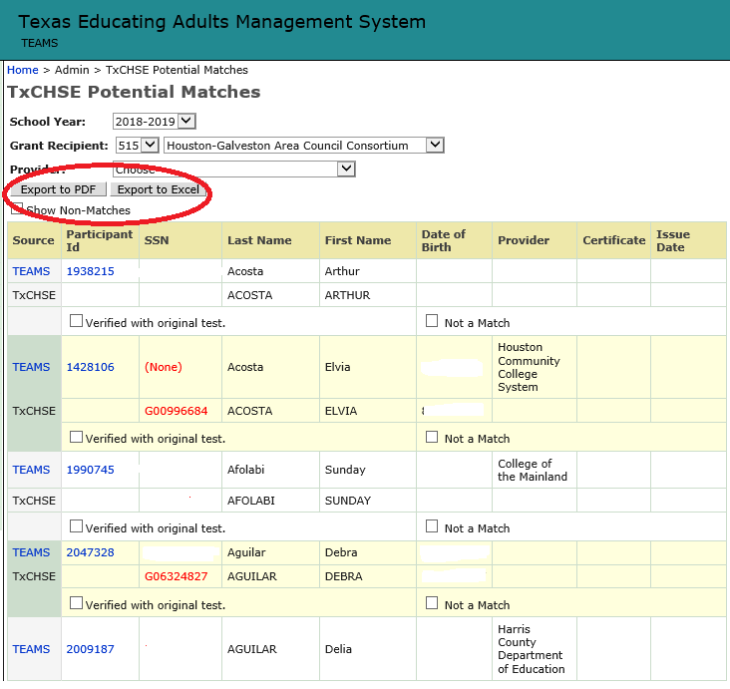
Export Feature
Allows you to export only your Potential Matches in both a PDF or Excel file

Slide 59
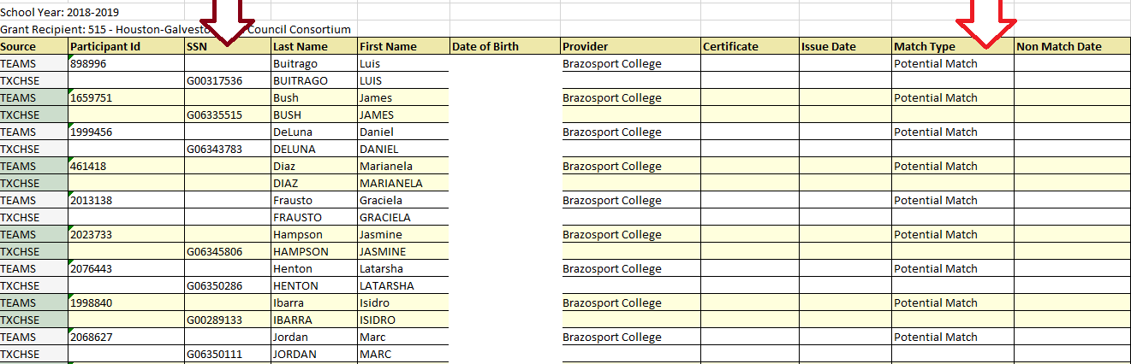

Excel Format
When exported, removes the SSN
Adds the Match Type:
  Potential Match
  Non-Match

Slide 60
Not A Match
Selecting and Submitting “Not A Match” means:
You have identified this person as not being the individual that is being matched by the system
Select “Not a Match” and Submit it –this changes the match type to “Not a Match”
You can choose to show or not show Non-Matches on main page, but they will always appear on the export

Slide 61
Future TEAMS Updates
What’s Coming …

Slide 62
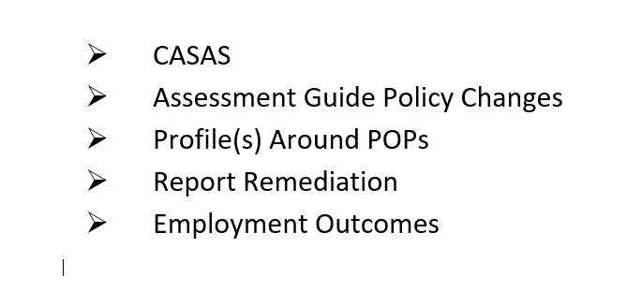
TEAMS Priority Changes
Slated for July 1st :
CASAS
Assessment Changes Due to Policy Update
Changes to HSE seed file (more matches!)
Slated for release after July 1st:
Profile(s) Around POPs
Report Remediation
Employment Outcomes

Slide 63
Getting your questions addressed today
Objective: Share future development and get your feedback
We have between 8:45 – 10:15
A lot of content to cover!
  Provide any questions and/or comments in the SurveyMonkey link below.
  https://www.surveymonkey.com/r/PY19-20assessmentguidefeedback

