Slide 1
Navigating Systems and Making Connections in Reentry

Slide 2
Objectives
TWC AEL Reentry Services: Veronica Moore
Understanding the Reentry Education Model
7 Reentry Education Frameworks
WIOA Title II Allowable Activities for AEL Under Corrections 225
Reentry Defined
Reentry and Post-Release Services
Non-Allowed Activities
Getting Started in Reentry Corrections
Reentry Tool Kit
Reentry Corrections and Transitions-Lee College: Brandon L. Warren
Reentry Corrections Services –Victoria College: Tiffany Johnson
Role as a Transitions Specialist
Challenges of Reentry
Best Practices when assisting Justice Involved Individual’s Success
Reentry Services Provided
Things to understand as a Provider
Challenges and Best Practices
Notes:
Veronica will discuss the following…
What are the TWC AEL Reentry Services that are Allowable! Understanding the Reentry Education Model and the Frameworks (7). This will help you build a model(s) for program growth and development. The tool kit and the resources that it contains.
Brandon a Transitions Specialist with Lee College and working with Lee College-TDCJ (Texas Department of Criminal Justice) Justice Involved Individuals as they transition from Institution to Community or Home based services will discuss his roll as a specialist, challenges, and best practices

Slide 3
REENTRY EDUCATION MODEL
Notes:
The Reentry Education Model made up of 7 frameworks…
Correctional Facility Programs, Educational Services, Community-Based Programs, Outcome(long-term Employment in Living wage jobs/careers without returning to incarceration), Strategic Partnerships, Program Infrastructure, and Sustainability

Slide 4
Reentry education model: 7 frameworks https://lincs.ed.gov/reentryed/
Correctional Facility Programs
Educational Services
Community Based Programs
Strategic Partnerships
Program Infrastructure
Outcome: Sustainability

Slide 5
WIOA TITLE II
WIOA Title II Section 225 463.3(a)/463.60(b) expands the allowable programs components for corrections education. The new list includes eight categories of academic programs:
(1)adult education and literacy activities
(2) special education, as determined by the eligible agency
(3) secondary school credit
(4) Integrated Education Training (IET)*
(5) career pathways
(6) concurrent enrollment*
(7) peer tutoring*
(8) transition to re-entry initiatives and other post release services with the goal of reducing recidivism*
* new activities allowable under WIOA

Slide 6
Re-entry Definition in 463.3
Re-entry and post-release services: services provided to a formerly incarcerated individual upon or shortly after release from a correctional institution that are designed to promote successful adjustment to the community and prevent recidivism.

Slide 7
ALLOWABLE ACTIVITIES CONTINUED…
8) Transition to re-entry initiatives and other post-release services with the goal of reducing recidivism.
1) may include educational counseling or case work to support incarcerated individuals’ transition to re-entry initiatives and other post-release services
2) assisting incarcerated individuals to develop plans for post-release education program participation
3) assisting students in identifying and applying for participation in post-release programs
4) and performing direct outreach to community-based program providers on behalf of re-entering students
Priority usage of these funds must be given to individuals who are likely to return back to the community within 5 years of receiving services.

Slide 8
TYPES OF RE-ENTRY AND POST RELEASE SERVICES
Examples include:
• education
• employment services
• substance abuse treatment
• housing support
• mental and physical health care
• family reunification services

Slide 9
AEL Activities Delivered Under Corrections
Tier I Basic AEL (Including EL Civics without IET) at $606 per
{Corrections and Transitions(Corrections)}
Tier II Intensive AEL at $1,106 (Tier I+$500) per and {Reentry (Corrections)}
Tier III IET AEL (Including Integrated EL Civics) at $2,406 (Tier I + $1,800) {IET (Corrections)}
- BASIC AEL CORRECTIONS
- TRANSITIONS (CORRECTIONS)
- IET (CORRECTIONS)
- REENTRY (CORRECTIONS)
Notes:
When serving participants in Corrections, they should be coded based on the activity that they are in…
Corrections are basic ASE, ABE, ESL Services
Transition (Corrections) are transitions to post secondary or employment Services provided to Justice Involved Individuals
IET (Corrections) are Technical Trainings /Training Programs that lead to a Recognized Credential (Note all IET Components must be present…Technical Training, AEL Contextualization, and Workforce Prep Activities)
Reentry (Corrections) are additional Case Management, Reentry, and Post Release type services provided to Justice Involved Individuals aimed at helping reduce Recidivism

Slide 10
Corrections funds may not be used for costs for participation in post-release programs or services
Non Allowable Services May Include….
Parole/Probation Fees
Fee for Treatment Classes
Fees for Housing Assistance

Slide 11
Getting Started At A New Facility/Partner
Point of Contact : Making contact with the right individuals, not being afraid to try again if something did not work in the past
“Selling” the unit on why you are best suited for what you are proposing : Return on Investment for community, facility, safety of community
Getting the “reentry conversation” started early : Why it is important to start talking about what is next for ANYONE who has a release date (70% of inmates in TX have a projected release date)
Opening the conversation to what is beyond traditional HSE services : Discussions surrounding IET Models, Transition classes, and Workforce preparation activities, Reentry Service Activities

Slide 12
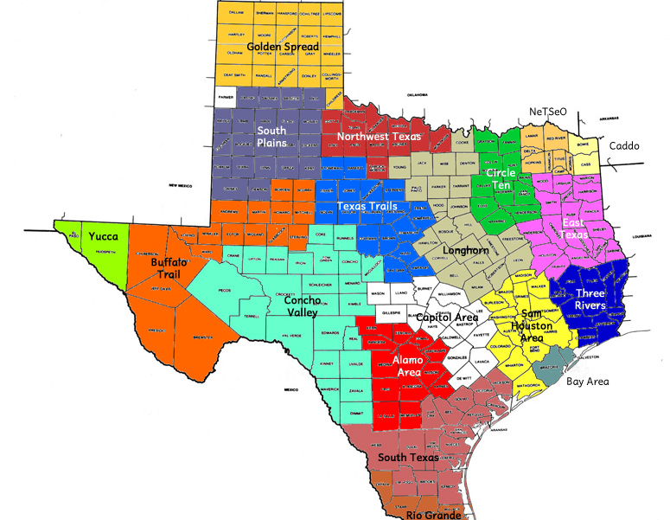
https://lincs.ed.gov/reentryed/
Reentry Tool Kit
This Photo by Unknown Author is licensed under CC BY

Slide 13
ADULT EDUCATION AND LITERACY CORRECTION CONTACT
VERONICA MOORE
512-463-0197
Veronica.Moore@twc.state.tx.us

Slide 14
Brandon Warren Lee College

Slide 15
Tiffany Johnson Victoria College

Slide 16
Correctional Re-Entry
Victoria College AEL

Slide 17
Pre-release Efforts
Partnership with Gonzales Intermediate Sanction Facility:
High School Equivalency classes
Lifeskills
Career Planning
IET Programs (NCCER – Core)

Slide 18
Post-Release Efforts
Challenge To Change helps individuals improve their life and job skills, prepare for release, obtain their GED©, learn how to prepare for college, or re-adjust to being in the free world.
Career counseling
Career exploration: resume building, mastering an application, job search strategies, interview preparation, workplace culture, appropriate on-the-job behavior, and overcoming background obstacles
Referral services for: health needs, housing needs, mental health issues, substance abuse issues, and clothing needs
Assistance with goal setting
Employment readiness
Digital literacy
Financial literacy
GED© preparation
College enrollment assistance and referrals
Challenge to Change
Partnership with Victoria Adult Parole

Slide 19
New Projects
Project: Connect
Workforce Solutions + VC/GISF + Tejas
The goal of this project is to create a formal pipeline that connects the trained student directly with an employer. With the training and skill development taking place before release, the ex-offender is able to transition directly into work.

Slide 20
Pilot Project (Tentative Start Date: Feb, 2020)
Recruitment
Gonzales ISF Core grads
Preparation
VCAE - 1 week (20 hrs)
Training/Internship
Employment
Community Supervision C2C completers
VC WCE - 2-15 weeks (286 workforce training hrs)
Trained Employee
4 hrs work/4 hrs training
4 hrs work/4 hrs training

Slide 21
One Final Word….
“I started with VCAEL in the county jail and completed my GED certificate. After prison, I met another VC person through Challenge to Change who said when I completed, I could enroll in the SAIL program. Now, I successfully completed the Electrical 1 course. I am very grateful I was given the chance. Not everyone would have given me a second chance and adult education has helped me to become NCCER certified and land a job in the electrical field. Thank you!”
- Robert Sanchez, 2019 SAIL Graduate

