Slide 1
Symbols
. , ? ! $ @ / # *

Slide 2
Period

Slide 3
Dot

Slide 4
Period
Dot

Slide 5
A period goes at the end of a sentence.

Slide 6
We say dot when it is in a web address.

Slide 7
Question Mark ?
We use a question mark at the end of a question.
Can you please repeat that?

Slide 8
Exclamation Point !
We use an exclamation point to show excitement or emotion.
I got a new car!

Slide 9
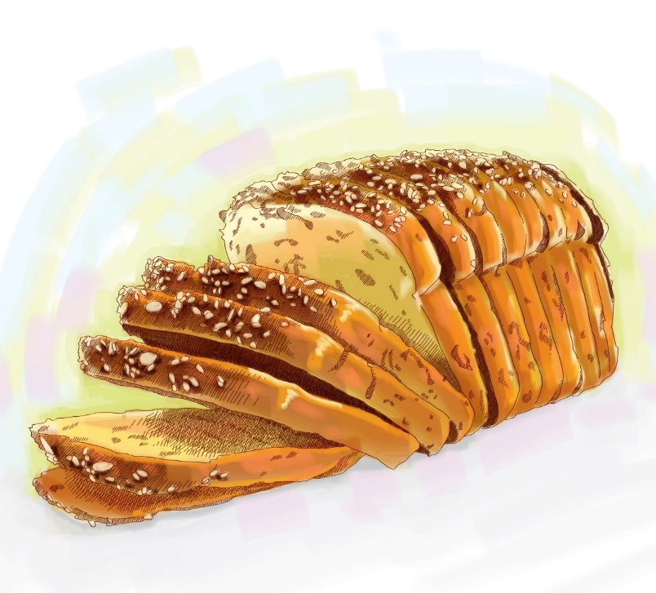
Comma ,
A comma separates words in lists.
I need coffee, bread, and milk.

Slide 10
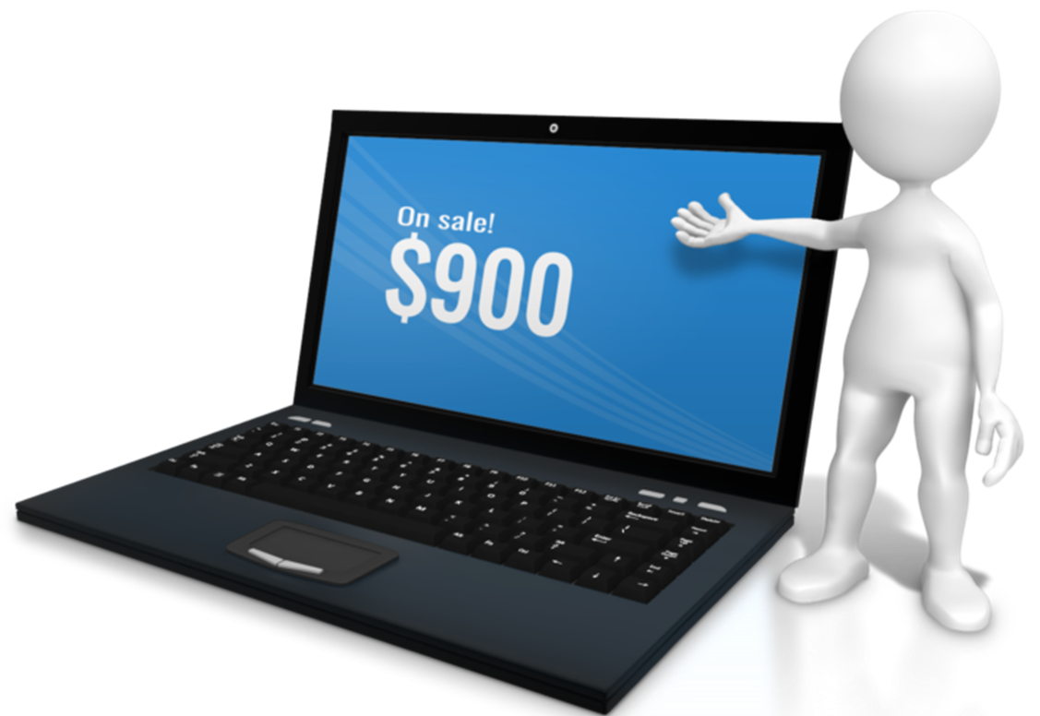
Dollar Sign $
We use a dollar sign for prices.
The computer is $900.

Slide 11
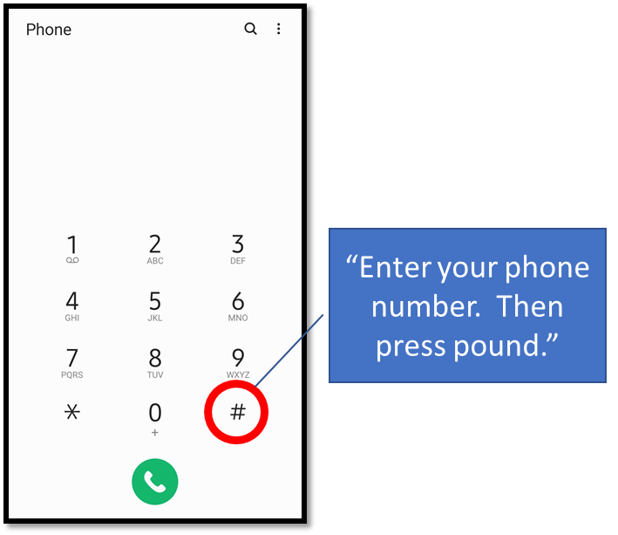
Number sign #
We use a number sign with numbers.
#1. On the phone, we call it the “pound sign.”
#2. In social media, we call it a “hash tag.”

Slide 12
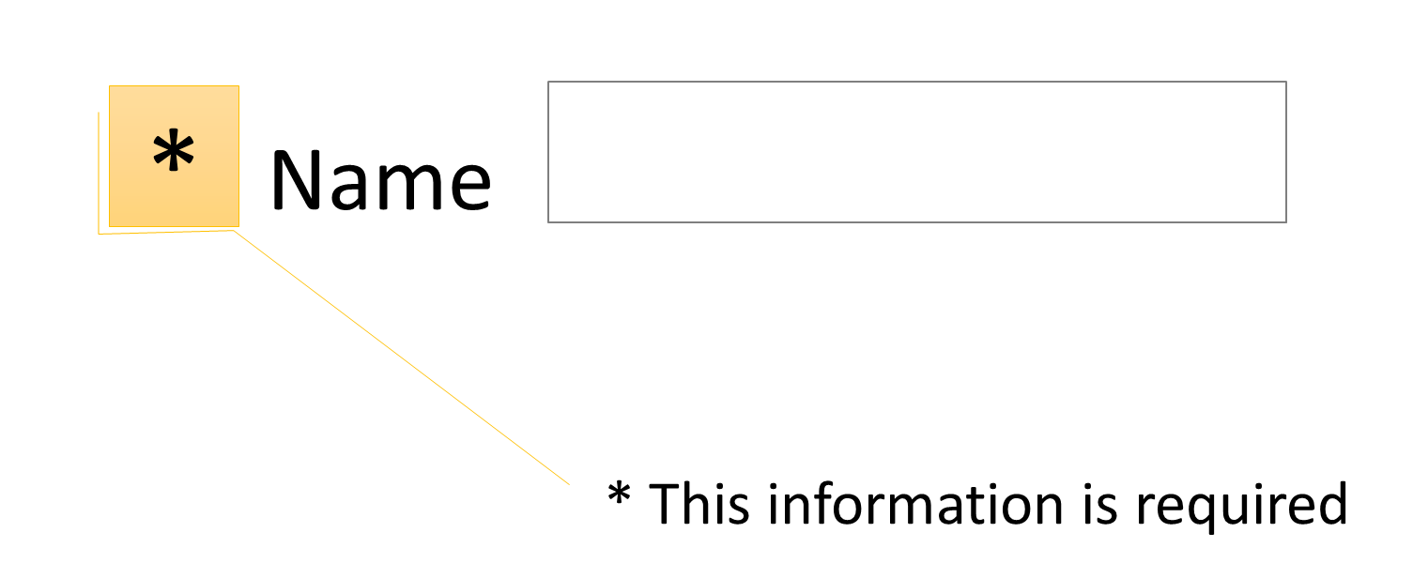
Star or asterisk
A star symbol tells you to look for more information.

Slide 13
At Sign @
We use the at sign in emails.
My email address is someone@tyson.com.

Slide 14
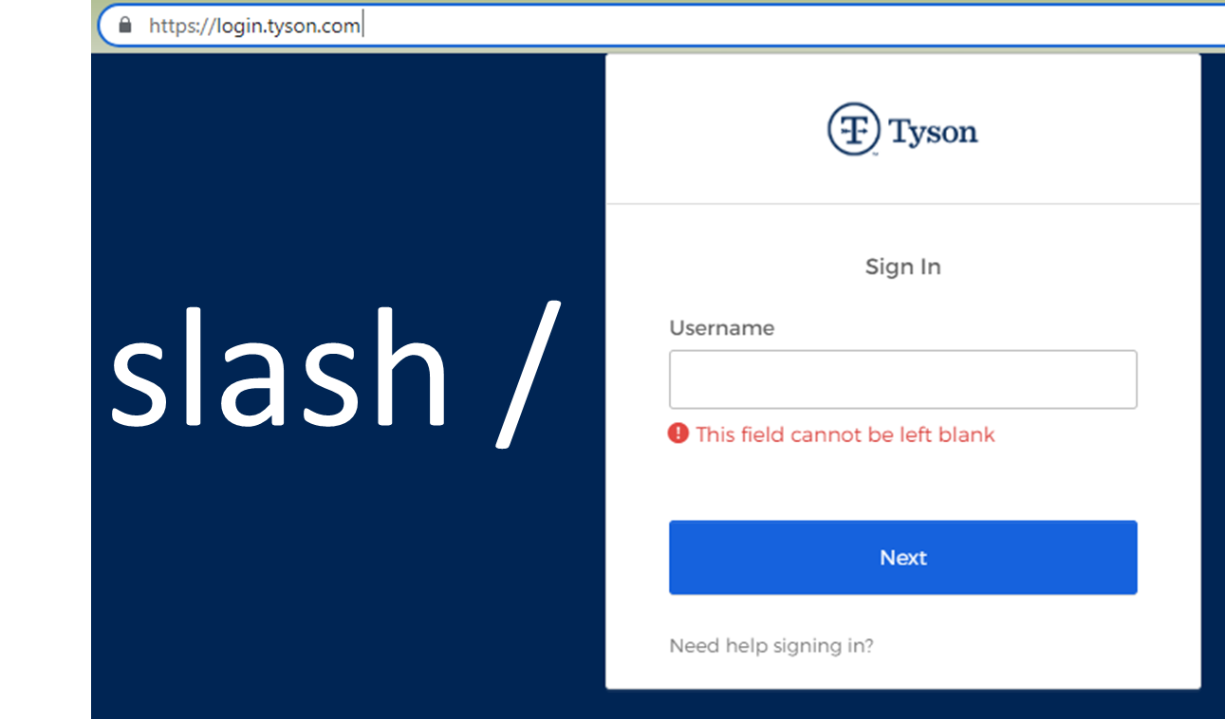
We use slashes in web addresses.
Log on at https://login.tyson.com

Slide 15
. , ? ! $ @ / # *
We also use symbols in passwords.

