Slide 1
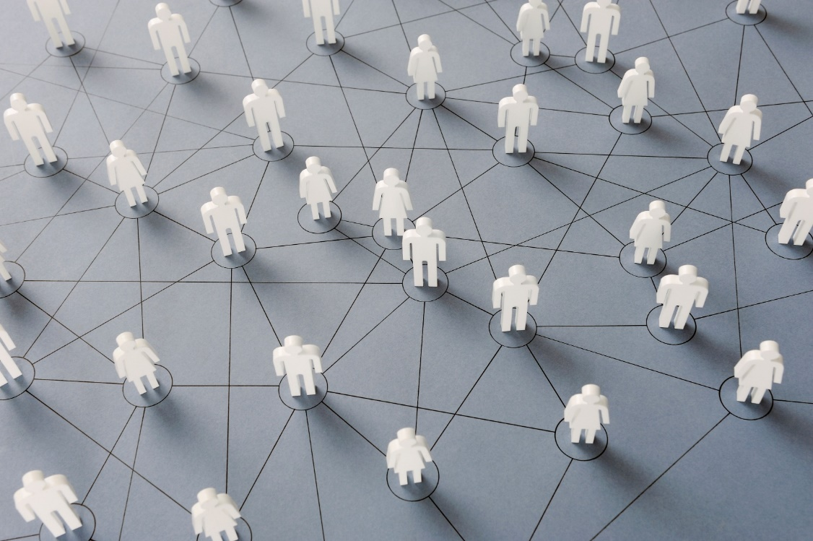
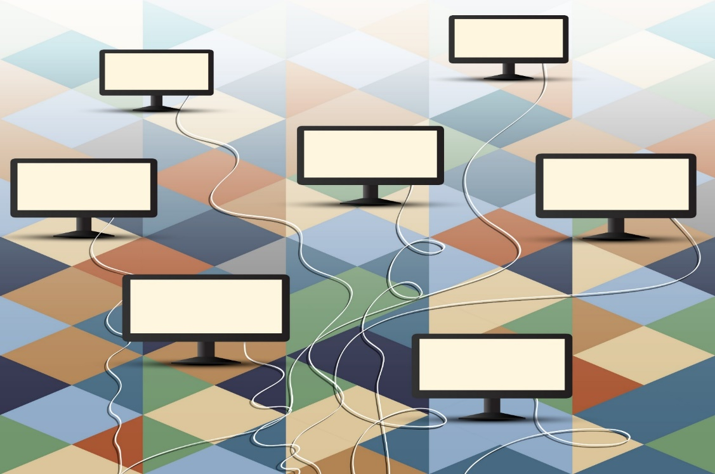
What is a network?
Network of people (friends, family, coworkers, and more)
Network of computers (Internet)
Notes:
What is a Network?
A network is a group of connected things. You have a network of people. Who would be in your network? (friends, families, coworkers, and so on).
The Internet is a network of computers. Why is it helpful for computers to connect to each other?” (share information, communication, etc.)

Slide 2
Compare these two ways of talking
Notes:
How are these two ways of talking the same? How are they different?

Slide 3
Compare these two telephones
Notes:
How are these two telephones the same? How are they different?

Slide 4
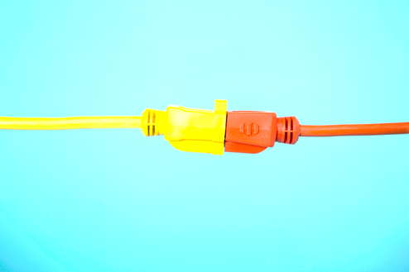
A Wired Network
wires/cables
wired connection
Notes:
A Wired Network
We can connect our computer with wires or cables. This is a wired connection.

Slide 5
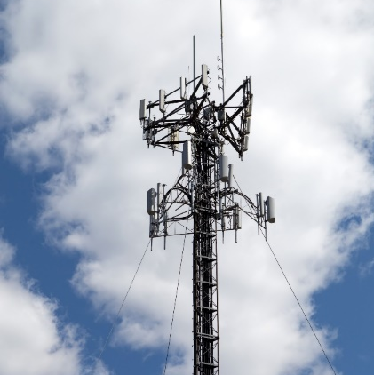
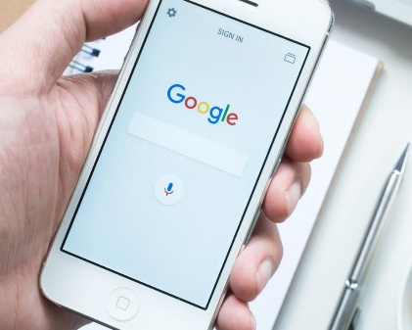
A Cellular Network
cell phone data
cellular connection
This Photo by Unknown Author is licensed under CC BY-NC
Notes:
A Cellular Network Connection
We can connect our computer with our cell phone data. This is a cellular connection.

Slide 6
A Wireless Network
wireless
wireless connection Wi-Fi
Notes:
A Wireless Network
We can connect our computer with a wireless network. This is a wireless connection. We also call this Wi-Fi.

Slide 7
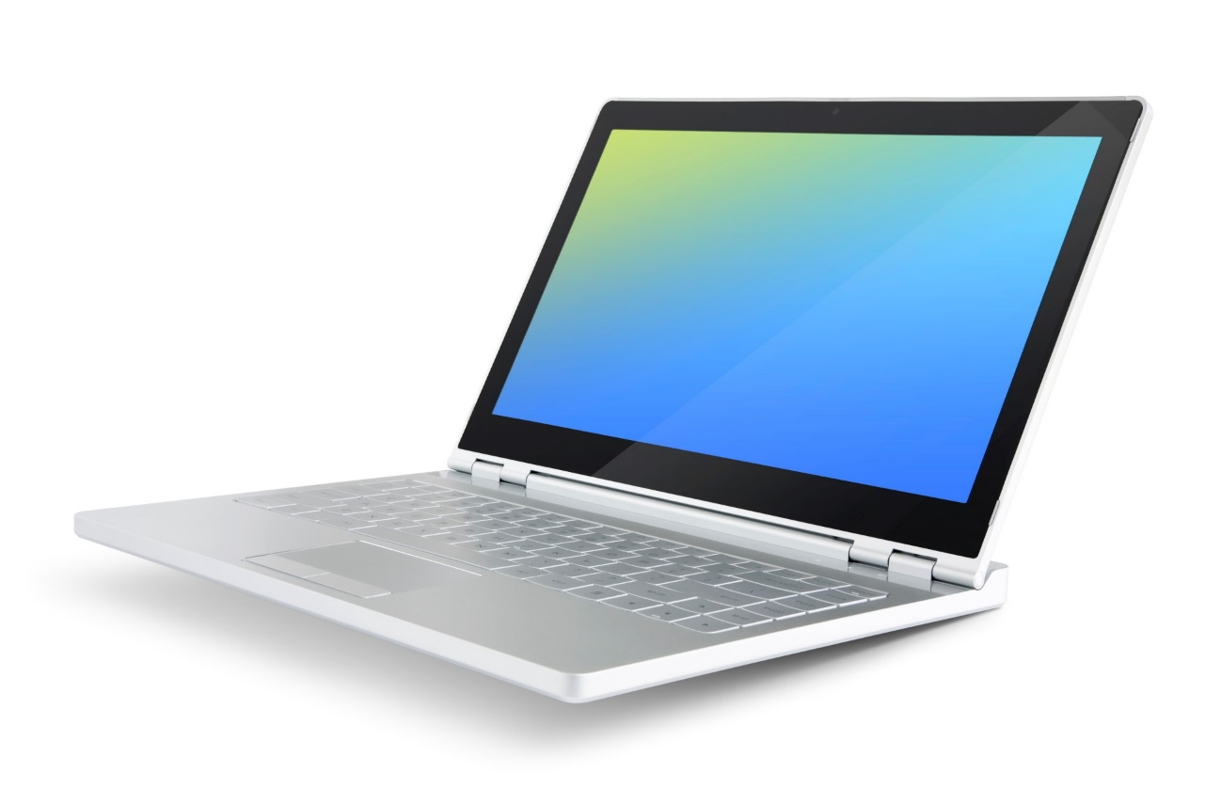
Connect to the Internet with Wi-Fi
Wi-Fi
This Photo by Unknown Author is licensed under CC BY-SA-NC
Notes:
Today you will learn to connect to the Internet with Wi-Fi.

