Slide 1


1.2 Computer Basics

Slide 2
Learning Goals
Learning Goals
Describe why computers are important.
Explain how computers work.
Explain the difference between computer hardware and computer software.
Describe what an operating system is.

Slide 3
Learning Goals
Learning Goals
Identify the operating system you have on your own computer and phone.
Define office productivity and communications software.
Turn on and log in to a computer.
Identify parts of the computer desktop.

Slide 4
Importance
Importance
Why is it important to learn how to use a computer?

Slide 5

What is a Computer?
What is a Computer?
An electronic device that:
  accepts data (input),
  manipulates the data (process),
  provides output (output) and
  stores the results (storage).

Slide 6
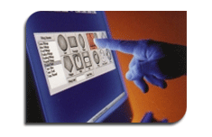
Input Devices
Input Devices
  The user must provide the data through an input device such as:

Slide 7
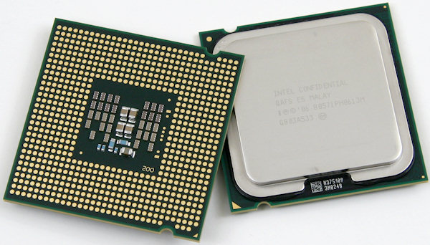
Processing Data
Processing Data
Once the user provides the computer with data, he/she must tell the computer what to do with the data. The central processing unit
performs the tasks the
user tells it to do.

Slide 8
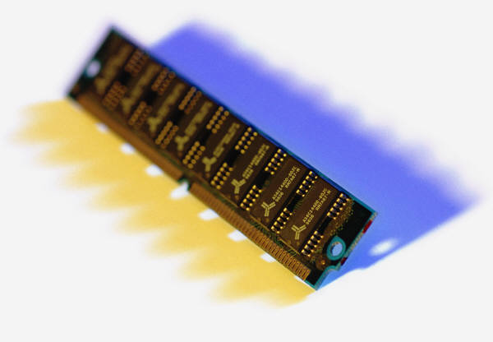
Data in Memory
Data in Memory
Many people use the terms memory and storage interchangeably. However, they are not the same thing.

Slide 9
Data in Memory
Data in Memory
Memory is a temporary holding space for data while it is being used by the user.

Slide 10
Data in Memory
Data in Memory
Example: This presentation has been saved to “storage,” but we are viewing it through the computer’s memory. If I make a change to it and do not save it to “storage” again, the changes will be lost.

Slide 11
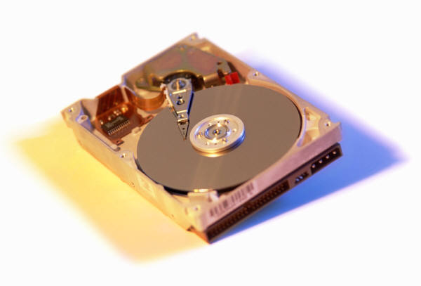
Storing Data
Storing Data
The computer user can store data so that he or she may access it again.

Slide 12
Storing Data
Storing Data
Primary storage consists of the hard drive which is located inside of the desktop or laptop computer.
Disadvantages
Advantages

Slide 13
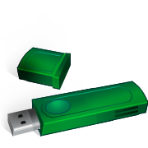

Storing Data
Storing Data
Secondary storage consists of any storage medium located outside of the desktop or laptop computer.
Disadvantages
Advantages

Slide 14
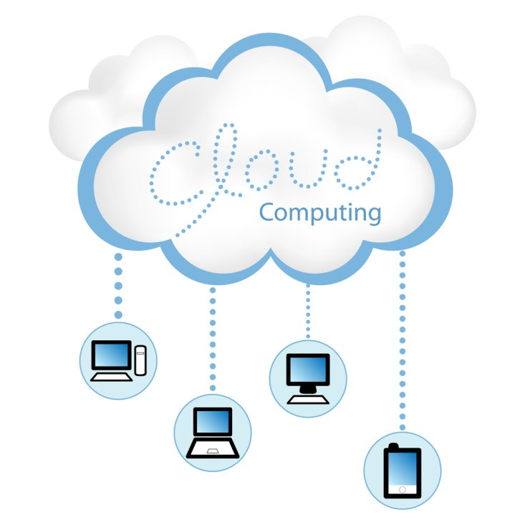

Storing Data
Storing Data
Disadvantages
Advantages

Slide 15
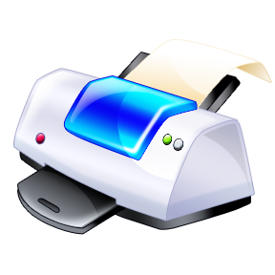

Output Devices
Output Devices
A few examples of output devices are:
The computer user can also instruct the computer to provide output.

Slide 16
Information Processing Cycle
REVIEW INFORMATION
PROCESSING CYCLE
Input
Output
Information Processing Cycle
Process
Memory/Storage

Slide 17

Why Use a Computer
Why Use a Computer
Speed
Accuracy
Reliability

Slide 18

Computer Programs
Computer Programs
A computer program is a collection of step-by-step instructions that tell the computer how to perform a particular task or group of related tasks.

Slide 19
Software
Software
There are two general types of software.
System software
Application software

Slide 20
System Software
System Software
System software generally comes preinstalled on your computer and you will, quite often, not even realize that you are interacting with it.
Operating Systems
Device Drivers

Slide 21

Operating Systems
Operating Systems
The two operating systems most users encounter are Microsoft Windows and Mac OS X.
Operating systems contain the instructions that allow the parts of a computer to work together by performing most, if not all, of the “behind the scenes” tasks such as transferring data from memory to storage devices.

Slide 22
Device Drivers
Device Drivers
Device drivers contain the instructions which tell the computer how to interact with that particular device.
Many device drivers come preinstalled on the operating system but devices such as printers and scanners come with a device driver to install on the computer if necessary.

Slide 23



Application Software
Application Software
Software the computer uses to carry out a specific task as specified by the user.

Slide 24
Word Processing
Word Processing
Software that enables the user to enter, edit, format and print documents containing primarily, but not limited to, text.

Slide 25
Spreadsheets
Spreadsheets
Software that enables the user to enter, edit, format, print, sort and calculate primarily numeric data.

Slide 26

Web Browsers
Web Browsers
Software that enables the user to access, retrieve and view documents and other resources on the Internet.
Chrome

Slide 27
Email
Email
Software that enables the user to send and receive electronic mail, commonly known as email over the internet.

Slide 28
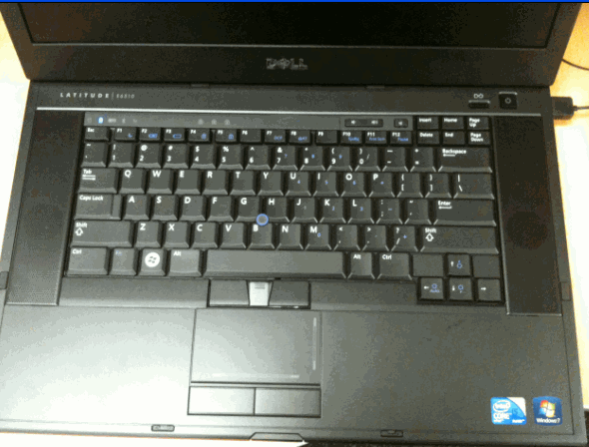
Laptop
Turn on the Computers

Slide 29
User Name
User Name
Type in if necessary
XXXXXXX
Password
Type in the following password:
XXXXXX

Slide 30
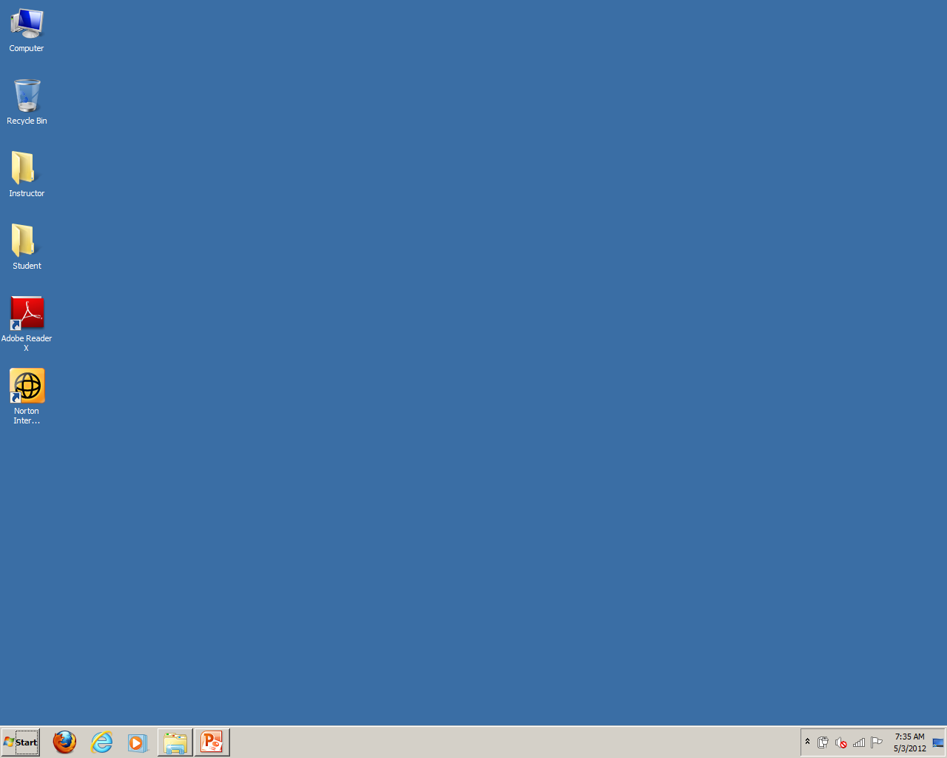
The Desktop
Icons
and/or
Shortcuts
The
Desktop
Start
Button
Quick
Launch
Notification
or Status Tray
Task bar

Slide 31
The Start Button
The
Start Button
Start
Button

Slide 32
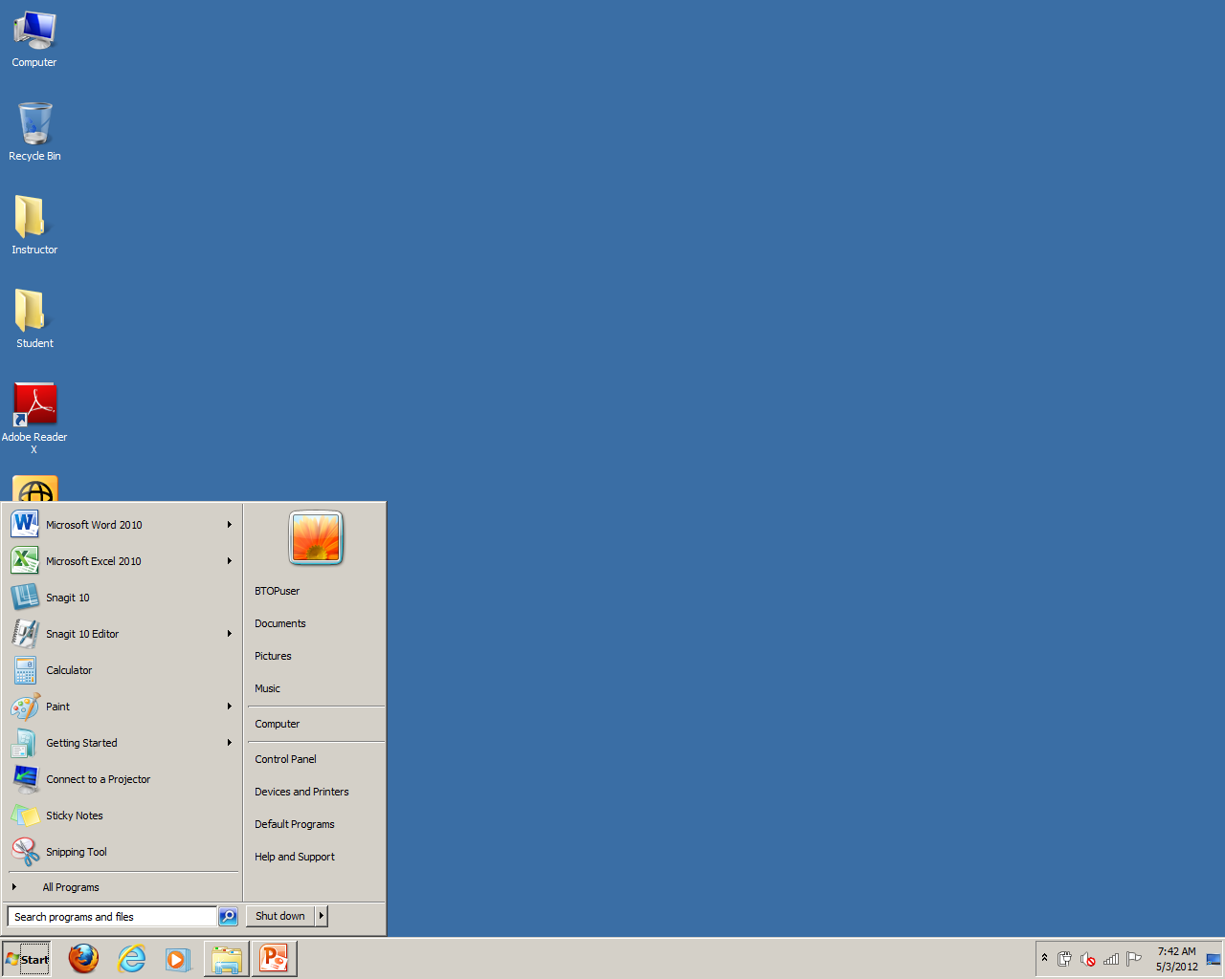
The Start Menu
The
Start
Menu

Slide 33
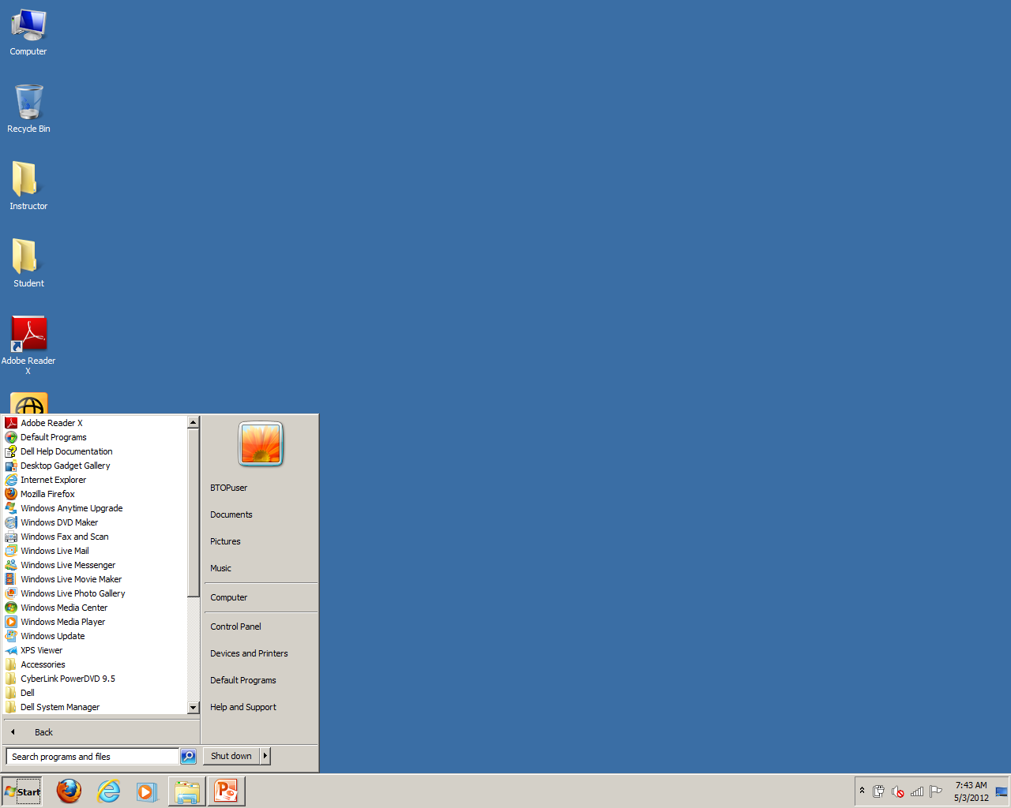
All Programs
All
Programs

Slide 34
Scroll Down
Scroll
Down

Slide 35

Open a Folder
Open a
Folder

Slide 36
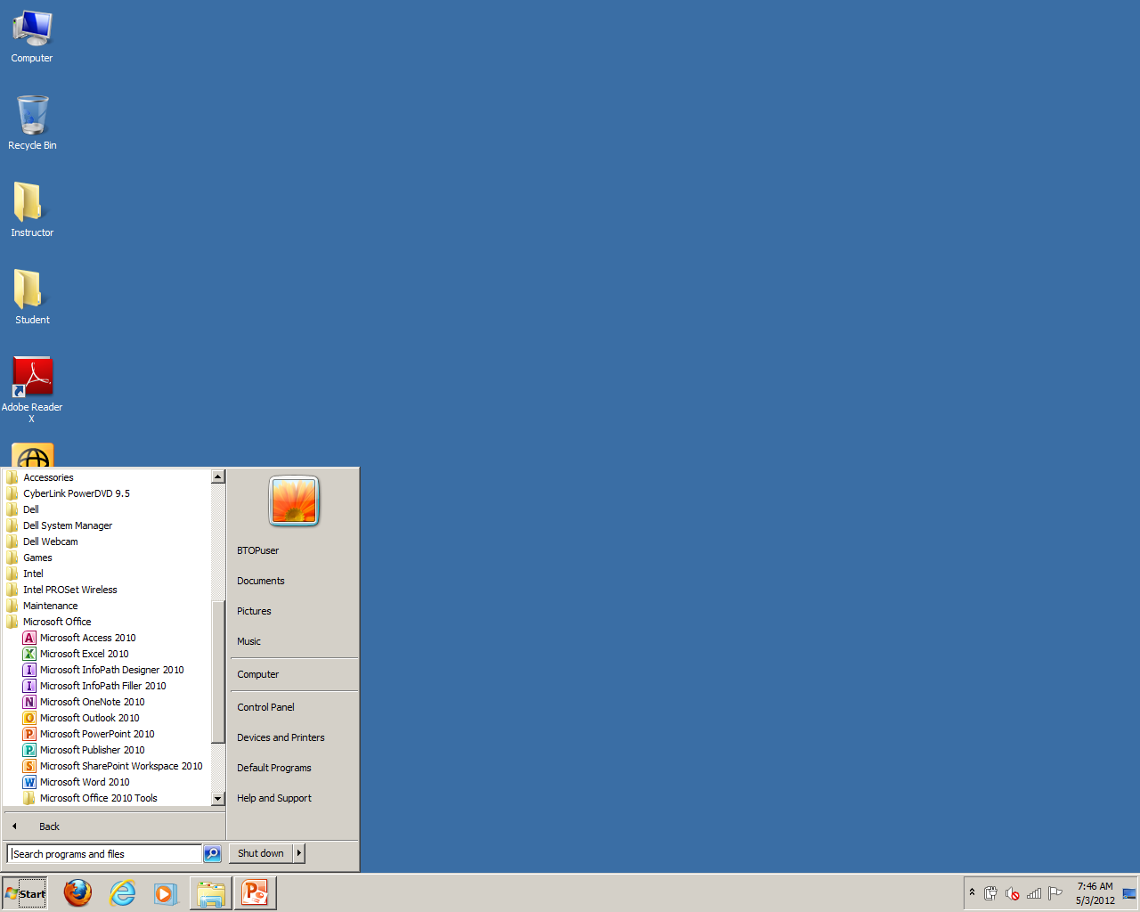
Open a Program
Open a Program

