Slide 1

PY 20-21 TEAMS UPDATE
Release 5.3 – Pre/Post Test Gains Pages
Mahalia Baldini, M.Ed
State Director
TWC | AEL

Slide 2
Back End Changes to Align Function to Performance
The information on the pages are a reflection of business rules that have been modified to align to current performance and assessment guide revisions, such as:
Initial Placement for NRS Reporting— Individuals will be placed in an EFL for reporting purposes for the program year based on one of the following:
the lowest initial test score, if all content area tests are taken on the same day
the earliest test score available in the program year, given new flexibilities to stagger tests in different content areas
None of this has any bearing on instructional placement based on individual’s needs and goals.
Removing DOS— A gain in any content area is a gain for performance in the program year regardless of lowest test score

Slide 3
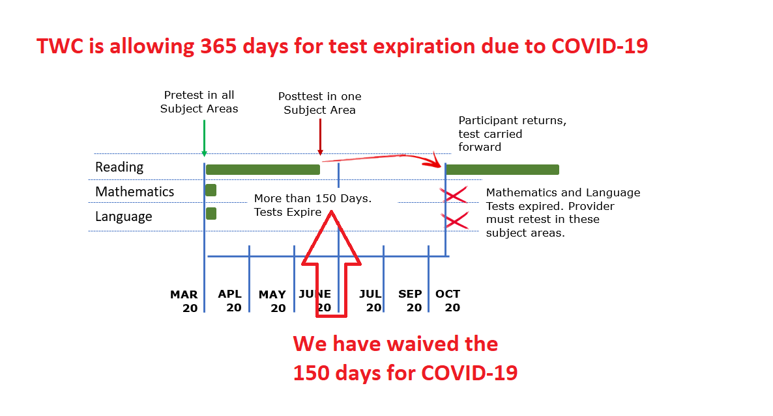
Bringing Forward Valid Test Across Years
PID#1065473
Notes:
Continuing Students
This isn’t a huge change from what we have always done, except that when determining NRS placement for reporting, they will look at the original test dates and place according to those test dates, not lowest functioning level.

Slide 4
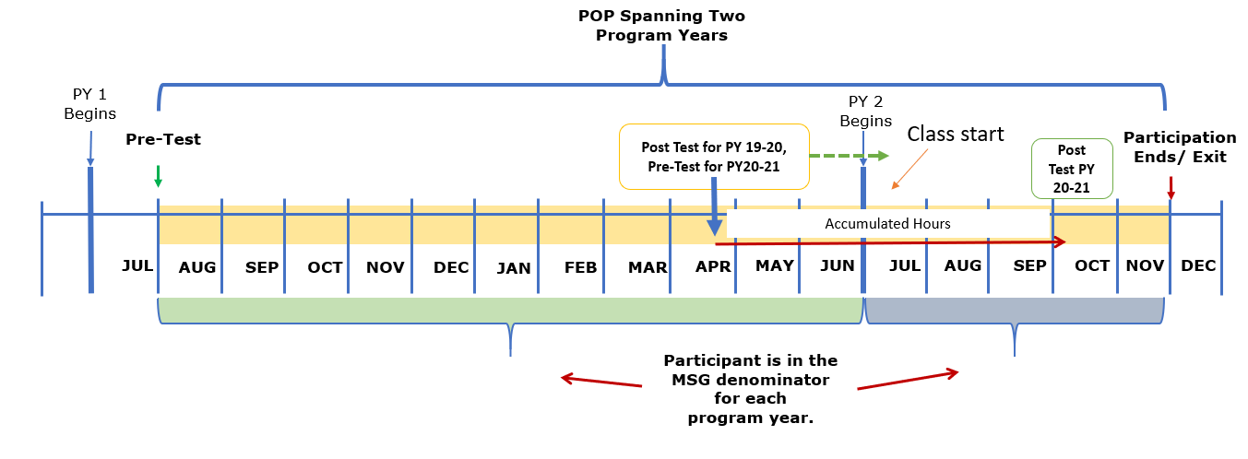
Across PY Performance Alignment

Slide 5
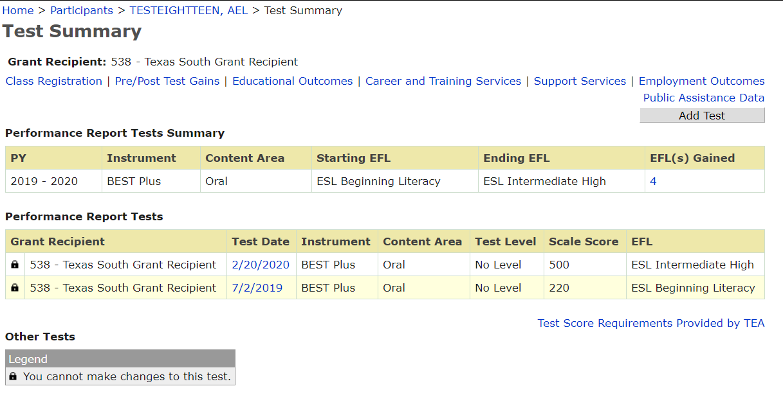
Assessment Page = Test Summary
Page Pathway
Home > Participant Record > Test Summary
Notes:
We have modified the current ‘Assessment Page’ to be a high-level review of test within a program year (PY).
It has a ‘starting EFL level’ and an Ending EFL level and number of level gains made in any instrument and content area
It also includes a hyperlink to the Educational Outcomes page to view those level gains
In this example, you can see that this student utilized two different instrument groups in PY 18-19 as they transitioned from ESL to ABE instruction. The student made 3 level gains in Best Plus 2.0 from starting the year in ESL Intermediate Low and Ending the PY in ‘Exit Criteria from NRS’, resulting in three level gains.
It also shows that the student was tested with a TABE 11/12 in Reading, Mathematics and Language, but did not post test on any of these areas
A user can summarize that the student counted as a positive in terms of performance and that they also have transitioned to non-ESL based testing.

Slide 6
Test Summary
Used to be “Assessment Page”
Does not indicate MSG’s, only test(s) that could potentially be considered for MSG
Other Tests=Non NRS Test and HSE Test

Slide 7
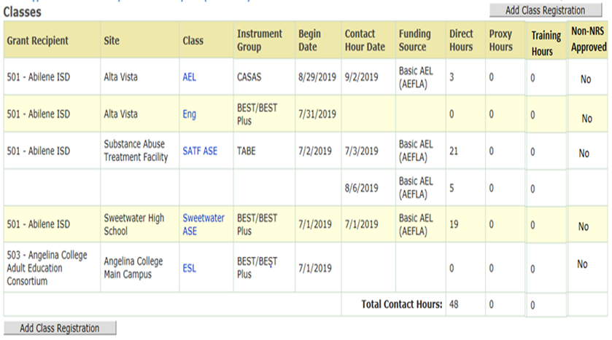
Participant Page New View
Access to see if student is in classes outside of your grantee
Better transparency for total instructional time between test
Addition of Training hours and Non NRS Approved class
Class Begin Date vs. First Contact Hour Date

Slide 8

Revised Participant Record Page
Notes:
Closer look at the prototype for the participant record page.
This combines information from the original classes header under the participant record page and the classes header under the pre/post testing page
Notice that we also added a column to indicate if the class and thus the contact hours are designated as Non NRS approved

Slide 9
Why Make This Change?
Making this change gives us more space on the Pre/Post Test page to create some exciting new features!
New features:
Program Year and Period of Participation View for all testing
Separation of testing by Content Area and Instrument groups
    Add in ‘Days Between Tests’ counter and modify the D+ P hours between tests to align to instrument and specific content area
Direct linkages to the Educational Outcomes page
Clear indication of just in time student performance and test validity

Slide 10
Program Year Option
Notes:
There are a few functionary changes that were made:
Change 1. You will now add all assessments/test from this page
Change 2: Users will be able to see all tests provided to a participant regardless of Grant Recipient who entered it
Change 3: Separation of each instrument group and content area so you can see from specific instrument and content area what progress has been made during the Program Year
Change 4: The “Made Gain’ column will indicate if the test in that row resulted in a basic education MSG/gain and the ‘PY Gain Applied’ column will tell you which program year it was applied to. This will allow you to see when a test being carried forward into a each program year that is acting as a baseline was a ‘progress’ test that resulted in a MSG/gain in a previous PY.

Slide 11
POP View
Notes:
This is all new information that will be available to users.
The first step is to select the Period of Participation (POP) you want to view from the drop down. The dropdown will include all existing periods of participation for the student as of the date you select this option.
Once you select the POP you want to view, the columns will populate with the corresponding data
In this example, you can see the participants testing and corresponding progress per how performance is measured under WIOA across multiple reporting years
Similarly to how the Program year information is delivered, users will see similar information in this section

Slide 12
Future Releases
What to Expect THIS YEAR
  Profile alignment to POPs
  Several data validation bugs
  Update PIRL
  Participant Note Page
  Enhanced Reports Experience—Disable/Modify Existing/Create New
  Future Enhancements
  Merge Participant Records—state level
  ITEC Page—create/modify
  Local User Admin Management—Pull active/inactive user reports, modify access
  Send other enhancement request to: TEAMS.technicalassistance@twc.state.tx.us
Notes:
It’s time to shift focus on future enhancements
<May take some questions, may not—depends on time>

Slide 13
Future Enhancements
Profiles Around Periods of Participation
Report Remediation and Creation

Slide 14
Profile Updates: High Level
Align Profiles to Periods of Participation (POPs)
  Grantees ‘share’ a profile (same as they do now), it is created at program entry
  Limits editing, maintain data integrity for reporting purposes
  Require a new Profile when ‘Exit Flag’ has been established regardless of PY
  If the person exits and returns to service in the same PY, serving Grantee will be able to create a new profile, but will be able to utilize an old profile and make updates instead of having to redo the full profile
  Automatically bring forward any valid profile when a participant is continuing across PY’s
  Add in additional joint reporting elements that are currently missing from our PIRL

Slide 15
Report Remediation : High-Level
Collaborative Project with Local Grantees, AEL/TWC Staff and DOI/TWC Staff
Decision Points:
Reports we want to disable
Reports we want to keep but align to current WIOA performance
New reports we need
    Decision Points about where these will be housed: TEAMS vs. Data Warehouse
    This will be a SIZABLE project

Slide 16

Questions

