Slide 1
TEAMS 3.8
The PoP’s Have Arrived!

Slide 2
The Basics
TEAMS version 3.8 will be released over the weekend, available early Monday, October 22
TEAMS will be down most of the weekend prior, beginning at 6:00 PM on Friday, October 19

Slide 3
What’s New in 3.8?
TEAMS now calculates an individual’s period of participation start and end dates
Planned gap functionality has been modified to align to period of participation start and end dates
The participant ID is now on the participant screen

Slide 4
Changes Part 1
Planned Gaps

Slide 5
The Planned Gap
Participants who have not received a qualifying service for a 90-day period, such as enrollment in coursework or an assessment, are automatically exited from the AEL program. Entering a planned gap in service into TEAMS reflects the participant’s commitment to continue enrollment and prevents automatic exit from the program and entrance into the denominator for exit-based measures.

Slide 6
What’s New With Planned Gaps
Planned gaps must be entered in month-long increments, and updated each month

Slide 7
Why?
1) This aligns Planned Gap functionality to other TWC systems
2) This prevents unintentional exit in the instance that a planned gap period is overlapped with service

Slide 8
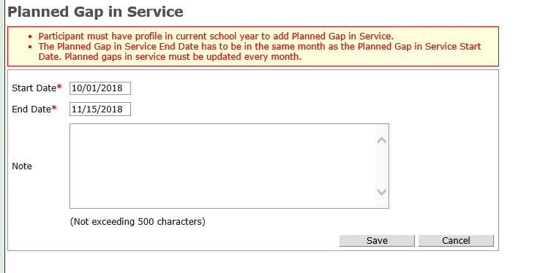
Refresher: Entering a Planned Gap
Step 1: From the Participant Screen, select “Add Gap in Service”
Step 2: Add a start date and end date. The gap end date cannot be in a new month
Important: The participant must be a participant (have 12 direct contact hours in their PoP) and have a current-year profile

Slide 9
What else do I need to know about planned gaps?
If you add a qualifying service during a planned gap, the planned gap date will be updated in TEAMS.
Qualifying services are:
1) Direct contact hours
2) Proxy contact hours
3) Training contact hours as outlined in AEL 01-18, change 1
4) Tests other than HSE tests
5) Career services other than orientation

Slide 10
Terminology
planned gap versus Planned Gap

Slide 11
Capital “P” Planned Gap
For the purposes of entry into TEAMS, every time you add a planned gap, we call it a planned gap
For the purposes of policy, a planned gap doesn’t really matter until it reaches 90 days (otherwise, the participant would not have exited anyway, so there was no need for a planned gap to be entered)
Planned Gaps (90+ days) and planned gaps (any planned gap entry) are all essentially treated the same in TEAMS in terms of not being able to overlap with qualifying services

Slide 12
Example – Adding Hours for Participant with a Planned Gap
This participant has a planned gap from 8/1 – 31 (we still call this a planned gap in TEAMS, even though it is not 90 days)

Slide 13
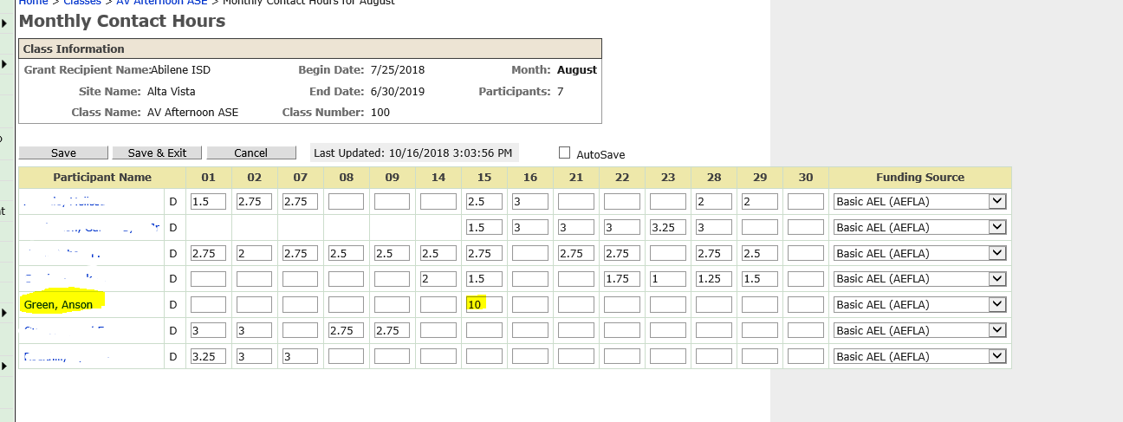
Example – Adding Hours for Participant with a Planned Gap (2)
This participant has hours added on August 15 (during the existing planned gap)

Slide 14
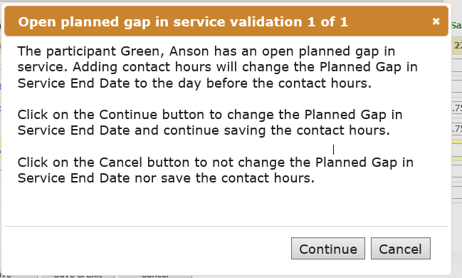
Example – Adding Hours for Participant with a Planned Gap 3
You will receive a notice from the system letting you know that this participant has a planned gap in place when you try to save these hours.
If you hit “continue” the planned gap date will be updated.
If you hit “cancel” you can modify the data (if, for example, you made a mistake)
If multiple participants in a class have a planned gap, you will receive multiple notices

Slide 15
Example – Adding Hours for Participant with a Planned Gap 4
A similar notice will appear if you try to add a test or a career service (other than orientation) during an existing planned gap.

Slide 16
Changes Part 2
Participant ID

Slide 17
The Participant ID
The participant ID is essentially the record number of a participant in TEAMS
So, for example, if Anson Green was the 1,900,000th entry into TEAMS, his participant ID would be 1900000
You can now see the participant ID in TEAMS on the profile screen and search for a participant with their ID
This is allows you to discuss/share information about a participant without sharing PII in email

Slide 18
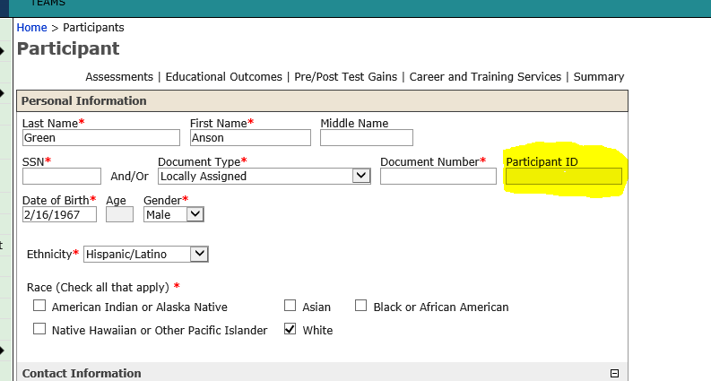
The Participant ID
The participant ID auto populates once you save the participant record
The participant ID does not replace an SSN or Document Number

Slide 19
Changes Part 3
PoPs

Slide 20
What is a Period of Participation?
Period of Participation (POP) begins each time an individual reaches 12 direct contact hours and is found eligible for AEL services by a pretest, and ends each time an individual goes 90 days without a participatory service.

Slide 21
Phasing Periods of Participation into TEAMS
TEAMS is built entirely around the concept of the “program year”
PoPs are huge and are being phased in
This is Phase 1
Phase 2 aligns assessments around PoPs so we can update all of the canned reports in TEAMS
Phase 3 aligns the participant profile to the PoP, not the program year

Slide 22
Phase 1 of PoP’s
The Participant Screen now shows all of the Periods of Participation an individual has had
You can pull two reports
The Period of Participation Report which shows you, for a selected period, the participants in your program
The Period of Participation extract which is like the report, but with more information about PoP’s

Slide 23
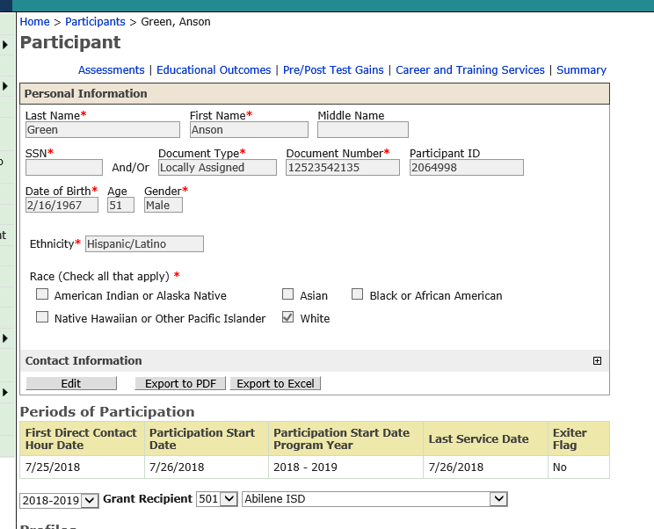
The Participant Screen
First Direct Contact Hour Date: The first date the participant got direct contact hours
Participation Start Date: The date the participant reached 12 direct contact hours
Participation Start Date Program Year: The year in which this particular PoP began
Last Service Date: The last date the participant received a qualifying service
Exiter Flag: Has there been 90 days since the last qualifying service? If yes, then the flag will be yes

Slide 24
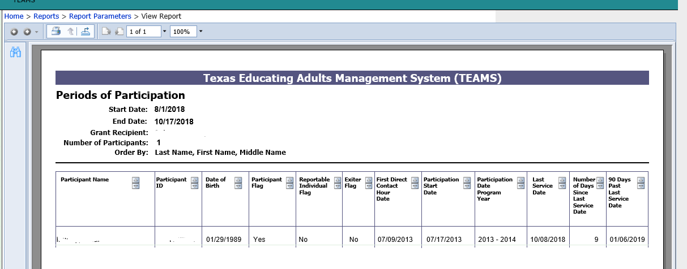
The Participant Report Summary
Can be found under Reports → Participants → Periods of Participation
Can be filtered by funding source, provider, site class and participant variables
Contains key participant information for purposes of day-to-day program management

Slide 25
The Participant Report Extract
Contains all the details about an individuals participation except assessments and outcomes/gains
We can’t update this until we update the way assessment are treated around the PoP’s in TEAMS

Slide 26
Running Either Report
You cannot pick a grant recipient until you’ve selected a start and an end date for the report
You can only run reports for a three-year period (this is the maximum system capacity for the largest grant recipient)

Slide 27
Running Either Report (2)
The grant recipients will filter for active grant recipients during the time period you select
If you need to run for multiple grant recipients, you’ll have to run multiple reports

Slide 28
Running Either Report (2)
The grant recipients will filter for active grant recipients during the time period you select
If you need to run for multiple grant recipients, you’ll have to run multiple reports

Slide 29
Running Either Report 3
The extract has a lot of information. You will need to be patient while the report runs.

Slide 30
Running Either Report 3
The filters you select matter. For example, if you select “IET (AEFLA) ” funding source only, the report will only pull contact hours associated with IET (AEFLA)

Slide 31
Running Either Report 5
The extract auto-selects to not-include SSN (last 4)
If you want to include last 4 of participant SSN’s, you will need to select it
The extract includes all reportable individuals (individuals with a baseline assessment and profile). If you just want to see participants (individuals with 12+ direct contact hours) you’ll need to select the “Participants” checkbox before running the extract
The report description explains what each of the columns in the report means

Slide 32
What’s Next?
Over the coming weeks we will be scheduling virtual, real-time training sessions that outline how to use and understand the reports. In the meantime, we encourage you to beginning trying them.
Individuals with accountability oversight or training responsibilities should attend one of the regional accountability events this fall. This is not a TEAMS training. Rather, these event explains the “why” of WIOA accountability and will help you better understand how periods of participation work with AEL performance.
If you need information on these events, please contact Carrie Tupa, carrie.tupa@twc.state.tx.us

Slide 33
Questions?
Please direct questions to your assigned program specialist, with a copy to Charmagne Coston, charmagne.coston@twc.state.tx.us

