Slide 1
TEAMS 2.11
Carrie Tupa
Strategic Planning and Accountability Coordinator
Adult Education and Literacy
Texas Workforce Commission
March 6, 2017
Notes:
Hello! This is Carrie Tupa from the Texas Workforce Commission, and this webinar will cover the TEAMs 2.11 release, which has changes that all TEAMS users need to know about.

Slide 2
TEAMS 2.11 Release (3/9/17)
The final regulations for WIOA and subsequent issuances of the PIRL (Participant Individual Record Layout) over the past year have included additional data elements we are required to collect
We will be phasing in additional data elements over the next six months
TEAMS 2.11 includes new profile data elements
For brand new data elements, they will not be required until July 1 to allow programs time to build them into their intake process
You should begin building them in as soon as possible
Notes:
The TEAMS 2.11 release will occur on the morning of March 9, 2017.
The final regulations for WIOA and subsequent issuances of the PIRL (the Participant Individual Record Layout) over the past year have included additional data elements we are required to collect
We will be phasing in additional data elements over the next six months in various releases of TEAMS
TEAMS 2.11 includes new profile data elements, but, while incredibly important that we collect this information, we are working the phase in these changes in a way that is most feasible for local programs.
We will be rolling out more trainings over the next six months to address more complicated TEAMs changes which, again, are the result of WIOA requirements, which are still being developed and released.
To best support local program implementation, the brand new data elements will not be required until July 1 to allow local programs time to build them into their intake process
Keep in mind, however, that these elements are required under WIOA, so you should begin building them in as soon as possible. We will be making these values required in a future release of TEAMS for PY 2017-2018

Slide 3
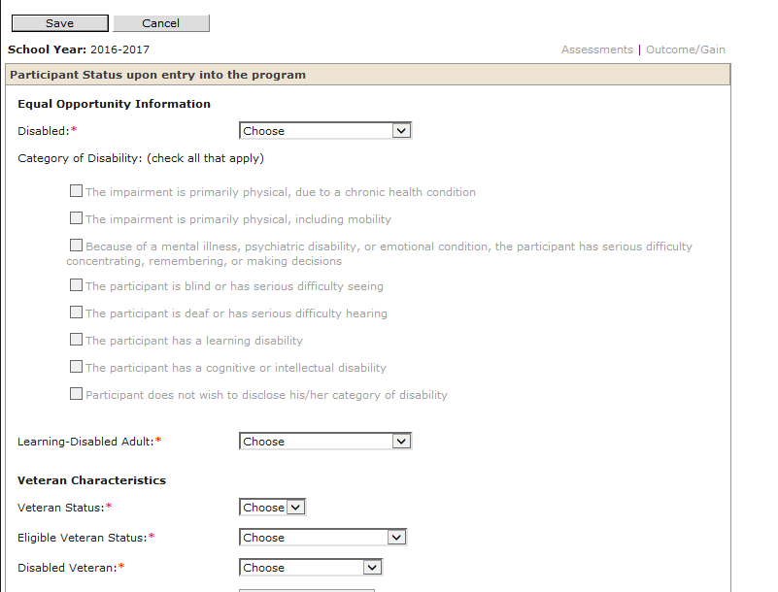
Participant Profile Screen
Notes:
The changes that we will be talking about in this release all affect the participant profile screen. Future changes will affect other areas of the system. Elements that are required (meaning you cannot save the profile without the element selected) are asterisked.

Slide 4
When will fields appear?
Participants with existing profiles are not affected by these changes, except
If you edit the profile
If there is existing data and the field has changed, there is a conversion value
You will see the fields when you add new profiles
Notes:
You have participants who already have profiles. Those profiles will not include these changes unless you click to edit the profile. For new required variables, you will be required to select a value before you can save the profile.
For new participants, you will have the option to select values for the new variables, but will also need to select a value for required variables.

Slide 5
Educational Attainment
Notes:
So, now to get into the new elements. The first new element is related to educational attainment.

Slide 6
New Data Element – Highest School Grade Completed
In the current TEAMS system there is one field under the participant profile screen – Highest Education Completed
The newest version of the PIRL splits this into two fields
Highest Grade Completed
Highest Education Level Completed
Notes:
Currently, you are required to select a value for highest education completed.
The lastest revised PIRL, however, contains two variables – highest school grade completed and highest education level completed.

Slide 7
Educational Attainment (1)
Highest school grade completed:
Highest grade 1-12 that an individual completed
Does not ask for the location
Highest education level completed:
Highest level beyond grade level that an individual completed
Example: HSE, Diploma, Certification
Still asks for whether it’s in/outside the US
Notes:
Highest school grade completed means the highest grade, 1-12, that and individual completed
The highest education level completed is the highest level beyond a school grade, that an individual completed. The highest school grade does not require a location (though, in the future, we may add in/out side of the US as this is valuable information)
The highest education level does contain the value of in/out of the US.

Slide 8
Educational Attainment (2)
Highest School Grade Completed
Highest Education Level Completed
First Grade Completed
Second Grade Completed
Third Grade Completed
Fourth Grade Completed
Fifth Grade Completed
Sixth Grade Completed
Seventh Grade Completed
Eighth Grade Completed
Ninth Grade Completed
Tenth Grade Completed
Eleventh Grade Completed
Twelfth Grade Completed
No School Grades Completed
Attained secondary school diploma
Attained a secondary school equivalency
The participant with a disability receives a certificate of attendance/completion as a result of successfully completing an Individualized Education Program (IEP)
Completed one of more years of postsecondary education
Attained a postsecondary technical or vocational certificate (non-degree)
Attained an Associate's degree
Attained a Bachelor's degree
Attained a degree beyond a Bachelor's degree
No Educational Level Completed
Notes:
Here, we have the values for 1-12th grade, or highest school grade completed, but there is also an option for no school grade completed
Then, we have the highest education value completed. Again, there is another option of no education level completed.
An important item to note here is that existing values have been appropriately mapped to new values, so while these options are different, you don’t have to do anything to existing profiles.

Slide 9
Requirements
Highest School Grade is not required in this release
Highest Education Level is required
BUT there is an option for “no education level completed”
Notes:
Let’s talk about requirements. While we understand the challenges around new required elements as you have worked to build your intake models, we need to begin to phase in necessary values.
For this release, the highest school grade is not required, but level is required. This is because we know many programs do not collect these items separately, and while you may have a grade, it would mean the individual didn’t complete anything beyond that grade – so you could enter “no education level completed” – but if you have the highest education level – for example, a diploma, you would have no value to guess for in the highest school grade.

Slide 10
Educational Attainment – New Participant Example
Example:
If an individual completed 8th grade, then got a HSE:
Highest school grade would be “8th grade completed”
Highest Education level would be “Attained a secondary school equivalency”
Notes:
This is a little complex, so let’s go through some examples.
If you have a new participant to enter, and that individual completed the 8th grade (and you had that information) before dropping out, then earned a high school equivalency, you would select “Attained a secondary school equivalency” for the highest education level.
In the instance you didn’t have a grade level, you could just leave that value blank.

Slide 11
Educational Attainment – Existing Participant Examples
Example: Participant’s original “Highest Education Completed” was “Attained GED or Equivalent”:
Leave the Highest School Grade completed blank unless you have this information
Their Highest Education Level completed becomes “Attained a secondary school equivalency”
Example: Participant’s original “Highest Education Completed” was “Eighth Grade Completed”
Highest School Grade completed would be “8th grade completed”
Highest Education level completed would be “No Education Level Completed”
Notes:
Let’s talk about some examples for existing participants, were you to need to edit a profile, which would contain these new values.
If a participant’s original highest education completed was attained GED or equivalent, you could Leave the Highest School Grade completed blank unless you have this information. Since this field is optional, you can leave it blank (until PY’17)
And Their Highest Education Level completed becomes “Attained a secondary school equivalency”
In this second Example, the Participant’s original “Highest Education Completed” was “Eighth Grade Completed”
So, their Highest School Grade completed would be “8th grade completed”
And their Highest Education level completed would be “No Education Level Completed”; you would have to select this value, because this field is required.

Slide 12
Requirements Reviewed
Highest School Grade is not required in this release
Highest Education Level is required
BUT there is an option for “no education level completed”
Notes:
So, to review,
For this release, the highest school grade is not required, but level is required. This is because we know many programs do not collect these items separately, and while you may have a grade, it would mean the individual didn’t complete anything beyond that grade – so you could enter “no education level completed” – but if you have the highest education level – for example, a diploma, you would have no value to guess for in the highest school grade.

Slide 13
School status at program entry
Notes:
The next new value is also required in this release, however, it is information you collect, you just might not collect it in this manner. As you will see, we’re providing some helpful “cheats” to assist you in data entry until you build you data collection and entry process adequately.

Slide 14
Requirements (2)
School status at program entry will be required, beginning in TEAMS 2.11, for all new participant profiles and when you edit a participant profile
This new field can be easily derived from existing data, however, it will take some preparation with your data entry staff
Notes:
So, again, School status at program entry will be required, beginning in TEAMS 2.11, for all new participant profiles and when you edit a participant profile
This new field can be easily derived from existing data, however, it will take some preparation with your data entry staff

Slide 15
Important definitions
Before we begin:
Adult education IS NOT “school” under WIOA
Postsecondary education IS “school” under WIOA
Notes:
First, I need to review some important definitions.
The purpose of this variable is to identify individuals as “in-school” or “out-of-school” – this is important for certain programs as we look at joint reporting, specifically the Title I youth program.
So, in WIOA – adult education is not considered “in-school” – however, postsecondary education is considered school. So, as soon as a participant either leaves adult education or co-enrolls while in adult education for postsecondary education, they are now in-school. This distinction is very important from a policy perspective, which we will further elaborate on as we develop future guidance, but is also important as you develop your data entry processes.

Slide 16
School Status at Program Entry (2)
For each new or edited participant you must select from:
In-school, Postsecondary school (would apply to referrals from college or individuals in IET)
Not attending school or Secondary school dropout (anyone without HSE or diploma; will apply to most of our participants)
Not attending school; secondary school graduate or has recognized equivalent (any of our participants who come in with an HSE or diploma)
Not attending school; within compulsory school attendance (anyone below 19 years of age)
Notes:
So, for each new and edited participant, you must select one of the following values:
In-school, Postsecondary school (would apply to referrals from college or individuals in IET)
Not attending school or Secondary school dropout (anyone without HSE or diploma; will apply to most of our participants)
Not attending school; secondary school graduate or has recognized equivalent (any of our participants who come in with an HSE or diploma)
Not attending school; within compulsory school attendance (anyone below 19 years of age)

Slide 17
Cheat Sheet
If their highest education level is… | And they are… | School status to enter is…
Not in college, No education level completed | Under 19 years of age | Not attending school; within compulsory age of attendance
Not in college, No education level completed | 19+ | Not attending school or secondary school dropout
Not in college, High school diploma, equivalency + | ALL AGES | Not attending school; secondary school graduate or has a recognized equivalent
Enrolled in college | ALL AGES | In-school, postsecondary school
Notes:
As I mentioned, this is somewhat difficult as you collect this information already, but this is a new way of capturing it in TEAMs, so we’ve developed this helpful cheat sheet to assist you/staff with data entry until you are able to add this into your data entry processes.
Following along the top row, the first column is the individuals education level, the second is their age, and the school status you would enter.
So, if the individual was not in college, had no education level completed (meaning less than a high school equivalency) and was below 19, you would select not attending school, within the compulsory age of attendance.
If the individual was not in collect, with less than a high school equivalency but was 19 or older, you would select not attending school or secondary school dropout.
The next two row are for all participant ages – an individual that is not in college and has a high school diploma, equivalent or higher, you would select “not attending school, secondary school graduate, or has a recognized equivalent”
Finally, any individual enrolled in college would be considered “in-school”, postsecondary.

Slide 18
Exhausting TANF
Notes:
Now lets move on to the next new field – Exhausting TANF

Slide 19
Exhausting TANF in 2 years
New data field
Will be optional in this release
Options are:
- Yes
- No
- Not applicable
Notes:
This value will be optional in this release, with the options are yes, no, or not applicable.

Slide 20
Important information
This field is for individuals on TANF
This is different than TANF eligibility as defined in AEL 01-15
You will have to verify this data with the TANF data which can be obtained in partnership with your Board
Notes:
It’s important to keep in mind that this field refers to actual TANF recipients, not TANF eligible, which is the definition you use when establishing TANF eligibility for your TANF-funded participants.
You will have to verify this data with the TANF data which can be obtained in partnership with your Board. Again, this value is optional until July 1.
While ‘not applicable” is an option, you should enter this until the individual is not on TANF. If you do not have the information, leave it blank. However, keep in mind that this value will be made mandatory in the future, so you need to start working now to obtain this information.

Slide 21
Job Corps Participant
Notes:
The next new field is for Job Corp participants.

Slide 22
Job Corp Participation
This field is optional in this release
For participant who have received services under Title 1, Chapter 4, Subtitle C of WIOA (Job Corps)
Options are:
Yes
No
Unknown
While this has an “unknown” option, this question should be added to your intake process before 7/1/17
Notes:
This field is optional in this release
For participant who have received services under Title 1, Chapter 4, Subtitle C of WIOA (Job Corps)
Options are:
Yes
No
Unknown
While this has an “unknown” option, this question should be added to your intake process before 7/1/17

Slide 23
Ex-Offender Status at Program Entry
Notes:
Next we have ex-offender status at program entry

Slide 24
Ex-offender status at Program entry (2)
Optional in this release
Options are:
Yes
No
Participant did not disclose
You need to add this into your intake by 7/1/17
Notes:
This field is Optional in this release
Options are:
Yes
No
Participant did not disclose
You need to add this into your intake by 7/1/17

Slide 25
Ex-offender status at Program entry: Definition
“Offender” definition:
participant is a person who either
has been subject to any stage of the criminal justice process for committing a status offense or delinquent act or
requires assistance in overcoming artificial barriers to employment resulting from a record of arrest or conviction for committing delinquent acts, such as crimes against persons, crimes against property, status offenses, or other crimes.
Notes:
What’s important in this field is the definition of ex-offender- as you build this field into your intake, you’ll want to make sure that you and your staff become familiar with this definition.
The other important piece of the definition is clarifying with participants why you are collecting this information. You will notice that the definition is EXTREMELY broad. You will want to reassure participants that this is not used in determining eligibility for this program or future employment. Rather, it’s a determination of potential barriers the individual might have.
So, the definition reads:
participant is a person who either
has been subject to any stage of the criminal justice process for committing a status offense or delinquent act or
requires assistance in overcoming artificial barriers to employment resulting from a record of arrest or conviction for committing delinquent acts, such as crimes against persons, crimes against property, status offenses, or other crimes.

Slide 26
Exporting participant profiles
Notes:
One exciting change that will be in this release is the ability to export participant profile information. The goal of this feature is to more easily share participant information across organizations.
At this time you can only export one profile at a time, as the number of decisions needed to determine exactly how to export a group of participants will require more development time. However, we hope this feature will be valuable to you.

Slide 27
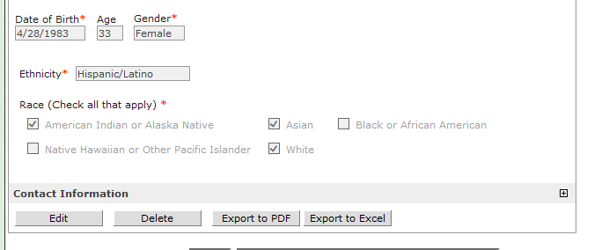
Export capability
Notes:
So, as you can see, from the primary part of the participant screen, you can select from two options: export to PDF and export to excel.

Slide 28
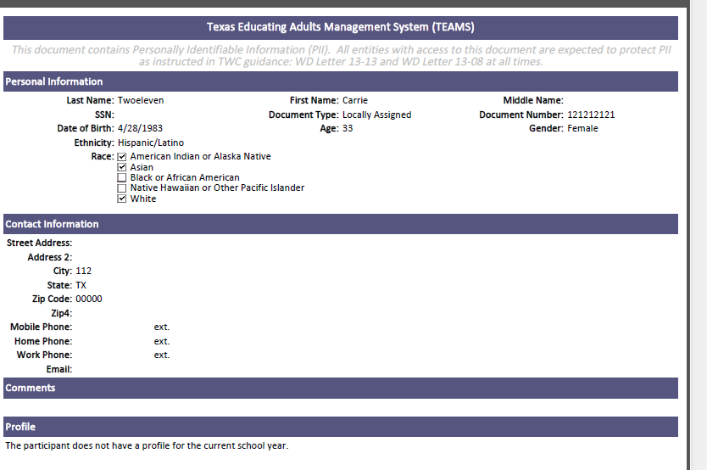
Export capability (cont’d)
You will only be able to export the most recent profile available.
Notes:
You can only export the most recently available profile. You can see here a sample of the export in PDF. You will notice at the top of the screen that there is an important privacy statement. This export will include all profile information, so it’s absolutely critical that you follow PII regulations.
However, you will NOT be able to see the full SSN, regardless of your role. The SSN will export as just the last 4 digits.

Slide 29
Export capability (cont’d) (2)
If no profile is available for the current year, you will receive a message that no profile is available
Notes:
This is a sample of the excel export. You will notice on both exports that if no profile is available in the current year, you cannot export.
We’ve had many requests for an import capability. It is in our development process, but is much more complex than anticipated…so, stay tuned!

Slide 30
Other issues addressed in TeAMS 2.11
Notes:
In addition to enhancements, we’ve addressed several issues in TEAMS.

Slide 31
Other issues addressed
Error when adding staff member after an inactive year
Addresses issue when staff member didn’t have required staff development in active year
TEAMS treats staff member as “new”
Error when adding end date to staff assigned to a class
Fix recognizes end-date of class, which needs to be before the end-date you add to the staff
Notes:
Error when adding staff member after an inactive year
Addresses issue when staff member didn’t have required staff development in active year
TEAMS treats staff member as “new”
Error when adding end date to staff assigned to a class
Fix recognizes end-date of class, which needs to be before the end-date you add to the staff

Slide 32
Questions?
Teams.technicalassistance@twc.state.tx.us
Your program specialist
Notes:
This concludes the webinar. If you have questions, please contact TEAMS technical assistance or your assigned program specialist.
Thank you so much, and have a great day!

