Slide 1
Defining Student Success in WIOA*
Series Webinar 5
Implementing the Participant Individual Record Layout (PIRL) A Quality Model for Student Success
Carrie Tupa Texas Workforce Commission March 24, 2016

Slide 2
WIOA Update: implementing the Participant Individual Record Layout (PIRL) Quality Model for Student Success
Carrie Tupa
Strategic Planning and Accountability Coordinator
Adult Education and Literacy

Slide 3
About this webinar
What it is…
What it isn’t…
An introduction to data collection requirements under WIOA
A place to start thinking about a holistic, student success focused, “quality” intake model
Training on how to implement data collection under WIOA
The end-all be-all for WIOA data collection and reporting preparation

Slide 4
Section 1: What is the PIRL?

Slide 5
What is the Participant Individual Record Layout (PIRL)?
In short, the PIRL are the required elements for reporting under the Workforce Innovation and Opportunity Act (WIOA)
The PIRL specifies specific data elements, how those elements are defined and how those elements are reported for all core programs
Under WIOA, there is an aligned accountability system across all core programs
Title I Adult and Dislocated Worker and Youth Programs
Title II Adult Education and Literacy
Title III Wagner-Peyser
Title IV Vocational Rehabilitation Services

Slide 6
What types of performance are reported under WIOA?
In general, WIOA requires that the following indicators of performance be reported:
(A) (i) I (I) the percentage of program participants who are in unsubsidized employment during the second quarter after exit from the program
(II) the percentage of program participants who are in unsubsidized employment during the fourth quarter after exit from the program
(III) the median earnings of program participants who are in unsubsidized employment during the second quarter after exit from the program
(IV) the percentage of program participants who obtain a recognized postsecondary credential, or a secondary school diploma or its recognized equivalent (subject to clause (iii)), during participation in or within 1 year after exit from the program
(V) the percentage of program participants who, during a program year, are in an education or training program that leads to a recognized postsecondary credential or employment and who are achieving measurable skill gains toward such a credential or employment
(VI) the indicators of effectiveness in serving employers established pursuant to clause (iv).

Slide 7
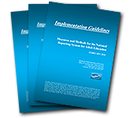
Is Reporting the same for all WIOA core programs?
Yes and no…
WIOA aligns accountability systems, however, individual Federal Agencies may specify unique reporting requirements
The Department of Education (ED) outlines requirements specific to Title II in the National Reporting System (NRS) Guidelines
NRS Guidelines have been revised, but are not final under WIOA

Slide 8
From Joint Reporting Supporting Statement…
SUPPORTING STATEMENT WIOA Annual State Performance Report Template, WIOA Annual Local Area Performance Report Template, WIOA Eligible Training Provider (ETP) Performance Report Template, WIOA Joint Participant Individual Record Layout (PIRL), and WIOA Data Element Specifications
OMB CONTROL No. 1205-0NEW
“The Office of Career, Technical, and Adult Education (OCTAE) will modify its currently-approved information collection instrument, which obtains aggregate data from States using a set of reporting tables developed by The Department of Education (ED) (Implementation Guidelines: Measures and Methods for the National Reporting System for Adult Education, OMB Control No. 1830-0027). For the purposes of the Adult Education and Family Literacy Act (AEFLA) program, States will be required to complete and submit the WIOA Annual State Performance Report template, in addition to the aggregate data tables that States are required to submit to OCTAE under OMB Control No. 1830-0027”
Full statement available here: https://www.doleta.gov/performance/pdf/Federal%20Register%20-%20Joint%20Performance%20ICR%20Supporting%20Statement.pdf

Slide 9
How is PIRL Data Used?
Basic understanding of service delivery and participant characteristics
PIRL data affects targets
As part of the performance accountability requirements, WIOA requires the use of a statistical adjustment model for setting targets for the core performance indicators
Factor data collected in the PIRL directly affects our statewide targets

Slide 10
Statistical Adjustment Model
Model based on differences in economic conditions and characteristics of participants, including:
Indicators of poor work history
Low levels of literacy
Low levels of English proficiency
Lack of educational or occupational skills attainment
Disability status
Homelessness
Ex-offender status
Welfare dependency
Barriers to employment (including cultural)
Dislocation from high-wage and high-benefit employment

Slide 11
Section 2: How is the PIRL “Different”?

Slide 12
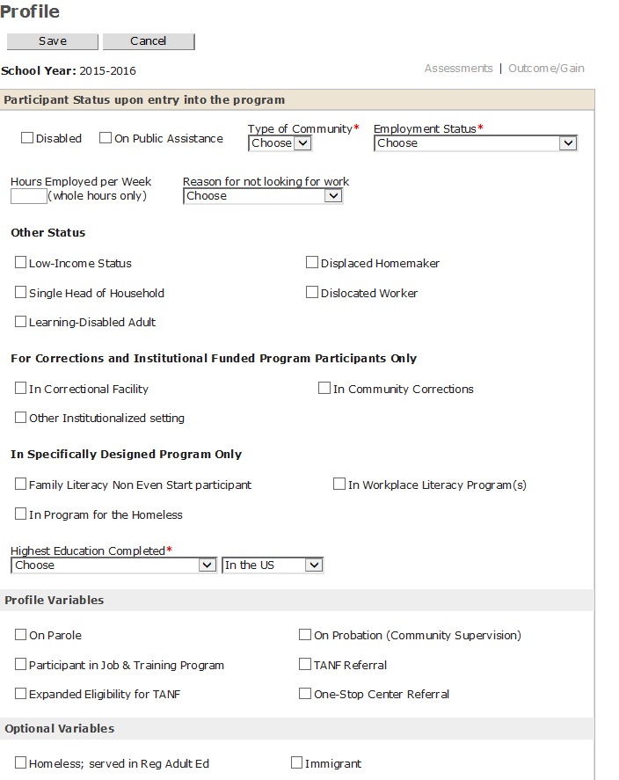
Example

Slide 13
Example(2)
According to the PIRL…
Record 1 if the participant indicates that he/she has any "disability”, as defined in Section 3(2)(a) of the Americans with Disabilities Act of 1990 (42 U.S.C. 12102). Under that definition, a "disability" is a physical or mental impairment that substantially limits one or more of the person's major life activities.
Record 0 if the participant indicates that he/she does not have a disability that meets the definition.
Record 9 if the participant does not wish to disclose his/her disability status.

Slide 14
Quality Model for Student Success
As part of data collection, programs:
Must make time to ask each of the PIRL fields as a question
Must make time to clarify each response
This means a need for a holistic, student success-focused, intake model

Slide 15
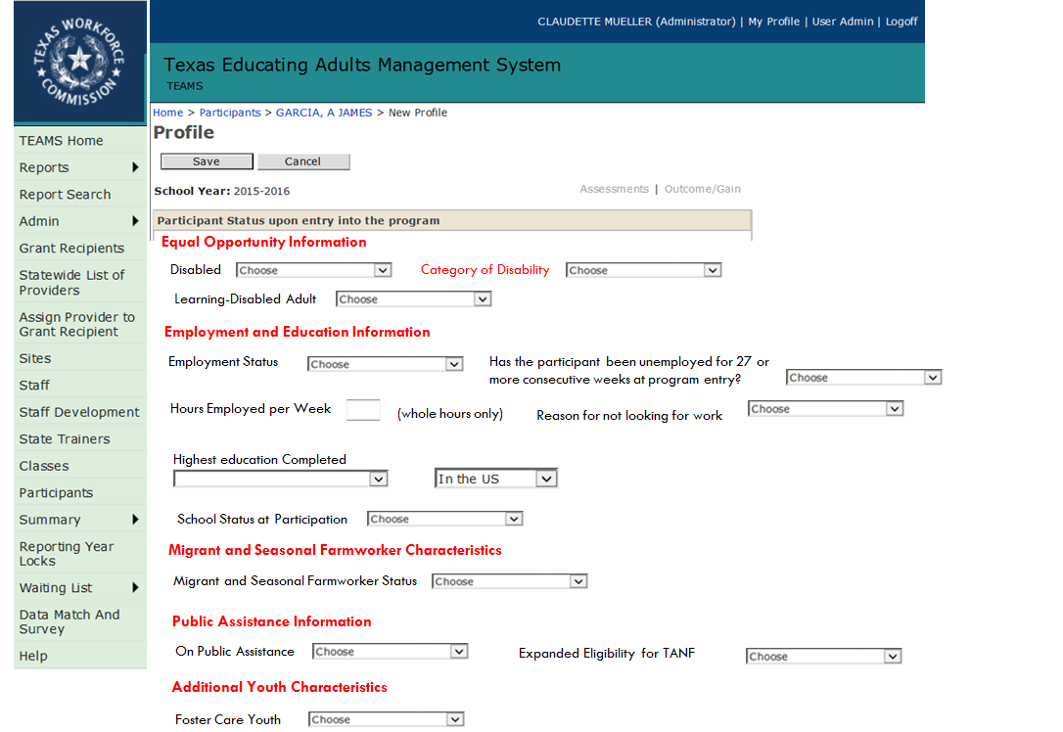
“New” TEAMS

Slide 16
What is meant by “Quality Intake for Student Success”
More akin to intake done for other workforce programs
In workforce, model is used to determine eligibility for various services, but also to assist in making referrals
WIOA performance metrics require ongoing monitoring of participant activities and performance past achievement of the high school equivalency
Must ensure route to success in entering and completing postsecondary education/training and/or employment!

Slide 17
What you told us…

Slide 18
What you told us…(2)

Slide 19
What are the Data Fields?

Slide 20
PIRL data Fields
What we know…
What we don’t know..
Draft regulations for the PIRL have been published
Final regulations are scheduled to come out sometime this summer
“Intake” for AEL will need to be adapted (to what extent we don’t yet know!)
What the final regulations are
What the final regulations will say about data collection for AEL
How the PIRL will be tied into the NRS
How best to collect/when to collect the information during peak enrollment periods

Slide 21
Draft regulations for PIRL have been published
Official draft version of the PIRL can be found here:
https://www.doleta.gov/performance/pdf/WIOA_PIRL.pdf
We have a draft information sheet for AEL providers; we will provide information how to access it at the end of this webinar.

Slide 22
Final Regulations are scheduled to come out this summer
We’ve begun changes in TEAMS scheduled to be released 6/23/16 based on draft regulations
AEL grant recipients need to plan to have a modified intake process beginning 7/1/16

Slide 23
AEL Intake will need to be adapted
We will share the draft regulations, but you should not begin printing materials until final regulations have been approved
AEL Student Success Quality model road show will be coming to a city near you in May – June
We will release locations in the next week
These sessions will be focused on how to conduct intake, how to design a student success quality intake model, and how to use the information gathered to improve participant success and retention
You can attend any session that is convenient for you

Slide 24
AEL Quality Model for Student Success Road Show

Slide 25
Who Should Attend?
Directors, supervisors, and any staff involved in participant intake/registration
Partner staff involved in participant intake/registration
Board partners

Slide 26
What will be covered?
Up-to-date information on required data collection
Best-practices in “intake”
Ideas for incorporating detailed intake into your registration process
Ways to ask questions to collect required information
Time to plan/discuss/prepare for implementing a quality model in your program
Changes to the AEL assessment guide to address WIOA
Requirements around protecting Personally Identifiable Information (PII)

Slide 27
Follow-up Documents and Next Steps
Complete the follow-up survey located at:
https://www.surveymonkey.com/r/AELPIRL
We will send you the draft AEL PIRL fields and a questionnaire to help you prepare for the road-show events

Slide 28
Questions?
Please use the survey for this webinar to submit questions so that we can respond with a Q&A to all participants.
https://www.surveymonkey.com/r/AELPIRL

