Slide 1
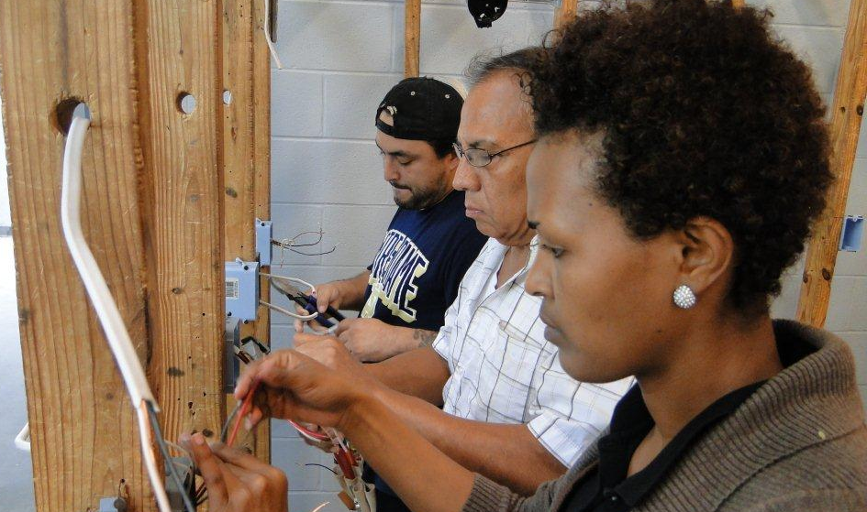
Integrated English Literacy Civics Education
Series Webinar 2
Defining Student Success in WIOA
The webinar will begin shortly. Please mute your phone/computer mic
To access webinar audio via phone:
1-877-820-7831
Code:557206#
Anson Green Director Adult Education and Literacy Texas Workforce Commission
February 3, 2016

Slide 2
Integrated English Literacy Civics Education (2)
Series Webinar 2
Defining Student Success in WIOA
Anson Green Director Adult Education and Literacy Texas Workforce Commission
February 3, 2016

Slide 3
Overview
WIOA Overview
English Language Learners in Texas
OCTAE Guidance Memo 15-7
English Language Acquisition Under WIOA
Reading the Law
Definition Integrated English Literacy Civics Education
WIA vs WIOA: Integrated English Literacy Civics Education
WIOA Section 231 and 243
Implementation: How will we do this?

Slide 4
WIOA Overview
Section 1

Slide 5
WIOA underscores What we have been doing
The law positions Adult Education and Literacy to:
Play an integral role within a broader, interconnected workforce development system
Deliver greater access to educational services for our customers through the Texas Workforce Solutions delivery system
Increase opportunities for a broader array of services available to students
Promote transitions at all levels to postsecondary education and training or employment
Notes:
WIOA strategically positions Adult Education and Literacy to play an integral role within a broader, interconnected workforce development system. This position will deliver greater access to educational services for our customers through the Texas Workforce Solutions delivery system and increase opportunities for a broader array of services available to students.
While the law aligns all program workforce and education services in many exciting and unprecedented ways, there are several notable enhancements we must embrace, plan, and prepare our programs for.
Under WIOA Adult Education and Literacy is expanded to place a focus on services that promote integration with and transitions to postsecondary education and training or employment. This shift in programmatic in philosophy is apparent throughout the law.
Many familiar programs, like EL Civics, that we are talking about today, , are now expanded and enhanced providing greater services options to support students toward their career and higher education and training goals.

Slide 6
Expanded Local Activities
Creates three new allowable activities that support student success
Workforce Preparation Activities, including Digital Literacy
Integrated Education and Training
Integrated English Literacy and Civics Education
Notes:
The law creates three new activities where we see some exciting new areas of development.
The first is workforce preparation activities, including digital literacy, integrated education and training, and finally the integrated English Literacy and Civics program that we are discussing today.

Slide 7
Call to Action & Innovation
WIOA reconceives EL/Civics as a comprehensive workforce development program
Significant transformation from what we have understood El Civics to be
Broadly expands, not limits, options available for English language learners by opening access to funding workforce training
A Call to Action so that programs and professional development systems be in place to not only recruit for, and deliver required services to students but that we can train teachers for the new model
Notes:
This is a call to action and a call for innovation
EL/Civics, now called Integrated English Literacy and Civics Education, is a familiar program model that will undergo a significant transformation from what we have understood El Civics program to be.
WIOA reconceives EL/Civics as a comprehensive workforce development program and makes other enhancements including emphasizing a focus on serving professionals with degrees and credentials in their native countries.
Of all the changes under Title II of WIOA, the changes to the traditional EL/Civics are perhaps the most impactful, and programs and professional development systems must place a priority on what changes are needed to not only recruit for, but to deliver and train teachers for the new model.

Slide 8
English Language Learners in Texas Source, Migration Policy Institute 2015
Section 2

Slide 9
Texas Foreign Born are Working Age
Age | Number | Percentage
16+ years (Total Population) | 3,936,000 | 100%
16 to18 | 110,000 | 3%
19 to 24 | 335,000 | 9%
25 to 44 | 1,878,000 | 48%
45 to 49 | 1,030,000 | 26%

Slide 10
Texas Foreign Born are Mostly from Latin America
Regions of Birth | Number | Percent
Latin America | 2,852,000 | 72%
Asia | 736,000 | 19%
Europe | 172,000 | 4%
Africa | 127,000 | 3%
Other | 41,000 | 2%
Notes:
It is also no surprise that the vast majority of these individuals are from Latin America. This will prove useful for programs considwering or doing bilingual workforce training and supporting students in Spanish language high school equivalency.

Slide 11
Texas Foreign Born as Big as those without a high school equivalency
Texans | No high school diploma or equivalency
Total under-educated | 3,360,000
English language learners 19+ years | 1,642,000
Notes:
Nearly half the state’s low-educated in Texas are also foreign born and the majority of these English Language Learners

Slide 12
Many Texas Foreign Born are well educated
English Language Learners | Educational attainment
563,000 | Have a high school diploma / equivalency
552,000 | Have some college, associate’s or bachelor’s degree or higher
Notes:
Over 1 million have HS or higher
These customers benefit from more accelerated instructional models
This is a group we need to appeal too as the Integrated English Literacy Civics Education model I will be discussing today is one for which these individuals will be very well suited. The law actually mentions this group in particular as a target student population

Slide 13
Data Source
Fact Sheet: Immigration and WIOA Services: Migration Policy Institute 2015
Discussion Forum: Understanding the Department of Education’s FAQ Memorandum on IELCE @ http://www.migrationpolicy.org
Notes:
Data fact sheet and discussion forum

Slide 14
OCTAE Guidance Memo 15-7
Section 3

Slide 15
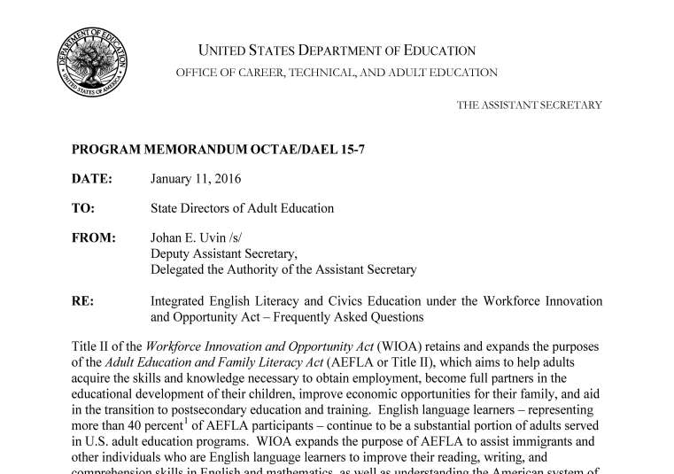
OCTAE Guidance Memo 15-7 (2)
Notes:
Released on January 11, 2016, the Department of Education released a memo attempting to resolve confusion about subtleties in WIOA’s treatment of Integrated English Literacy and Civics Education (IELCE). I’ll be describing these subtleties in more detail in a moment.

Slide 16
OCTAE Guidance Memo 15-7 (3)
“The purpose of this memorandum is to clarify statutory provisions related to the expanded use of integrated English literacy and civics education (IEL/CE)…”
Notes:
The main point, which this memo clarifies, has to do with how the law describes EL/Civics programming and whether or not such programs must include integrated education and training.

Slide 17
OCTAE Guidance Memo 15-7 (4)
Clarifies two distinct allowable activities targeted at English Language Learners:
English language acquisition (ELA, formerly ESL)
Integrated English Literacy Civics Education (IEL/CE)
Very subtle interpretation that has confounded many following the law
Support July 1 2016 implementation
Notes:
In addition to Integrated English Literacy Civics Education, the memo underscores and clarifies distinct allowable activities targeted at English Language Learners under the English language acquisition activities. Formerly known as ESL.
We were relived at the release of this memo as we were considering well what guidance to release to grantees for July 1 implementation of this new program.

Slide 18
English language acquisition Under WIOA
Section 4

Slide 19
How is ELA Different from ESL?
ESL under WIA
ELA under WIOA

Slide 20
How is ELA Different from ESL? (1)
ESL under WIA
ELA under WIOA
Focused on instruction designed to help English Language Learners achieve competence in the English language.

Slide 21
How is ELA Different from ESL? (2)
ESL under WIA
ELA under WIOA
Focused on instruction designed to help English Language Learners achieve competence in the English language.
Focuses on helping English language learners achieve competence in reading, writing, speaking, and comprehension of the English language.

Slide 22
How is ELA Different from ESL? (3)
ESL under WIA
ELA under WIOA
Focused on instruction designed to help English Language Learners achieve competence in the English language.
Focuses on helping English language learners achieve competence in reading, writing, speaking, and comprehension of the English language.

Slide 23
How is ELA Different from ESL? (4)
ESL under WIA
ELA under WIOA
Focused on instruction designed to help English Language Learners achieve competence in the English language.
Focuses on helping English language learners achieve competence in reading, writing, speaking, and comprehension of the English language.

Slide 24
How is ELA Different from ESL? (5)
ESL under WIA
ELA under WIOA
Focused on instruction designed to help English Language Learners achieve competence in the English language.
Focuses on helping English language learners achieve competence in reading, writing, speaking, and comprehension of the English language.

Slide 25
How is ELA Different from ESL? (6)
ESL under WIA
ELA under WIOA
Focused on instruction designed to help English Language Learners achieve competence in the English language.
Focuses on helping English language learners achieve competence in reading, writing, speaking, and comprehension of the English language.
Requires that the program must lead to attainment of a secondary school diploma or its recognized equivalent, and transition to postsecondary education and training, or employment.

Slide 26
How is ELA Different from ESL? (7)
ESL under WIA
ELA under WIOA
Focused on instruction designed to help English Language Learners achieve competence in the English language.
Focuses on helping English language learners achieve competence in reading, writing, speaking, and comprehension of the English language.
Requires that the program must lead to attainment of a secondary school diploma or its recognized equivalent, and transition to postsecondary education and training, or employment.

Slide 27
How is ELA Different from ESL? (8)
ESL under WIA
ELA under WIOA
Focused on instruction designed to help English Language Learners achieve competence in the English language.
Focuses on helping English language learners achieve competence in reading, writing, speaking, and comprehension of the English language.
Requires that the program must lead to attainment of a secondary school diploma or its recognized equivalent, and transition to postsecondary education and training, or employment.

Slide 28
How is ELA Different from ESL? (9)
The law disrupts historical ESL models based on education-for-education sake
Future is “English for what?”
Working toward high school equivalency (1,642,000 eligible students)
Transition to postsecondary education and training
Employment
Curriculum, program models, and professional development must be significantly redesigned and aligned to these objectives
AEL Standards work is underway at Texas State

Slide 29
Reading the Law
Section 5

Slide 30
Programs, Activities, and Definitions
Understanding the interplay of Programs, Activities, and Definitions will help you understand the options available for implementing Integrated English Literacy Civics Education program
Notes:
Turn you into policy wonks for a minute.

Slide 31
Programs, Activities, and Definitions (1)
Definitions are…well…definitions
Programs and activities take some explanation

Slide 32
Activities versus programs
Activity
Activity
Activity

Slide 33
Activities versus programs (1)
Program
Activity
Activity
Activity

Slide 34
Programs & Activities
Programs and Activities
Programs made up of activities
Example:
SEC. 225. Programs for Corrections Education and Other Institutionalized Individuals
Programs include activities
Corrections
Adult Education and Literacy
Re-entry Initiatives
Post-release Services
Notes:
Understanding the differences between Program and Activities is critical to develop an understanding of how to implement the new Integrated English Literacy Civics Education program and especially when the program must include a workforce training and when it can be done without training. This difference is critical to your program planning, costs, program outreach and alignments with the Workforce Solutions system.

Slide 35
Programs & Activities
Required and Permissive Activities
Activities may be required or permissible in programs
Example:
SEC. 223. State Leadership Activities
Providing professional Development is required
Identifying curriculum frameworks and aligning rigorous content standards is permissible
Required Activity
Professional development services
Permissive Activity
Curriculum frameworks and aligning rigorous content standards

Slide 36
Programs & Activities
Understanding program and activities is instrumental in understanding the options available to programs when implementing the Integrated English Literacy Civics Education program next year.

Slide 37
Definition Integrated English Literacy Civics Education
Section 6

Slide 38
Definition
(12) INTEGRATED ENGLISH LITERACY AND CIVICS EDUCATION.—
means education services provided to English language
learners who are adults, including professionals with degrees
and credentials in their native countries, that enables such
adults to achieve competency in the English language and
acquire the basic and more advanced skills needed to function
effectively as parents, workers, and citizens in the United
States. Such services shall include instruction in literacy and
English language acquisition and instruction on the rights and
responsibilities of citizenship and civic participation, and may
include workforce training.

Slide 39
Definition (2)
(12) INTEGRATED ENGLISH LITERACY AND CIVICS EDUCATION.—
means education services provided to English language
learners who are adults, including professionals with degrees
and credentials in their native countries, that enables such
adults to achieve competency in the English language and
acquire the basic and more advanced skills needed to function
effectively as parents, workers, and citizens in the United
States. Such services shall include instruction in literacy and
English language acquisition and instruction on the rights and
responsibilities of citizenship and civic participation, and may
include workforce training.

Slide 40
Definition (3)
(12) INTEGRATED ENGLISH LITERACY AND CIVICS EDUCATION.—
means education services provided to English language
learners who are adults, including professionals with degrees
and credentials in their native countries, that enables such
adults to achieve competency in the English language and
acquire the basic and more advanced skills needed to function
effectively as parents, workers, and citizens in the United
States. Such services shall include instruction in literacy and
English language acquisition and instruction on the rights and
responsibilities of citizenship and civic participation, and may
include workforce training.

Slide 41
Definition (5)
(12) INTEGRATED ENGLISH LITERACY AND CIVICS EDUCATION.—
means education services provided to English language
learners who are adults, including professionals with degrees
and credentials in their native countries, that enables such
adults to achieve competency in the English language and
acquire the basic and more advanced skills needed to function
effectively as parents, workers, and citizens in the United
States. Such services shall include instruction in literacy and
English language acquisition and instruction on the rights and
responsibilities of citizenship and civic participation, and may
include workforce training.

Slide 42
Definition (6)
(12) INTEGRATED ENGLISH LITERACY AND CIVICS EDUCATION.—
means education services provided to English language
learners who are adults, including professionals with degrees
and credentials in their native countries, that enables such
adults to achieve competency in the English language and
acquire the basic and more advanced skills needed to function
effectively as parents, workers, and citizens in the United
States. Such services shall include instruction in literacy and
English language acquisition and instruction on the rights and
responsibilities of citizenship and civic participation, and may
include workforce training.

Slide 43
Definition (7)
(12) INTEGRATED ENGLISH LITERACY AND CIVICS EDUCATION.—
means education services provided to English language
learners who are adults, including professionals with degrees
and credentials in their native countries, that enables such
adults to achieve competency in the English language and
acquire the basic and more advanced skills needed to function
effectively as parents, workers, and citizens in the United
States. Such services shall include instruction in literacy and
English language acquisition and instruction on the rights and
responsibilities of citizenship and civic participation, and may
include workforce training.

Slide 44
Definition (8)
(12) INTEGRATED ENGLISH LITERACY AND CIVICS EDUCATION.—
means education services provided to English language
learners who are adults, including professionals with degrees
and credentials in their native countries, that enables such
adults to achieve competency in the English language and
acquire the basic and more advanced skills needed to function
effectively as parents, workers, and citizens in the United
States. Such services shall include instruction in literacy and
English language acquisition and instruction on the rights and
responsibilities of citizenship and civic participation, and may
include workforce training.
Notes:
This is a definition and the definition applies to the whole law. The inclusion of a permissive “may” here is important. Keep this in mind as we turn our attention to the two applicable sections of the law.

Slide 45
WIOA Section 231 and 243
Section 7

Slide 46
WIOA Section 231 and 243 (1)
Understanding the two sections, and associated funding, is critical.
Bottom line:
IEL/CE can be funded through both section 231 and 243 funds
Depending on how programs fund IEL/CE determines if the program must be integrated with Integrated Education and Training
Notes:
Let’s do some policy detective work and review the law in light of the OCTAE memo.

Slide 47
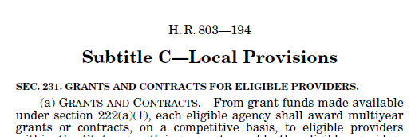
Section 231

Slide 48
Section 231 (2)
Outlines local Adult Education and Literacy program requirements
(b) REQUIRED LOCAL ACTIVITIES.—The eligible agency shall
require that each eligible provider receiving a grant or contract
under subsection (a) use the grant or contract to establish or operate
programs that provide adult education and literacy activities,
including programs that provide such activities concurrently.
Notes:
Section 231 define the main Adult Education and Family Literacy Act program for Adult Education and Literacy program. Recall that “Programs” are made up of activities, and activities may be required or permissible in programs.
So what are Adult Education and Literacy “Activities”?

Slide 49
Summary (7)
Section 231 (Primary AEFLA Funding)
adult education
literacy
workplace adult education and literacy activities
family literacy activities
These are activities. Integrated English Literacy Civics Education can be funded individually as an activity under Section 231 funding
English language acquisition activities
integrated English literacy and civics education
workforce preparation activities
integrated education and training
Notes:
By listing Integrated English Literacy Civics Education as an allowable activity, it means that programs may implement Integrated English Literacy Civics Education with their regular AEFLA funds, but just their Civics funds. This flexibility is important to keep in mind as we read further into the law.

Slide 50
WIOA Section 243
Notes:
Now let’s look at Section 243.

Slide 51
Section 243 Integrated English Literacy Civics Education
Notes:
Prior to WIOA English Literacy Civics was not in WIA but rather funded annually through the federal appropriation. It is now codified in WIOA.

Slide 52
Section 243 Integrated English Literacy Civics Education (1)
SEC. 243. INTEGRATED ENGLISH LITERACY AND CIVICS EDUCATION.
(a) IN GENERAL.—From funds made available under section 211(a)(2) for each fiscal year, the Secretary shall award grants to States, from allotments under subsection (b), for integrated English literacy and civics education, in combination with integrated education and training activities.

Slide 53
Section 243 Integrated English Literacy Civics Education (2)
SEC. 243. INTEGRATED ENGLISH LITERACY AND CIVICS EDUCATION.
(a) IN GENERAL.—From funds made available under section 211(a)(2) for each fiscal year, the Secretary shall award grants to States, from allotments under subsection (b), for integrated English literacy and civics education, in combination with integrated education and training activities.

Slide 54
Section 243 Integrated English Literacy Civics Education (3)
SEC. 243. INTEGRATED ENGLISH LITERACY AND CIVICS EDUCATION.
(a) IN GENERAL.—From funds made available under section 211(a)(2) for each fiscal year, the Secretary shall award grants to States, from allotments under subsection (b), for integrated English literacy and civics education, in combination with integrated education and training activities.

Slide 55
Section 243 Integrated English Literacy Civics Education (4)
SEC. 243. INTEGRATED ENGLISH LITERACY AND CIVICS EDUCATION.
(a) IN GENERAL.—From funds made available under section 211(a)(2) for each fiscal year, the Secretary shall award grants to States, from allotments under subsection (b), for integrated English literacy and civics education, in combination with integrated education and training activities.
Notes:
When funded with Civics funding under Section 243, all Integrated English Literacy Civics Education programs must
Incorporate Integrated Education and Training in their program designs.

Slide 56
Section 243 Integrated English Literacy Civics Education (6)
The GOAL under Integrated English Literacy Civics Education is also critical to understanding how we must implement the program.

Slide 57
Section 243 Integrated English Literacy Civics Education (5)
(c) GOAL.—Each program that receives funding under this section
shall be designed to—
(1) prepare adults who are English language learners for,
and place such adults in, unsubsidized employment in in-demand
industries and occupations that lead to economic self-sufficiency;
and
(2) integrate with the local workforce development system
and its functions to carry out the activities of the program.

Slide 58
Section 243 Integrated English Literacy Civics Education (6)
(c) GOAL.—Each program that receives funding under this section
shall be designed to—
(1) prepare adults who are English language learners for,
and place such adults in, unsubsidized employment in in-demand
industries and occupations that lead to economic self-sufficiency;
and
(2) integrate with the local workforce development system
and its functions to carry out the activities of the program.

Slide 59
Section 243 Integrated English Literacy Civics Education (7)
(c) GOAL.—Each program that receives funding under this section
shall be designed to—
(1) prepare adults who are English language learners for,
and place such adults in, unsubsidized employment in in-demand
industries and occupations that lead to economic self-sufficiency;
and
(2) integrate with the local workforce development system
and its functions to carry out the activities of the program.

Slide 60
Summary
Section 231 (Primary AEFLA Funding)
Section 243
(IEL/CE Funding)

Slide 61
Summary (1)
Section 231 (Primary AEFLA Funding)
Section 243
(IEL/CE Funding)
From IEL/CE Definition:
“Such services shall include ①instruction in literacy and English language acquisition and ②instruction on the rights and responsibilities of citizenship and civic participation, and may include workforce training.”

Slide 62
Summary (2)
Section 231 (Primary AEFLA Funding)
Section 243
(IEL/CE Funding)
From IEL/CE Definition:
“Such services shall include ①instruction in literacy and English language acquisition and ②instruction on the rights and responsibilities of citizenship and civic participation, and may include workforce training.”

Slide 63
Summary (3)
Section 231 (Primary AEFLA Funding)
Section 243
(IEL/CE Funding)
From IEL/CE Definition:
“Such services shall include ①instruction in literacy and English language acquisition and ②instruction on the rights and responsibilities of citizenship and civic participation, and may include workforce training.”

Slide 64
Summary (4)
Section 231 (Primary AEFLA Funding)
Section 243
(IEL/CE Funding)
From IEL/CE Definition:
“Such services shall include ①instruction in literacy and English language acquisition and ②instruction on the rights and responsibilities of citizenship and civic participation, and ③may include workforce training.”
The “may” means it is permissive.

Slide 65
Summary (5)
Section 231 (Primary AEFLA Funding)
Section 243
(IEL/CE Funding)
From IEL/CE Definition:
“Such services shall include ①instruction in literacy and English language acquisition and ②instruction on the rights and responsibilities of citizenship and civic participation, and ③may include workforce training.”
From Section 243:
“… shall award grants to States, from allotments under subsection (b), ① for integrated English literacy and civics education, ②in combination with integrated education and training activities.”

Slide 66
Summary (6)
Section 231 (Primary AEFLA Funding)
Section 243
(IEL/CE Funding)
From IEL/CE Definition:
“Such services shall include ①instruction in literacy and English language acquisition and ②instruction on the rights and responsibilities of citizenship and civic participation, and ③may include workforce training.”
From Section 243:
“… shall award grants to States, from allotments under subsection (b), ① for integrated English literacy and civics education, ②in combination with integrated education and training activities.”

Slide 67
Summary (9)
Section 231 (Primary AEFLA Funding)
Section 243
(IEL/CE Funding)
From IEL/CE Definition:
“Such services shall include ①instruction in literacy and English language acquisition and ②instruction on the rights and responsibilities of citizenship and civic participation, and ③may include workforce training.”
From Section 243:
“… shall award grants to States, from allotments under subsection (b), ① for integrated English literacy and civics education, ②in combination with integrated education and training activities.”

Slide 68
Summary (10)
Section 231 (Primary AEFLA Funding)
Section 243
(IEL/CE Funding)
From IEL/CE Definition:
“Such services shall include ①instruction in literacy and English language acquisition and ②instruction on the rights and responsibilities of citizenship and civic participation, and ③may include workforce training.”
From Section 243:
“… shall award grants to States, from allotments under subsection (b), ① for integrated English literacy and civics education, ②in combination with integrated education and training activities.”

Slide 69
Summary (11)
Section 231 (Primary AEFLA Funding)
Section 243
(IEL/CE Funding)
From IEL/CE Definition:
“Such services shall include ①instruction in literacy and English language acquisition and ②instruction on the rights and responsibilities of citizenship and civic participation, and ③may include workforce training.”
From Section 243:
“… shall award grants to States, from allotments under subsection (b), ① for integrated English literacy and civics education, ②in combination with integrated education and training activities.”
From IET Definition: ‘‘…integrated education and training provides ③ adult education and literacy activities concurrently and contextually with ④ workforce preparation activities ⑤ and workforce training”

Slide 70
Summary (12)
Section 231 (Primary AEFLA Funding)
Section 243
(IEL/CE Funding)
From IEL/CE Definition:
“Such services shall include ①instruction in literacy and English language acquisition and ②instruction on the rights and responsibilities of citizenship and civic participation, and ③may include workforce training.”
From Section 243:
“… shall award grants to States, from allotments under subsection (b), ① for integrated English literacy and civics education, ②in combination with integrated education and training activities.”
From IET Definition: ‘‘…integrated education and training provides ③ adult education and literacy activities concurrently and contextually with ④ workforce preparation activities ⑤ and workforce training”

Slide 71
Summary (13)
Section 231 (Primary AEFLA Funding)
Section 243
(IEL/CE Funding)
From IEL/CE Definition:
“Such services shall include ①instruction in literacy and English language acquisition and ②instruction on the rights and responsibilities of citizenship and civic participation, and ③may include workforce training.”
From Section 243:
“… shall award grants to States, from allotments under subsection (b), ① for integrated English literacy and civics education, ②in combination with integrated education and training activities.”
From IET Definition: ‘‘…integrated education and training provides ③ adult education and literacy activities concurrently and contextually with ④ workforce preparation activities ⑤ and workforce training”

Slide 72
Summary (14))
Section 231 (Primary AEFLA Funding)
Section 243
(IEL/CE Funding)
From IEL/CE Definition:
“Such services shall include ①instruction in literacy and English language acquisition and ②instruction on the rights and responsibilities of citizenship and civic participation, and ③may include workforce training.”
From Section 243:
“… shall award grants to States, from allotments under subsection (b), ① for integrated English literacy and civics education, ②in combination with integrated education and training activities.”
From IET Definition: ‘‘…integrated education and training provides ③ adult education and literacy activities concurrently and contextually with ④ workforce preparation activities ⑤ and workforce training”

Slide 73
Summary (15)
Section 231 (Primary AEFLA Funding)
Section 243
(IEL/CE Funding)
From IEL/CE Definition:
“Such services shall include ①instruction in literacy and English language acquisition and ②instruction on the rights and responsibilities of citizenship and civic participation, and ③may include workforce training.”
From Section 243:
“… shall award grants to States, from allotments under subsection (b), ① for integrated English literacy and civics education, ②in combination with integrated education and training activities.”
From IET Definition: ‘‘…integrated education and training provides ③ adult education and literacy activities concurrently and contextually with ④ workforce preparation activities ⑤ and workforce training”

Slide 74
Summary (16) (16)
Section 231 (Primary AEFLA Funding)
Program must include:
instruction in literacy and English language acquisition
instruction on the rights and responsibilities of citizenship and civic participation
③ may include workforce training

Slide 75
Summary (16) (16)
Section 231 (Primary AEFLA Funding)
Required Activity
Program must include:
instruction in literacy and English language acquisition
instruction on the rights and responsibilities of citizenship and civic participation
③ may include workforce training
Literacy/ ELA
Civics
Permissive Activity
Workforce Training
Notes:
Understanding the differences between required and permissive activities is critical to develop an understanding of how to implement the new Integrated English Literacy Civics Education program and especially when the program must include workforce training and when it can be done without training. This difference is critical to your program planning, costs, program outreach and alignments with the Workforce Solutions system.

Slide 76
Summary Section 243
Section 243 (IEL/CE Funding)
Program must include:
instruction in literacy and English language acquisition
instruction on the rights and responsibilities of citizenship and civic participation
In combination with Integrated Education and Training
adult education and literacy activities concurrently and contextually
workforce preparation activities
and workforce training

Slide 77
Summary Section 243 (3)
Section 243 (IEL/CE Funding)
Required Activity
Program must include:
instruction in literacy and English language acquisition
instruction on the rights and responsibilities of citizenship and civic participation
In combination with Integrated Education and Training
adult education and literacy activities concurrently and contextually
workforce preparation activities
and workforce training
Literacy/ ELA
Civics
IET

Slide 78
New customers
We must recruit and attract new customers for the new Integrated English Literacy Civics Education model.

Slide 79
Recruiting new customers for IELCE
WIA
Typical customers
Low level English language learners
Often not in the workforce/ not looking for work

Slide 80
Recruiting new customers for IELCE (2)
WIA
WIOA
Typical customers
Low level English language learners
Often not in the workforce/ not looking for work
Target customers
English language learners desiring training in in-demand industries and occupations that lead to economic self-sufficiency

Slide 81
Recruiting new customers for IELCE (3)
WIA
WIOA
Typical customers
Low level English language learners
Often not in the workforce/ not looking for work
Target customers
English language learners desiring training in in-demand industries and occupations that lead to economic self-sufficiency
Professionals with degrees and credentials in their native countries

Slide 82
Brave new world
A powerful departure
More options for English language learners
Different and expanded activities
Demand for different ELL populations
Two models exist under the law
One is required under Section 243 funding

Slide 83
Implementation: How wilL we do this?
Section 9

Slide 84
IEL/CE Pilots
Programs receiving PY ‘15 reallocated funds under AEL Letter 01-16
Literacy Council of Tyler
Socorro ISD
Austin Community College
Community Action Incorporated
Region 5 ESC
Houston Galveston Area Council

Slide 85
Two Approaches to address the “In combination with IET”
ELA /
Civics
Integrated Education and Training
Model 1: Separate Classes funded with Section 243 funds
ELA /Civics
Integrated Education and Training
Model 2: IET with a Civics component funded with Section 243 funds

Slide 86
Call to Action & Innovation
WIOA reconceives EL/Civics as a comprehensive workforce development program
Significant transformation from what we have understood El Civics to be
Broadly expands, not limits, options available for English language learners by opening access to funding workforce training
A Call to Action so that programs and professional development systems be in place to not only recruit for, and deliver required services to students but that we can train teachers for the new model
Notes:
This is a call to action and a call for innovation
EL/Civics, now called Integrated English Literacy and Civics Education, is a familiar program model that will undergo a significant transformation from what we have understood El Civics to be.
WIOA reconceives EL/Civics as a comprehensive workforce development program and makes other enhancements including emphasizing a focus on serving professionals with degrees and credentials in their native countries.
Of all the changes under Title II of WIOA, the changes to the traditional EL/Civics are perhaps the most impactful, and programs and professional development systems must place a priority on what changes are needed to not only recruit for, but to deliver and train teachers for the new model.

Slide 87
Integrated English Literacy Civics Education
Defining Student Success in WIOA
Notes:
I want to thank everyone for your time and listening to this webinar and viewing this webinar; as I mentioned at the beginning, we’ll be recording this and sending it out, and we’ll be developing a question and answer document so I’m very happy to the questions that have come in and we will be compiling those. I’m very happy to begin this journey to defining student success in WIOA. Texas has been a leader in this integration with the WDS and post secondary delivery system and now we are well positioned to lead with great vigor and we move into full WIOA implementation. Thank you very much and have a great afternoon.

