Slide 1
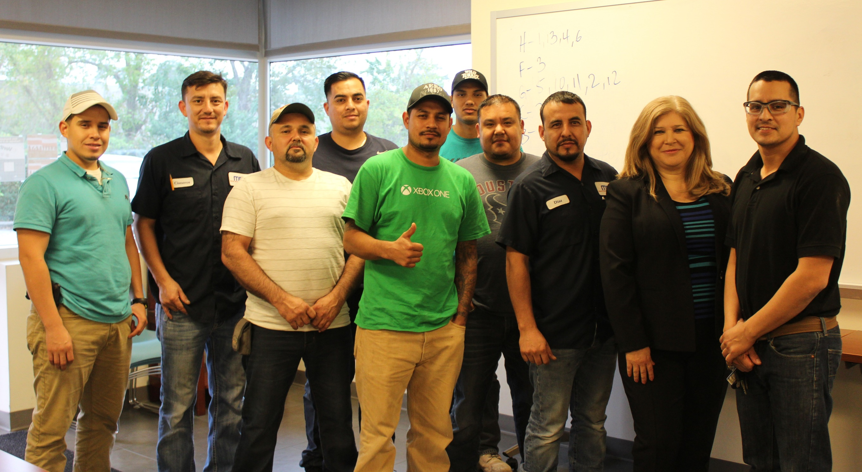
HCDE and Marek
Partners in Building People

Slide 2

10 Year Partnership
Harris County Department of Education (HCDE)
  1 of 6 Adult Education and Literacy Programs in 13-county area
  8,882 adults served in 2015-2016
  Custom solutions for Marek, S&B, TAS Concrete, Builder Specialties
Marek
  78 years in business
  Commercial construction: hospitals, stadiums, schools, offices, hotels
  Formal workforce development program

Slide 3
Why Workplace Literacy?
Enhanced job retention and worker engagement
Opportunities for participants to advance and increase wages
Upskilled talent pool for employers
Identifying partners for Integrated Education and Training (IET) opportunities
Leveraging HGAC-HCDE resources to reach more clients

Slide 4
Recent Projects
Safety ESL
Fall 2015 – 6 weeks
Basic Drawings ESL
Fall 2016 – 11 weeks
Advanced Drawings ESL
Spring 2017 – 17 weeks
Bilingual Marek Vocational Instructor
HCDE ESL Instructor
Bilingual Marek Course Mentor
Classroom + Distance
Vocabulary + Safety Scenarios
HCDE ESL Instructor
Bilingual Marek Course Mentor
Marek and NCCER Basic Drawings Module Completion
(Written + Performance)
Bilingual Marek Vocational Instructor
HCDE ESL Instructor
Bilingual Marek Course Mentor
Marek and NCCER Advanced Drawings Module Completion
(Written)

Slide 5
Measuring Results and Impact

Slide 6
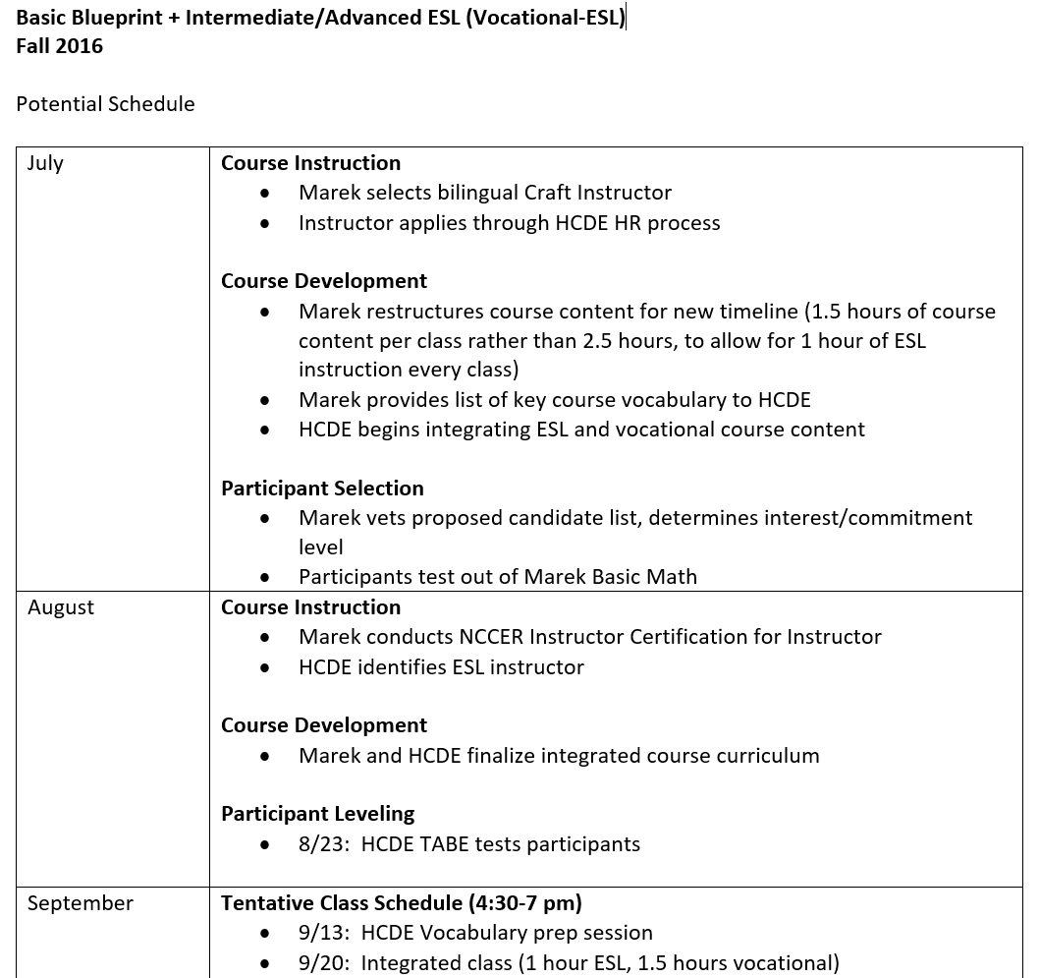
Planning
Brainstorm early
Gather input from stakeholders
Allow time for needs assessment and meaningful contextualized lessons

Slide 7
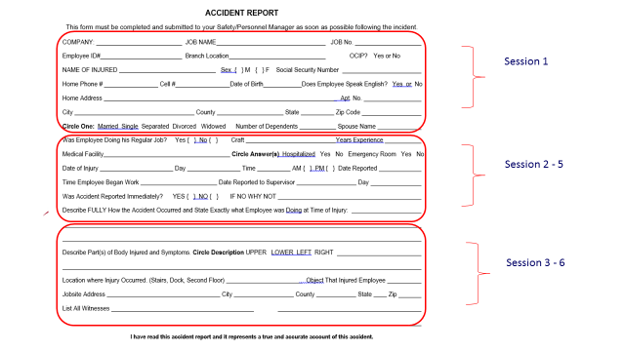
Contextualizing the Curriculum
Invest in learning what the employer and students need help with
  Job site visits
  Actual work documents
Develop reading, writing and communication scenarios around real worksite issues
Focus on skills that ensure student success

Slide 8
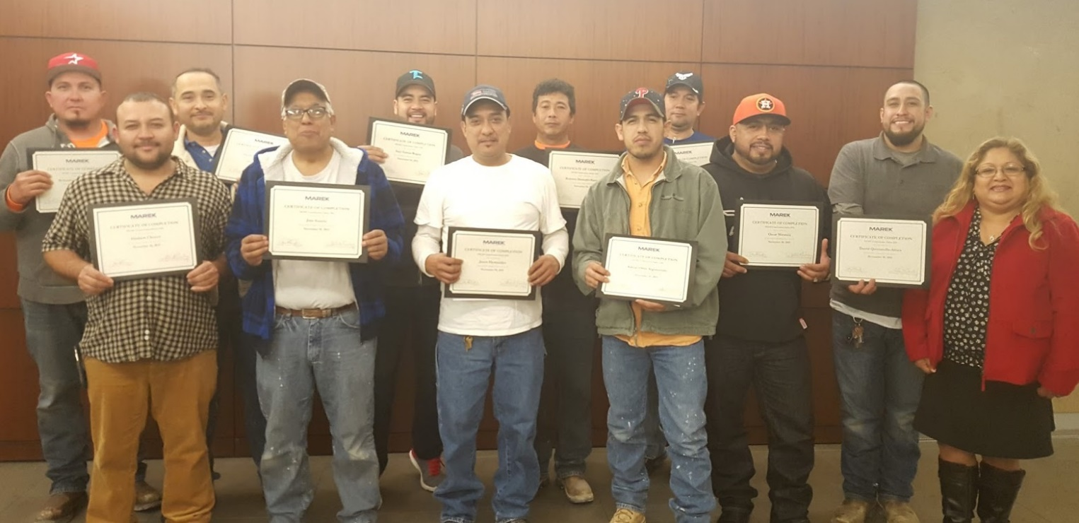
Implementation
Recruiting students
Buy-in from supervisors
Role of mentor
Communication between HCDE and Marek
Flexibility to adjust
“I’m able to use what I learned in class on a daily basis.”
Oscar M.

Slide 9
Lessons Learned
HGAC-HCDE
Listen
Invest in customized solutions
Balance AEL results with customer’s business needs
Keep communication open
Be responsive and flexible
Marek
Clear outcomes
Lead time to prepare
Adequate class time
Include Marek instructor and mentor

Slide 10
Table Activity
Directions: On your table, you have a list of questions to discuss.
Please assign one person in your group to be a scribe for this activity. The scribe should open the Google Document (at http://bit.ly/2017workplace - or use the QR code) and record your group’s best responses to the questions.
Using the Google Document will allow all participants to have the notes from all other groups.
Dr. Honold’s responses will be added at the end of the day, so please return to view those.

Slide 11
The Questions
What are the key criteria for choosing employer partners for your AEL career pathways program?
What are the factors to be considered in establishing a career pathways program that meets the needs of employers?
How should the employer and the AEL provider share responsibility in implementing an effective career pathways program?
What are the key considerations in developing an effective contextualized career pathways curriculum that meets the needs of the employer and the AEL program?
What are the key benchmarks for evaluating the degree of success of your employer-based career pathways project?

