Slide 1
NAVIGATING THE GRANT
Learn the basics and explore areas you didn’t know existed

Slide 2
AEL Grant Network
Texas Workforce Commission
Adult Education & Literacy
Board & AEL Grants
Subrecipient Monitoring
Finance Reporting
Fiscal TA
Accounts Payable
Grants Administration
Financial System Support
Program Specialist
Grant
Manager

Slide 3
Who is Board and AEL Grants?
Jennifer Troke
Director
Workforce Grants and Contracts
Travis Weaver
Manager
Board & AEL Grants
Diana Blackwell
Team Lead
AEL Grant Manager
Jonathan Valenzuela
AEL Grant Manager
Kara McVey
AEL Grant Manager
Manages local Workforce Development Boards (WDBs) through workforce service delivery and special initiative grants including AEL
Work alongside the AEL Program Specialist to provide grant support
Field grant and fiscal inquiries
Prepare and process grant changes
Responsible for the overall compliance of the grantee to the agreed terms and the documentation of the grant of such

Slide 4
Board & AEL Grants Contact Information
Name | Title | Email Address | Office Phone
Jennifer Troke | Director Workforce Grants & Contracts | jennifer.troke@twc.state.tx.us | 512-936-0234
Travis Weaver | Manager Board & AEL Grants | travis.weaver@twc.state.tx.us | 512-463-3842
Diana Blackwell | Team Lead AEL Grant Manager | diana.blackwell@twc.state.tx.us | 512-463-7227
Jonathan Valenzuela | AEL Grant Manager | jonathan.valenzuela@twc.state.tx.us | 512-936-0367
Kara McVey | AEL Grant Manager | kara.mcvey@twc.state.tx.us | 512-463-2343

Slide 5
Your TWC Support Team
Grant manager
Program Specialist
Grant questions
Grant processes
All Amendments
Adjustments to B-1 and CDER budget
Grant changes: POC, signature authority, subrecipient or consortium, etc.
Expenditures/ Projections
Purchasing requirements: TWC Forms 7100, 7200, 7300
Allowable Expenses
Program questions
TEAMS
Enrollment
Student Testing
Professional development
Intake and Screening
Eligibility
IET Support
Allowable activities

Slide 6
Scavenger Hunt – First Question

Slide 7
Where in the grant is the following located?
The detailed grant fund amount available July 1st vs the award amount available September 1st
&
The amount of Performance Based Funding Reserve.

Slide 8
ANSWER 1
Attachment D

Slide 9
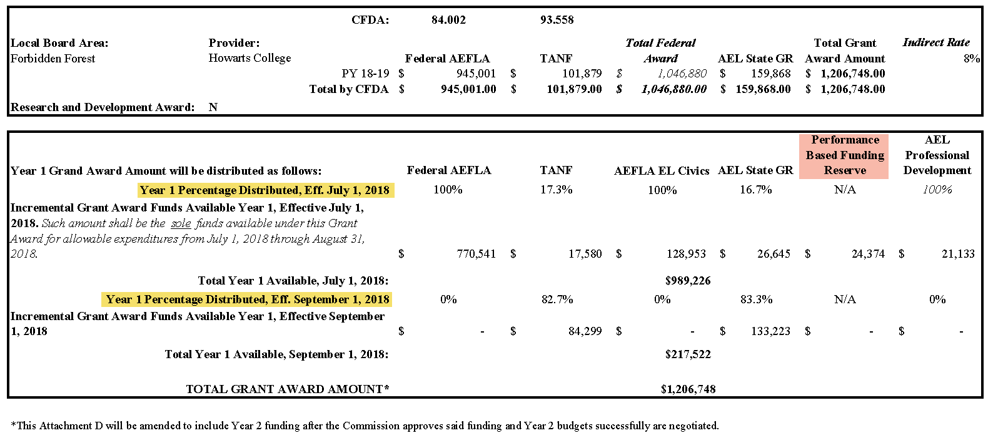
Answer continued – Attachment D example

Slide 10
The Grant Sandwich
General Terms and Conditions
Attachments A, B, & B-1 (SOW)
Attachments C & D

Slide 11
The Bread: TWC’s General Agreements (1 of 3)
General Terms & Conditions
Sets forth the general responsibilities and obligations of the grantee to the grant with respect to the implementation and administration of the program.
Administrative Requirements
Bonding Requirements
TWC’s rights in data, products or inventions
Fraud Prevention
Records and Retention
Appeals
Changes and Amendments
Etc.

Slide 12
The Bread: TWC’s General Agreements (2 of 3)
Attachment C
AKA: Certifications
Acknowledgement of Federal regulations that the grantee must disclose, abide by, or restrict in reference to:
Lobbying
Debarment, Suspension, and Other Responsibility Matters
Drug-Free Workplace
Restrictions on the Use of Certain Public Subsidies

Slide 13
Attachment D
The Bread: TWC’s General Agreements
(3 of 3)
Identifies reportable grant information as required by Uniform Grant Guidance from Office of Budget Management, Section 200.331, Requirements for Pass-Through Entities
Lists source of funds as well as Catalog of Federal Domestic Assistance (CFDA) numbers and descriptions
Lists Indirect Cost Rate
Provides itemized list of funding amounts and delivery schedule including PBF

Slide 14
Attachment A
The Meat: Statement of Work
Section 1: Project Abstract – Identifies the provider and objectives of the project.
Section 2 & 3: Applicable Contract Authorities & Allowable Services/Activities – Identifies the Fiscal and Contractual authorities as well as Allowable Activities.
Section 4 Eligibility – Identifies Eligible Population and eligibility requirements.
Section 5: Award specific requirements – Lists grant specific requirements: Staffing, Program types, Intake, Assessment, Orientation, etc.
Section 6:Activities and Performance Measures – This section is a table which contains the programmatic deliverable requirements with due dates.
Section 7: Reporting Requirements – TWC required reporting. Contains reporting schedules, quarterly narrative report and final written report guidance.

Slide 15
Attachment A: NEW grant language in Eligibility
The Meat: Statement of Work
AEFLA Federal | AEFLA State (GR)
Individuals with disabilities, including eligible individuals with learning disabilities. (34 C.F.R. § 463.20(b)(2)) | No longer has the age restriction for “individuals who have attained 19 years of age” There is no change in the actual eligibility only clarification of language.

Slide 16
Attachment A: NEW in TANF Eligibility
The Meat: Statement of Work
Temporary Assistance for Needy Families (TANF): The overall purpose of the TANF-funded component of the program is to move TANF recipients, needy parents, and non-custodial parents into education and job skills training that assist with obtaining employment and maintaining financial support for their children. The Eligible Population for TANF funded services includes those who meet eligibility criteria below:
Needy Parents—deemed eligible for TANF AEL services are those that include a child eighteen (18) and younger living at home if a family member receives any of the following forms of assistance:
TANF, SNAP, Medicaid, CHIP, CCDF, public housing assistance, or WIC
Non-custodial Parents—Noncustodial parents with children eighteen (18) and younger are also eligible to receive TANF funded AEL services.
When charging federal TANF funds, documentation must be collected that a participant qualifies for use of TANF funding for AEL services.

Slide 17
Scavenger Hunt – Second Question

Slide 18
Where in the grant would you find…?
The minimum percentage FTE required for the Lead for Quality Assurance staff position.

Slide 19
ANSWER 2
Attachment A Section 5.7.3.2
(10% minimum)

Slide 20
NEW Minimum Staffing Requirements
The following staff requirements have been implemented under Section 5.7 of Attachment A:
Alternative percentages may be considered by the Agency if the grantee’s allocations are not sufficient to support as listed.
Contact your Grant Manager for more information
Position Description | Minimum Percent FTE Rate
Director | 100%
Lead for Quality Assurance | 10%
Lead for Performance Accountability | 20%
Professional Development Coordinator | 20%
Lead for Distance Learning | 20%
Instructional Lead | 20%
Career Navigator | 20%

Slide 21
The Meat: Statement of Work
Attachment B
Section 1: Expenditure Limitations
General limitations established within the program budget documents
Indirect cost rate restrictions
Admin cap limitations and flexibility
Budget Amendments vs Budget Adjustments
Infrastructure Costs
Section 2: Obligation and De-obligation of Funds
Agency may obligate and de-obligate funds
How a grantee can request de-obligation of funds
Section 3: Financial Reporting
Submitting monthly financial reports including obligations
Submitting contract closeout packages

Slide 22
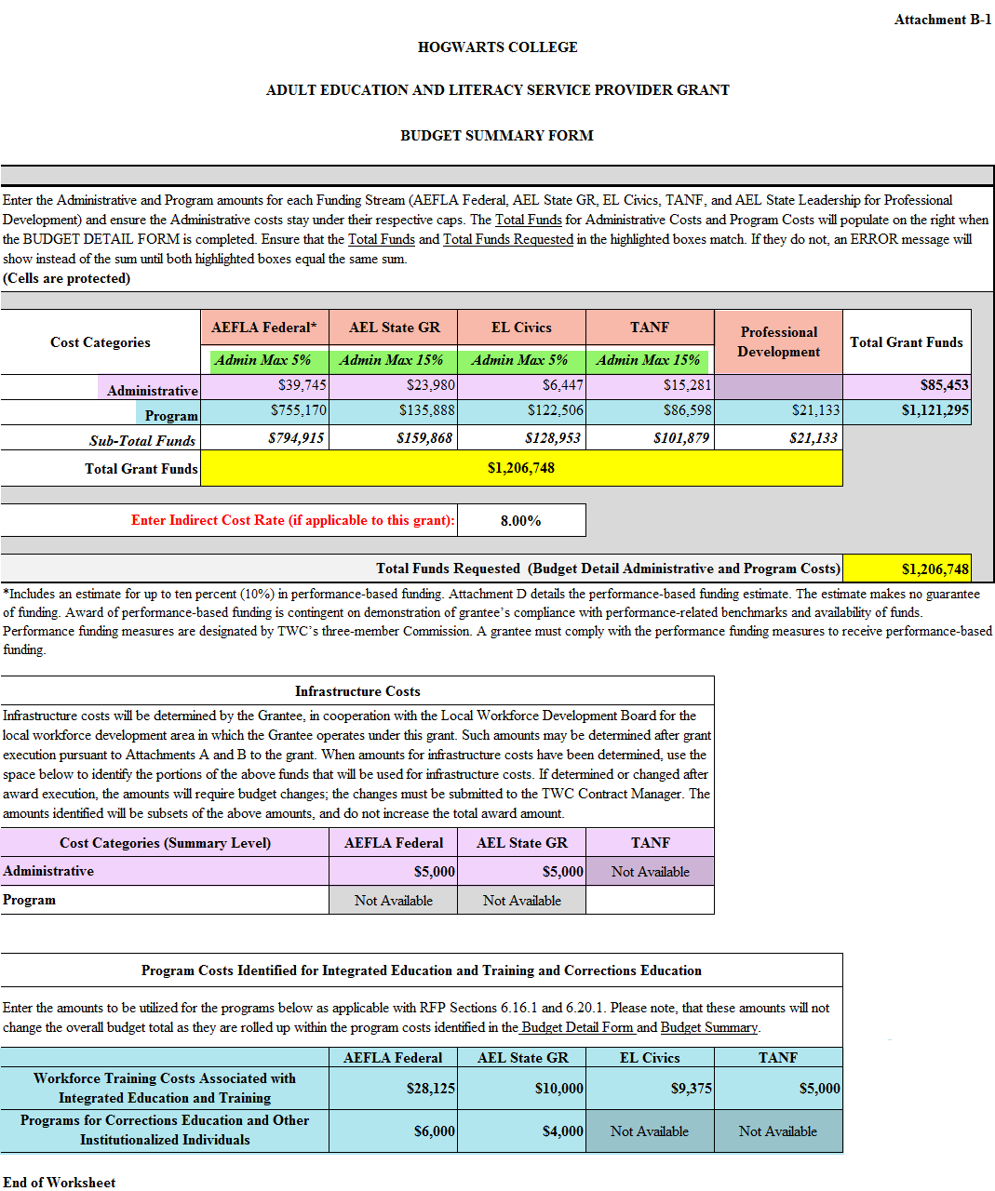
The Meat: Statement of Work, slide 2
The Meat: Statement of Work
Attachment
B-1
AKA: BUDGET

Slide 23
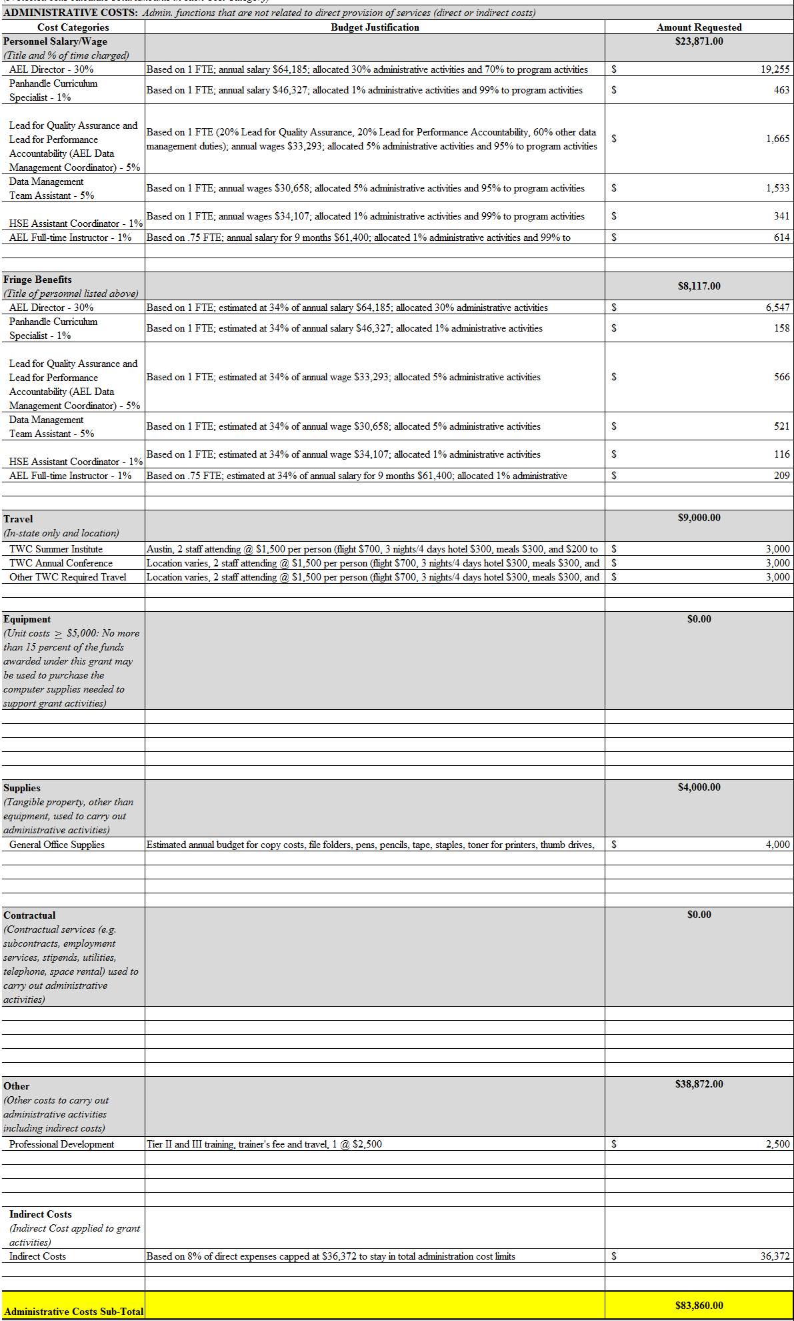
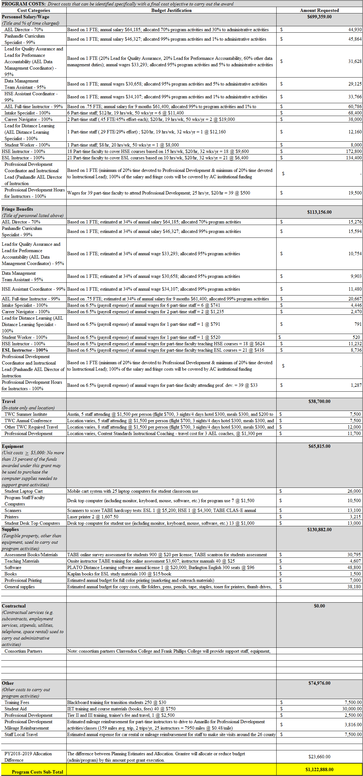
Attachment B-1, Budget detail
Attachment B-1: Budget Detail
Administrative
Program

Slide 24
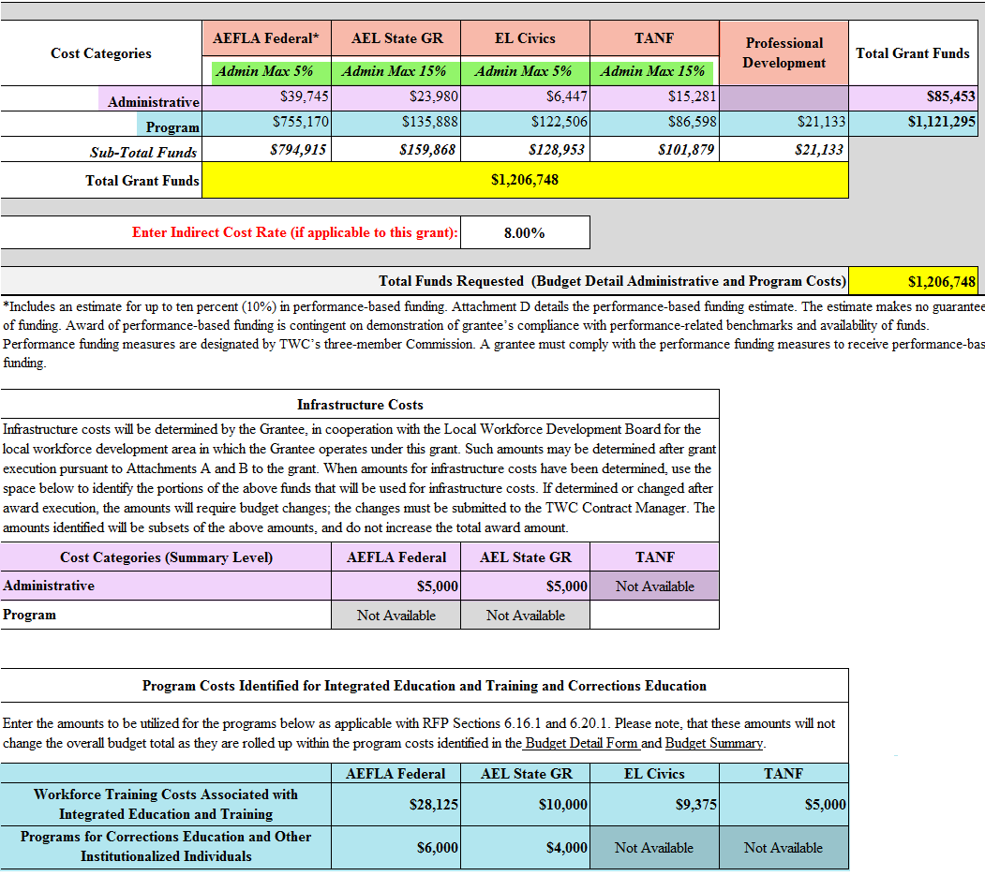
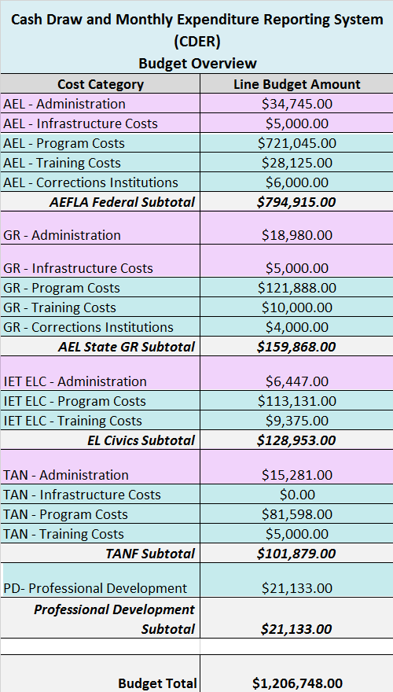
Attachment B-1, Budget detail, continued

Slide 25
Scavenger Hunt - Third Question

Slide 26
Where in the grant will you find…?
The percentage of aggregate change to a budget line item without a grant amendment.

Slide 27
ANSWER 3
Attachment B Section 1.7.1
20%

Slide 28
BUDGET ADJUSTMENTS, AMENDMENTS, AND PROCESSES

Slide 29
Budget Adjustment vs Budget Amendment
Adjustment
Amendment
A change in the amount of a budget line item or combination of line items in which the aggregate change is less than twenty percent (20%) of the total grant award may be approved by the Agency Grant Manager at their discretion.
May take approximately between 2-72 hours.
A change in the amount of a budget line item or combination of line items in which the aggregate change is equal to or exceeds twenty percent (20%) of the total grant award will require a contract amendment.
Now only relvent for changes between Admin and Program
May take approximately 3-6 weeks.

Slide 30
Requesting Grant Actions Checklist
Contact your designated Grant Manager to make sure you have the most current forms.
Most recent B-1 for a budget adjustment
Grant Action Form (CAR) for an amendment
Fill out appropriate forms as instructed.
Submit to: Grant Manager & COPY Program Specialist.
Wait for processing. This will vary depending on the type of request.
The Grant Manager will notify you of the status and confirmation of request.
Budget adjustment: CDER screenshot confirmation will be sent.
Amendment: Document packet will be sent out for signature by GA.

Slide 31
Contract Action Request (CAR) Description Should…
Clearly and concisely describe the request at hand
Leave no questions for grant manager
If applicable, identify the funding stream
If applicable, identify the service cost: Administrative or Program
If applicable, identify the amount being reduced /increased

Slide 32
CAR Explanation…
This statement should provide your CM with sufficient information to recommend an amendment
Should be informative but concise
Should explain the situation at hand that has led to needed changes
If applicable, tie requested changes with relevant program needs and requirements
If applicable, include activities or issues that led to request

Slide 33
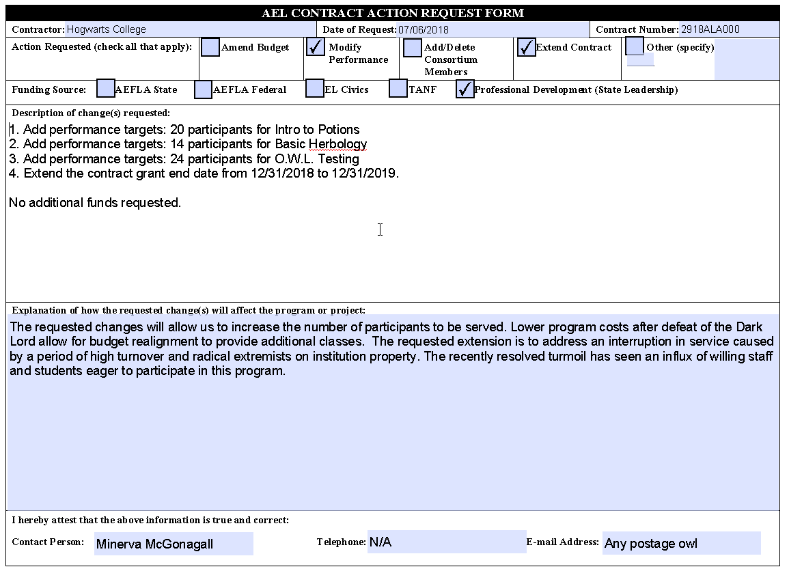
CAR Form

Slide 34
Scavenger Hunt – Fourth Question

Slide 35
Where in the grant is this located?
Information about the required alignment with the Board, MOU, and infrastructure payment?

Slide 36
ANSWER
Attachment A: Sections, 5.9 & 5.26
Attachment B: Section 1.12

Slide 37
Question on administrative cost limitations
What to do about Administrative cost limitations if most Infrastructure costs will also come out of Admin?
Attachment B, Section 1.9
Administrative costs charged to this grant shall not exceed the above caps, except where such rates are demonstrated by the Grantee to be too restrictive to allow for administrative activities and a higher rate has been negotiated with the Agency pursuant to AEFLA § 233(b).
Negotiations for cap increase only applies to AEFLA Federal funding stream
Agency will review on a case by case basis
Infrastructure cost amounts will be taken into consideration
Contact your Grant Manager and submit a CAR:
Explanation for justification of increase should be clearly stated
Include proposed AEFLA % increase amount
Include indirect cost rate if this is also a factor
Provide applicable supporting document(s): itemized list of infrastructure cost amounts and methodology agreement used for payment

Slide 38
CASH DRAW EXPENDITURE REPORTING SYSTEM (CDER)

Slide 39
TYPES of CDER ACCESS
Full Access
Read/ View ONLY
For individuals processing expenditure reports, cash draws, closeout packages, etc.
For Directors and others who may need to know the current budget status, view the past and current monthly expenditure reports, etc.

Slide 40
How to Request Read Only CDER Access…
Request an account on-line from the CDER log-on screen at: http://www.twc.state.tx.us/boards/cashdraw.html
The designated security coordinator for your institution will submit a completed CashDraw Operator Security Request form with the appropriate level access to TWC mailbox: cashdraw.ta@twc.state.tx.us
You will receive a provisional account and will be required to complete the CDER training on the homepage
Provisional status will change to regular status

Slide 41
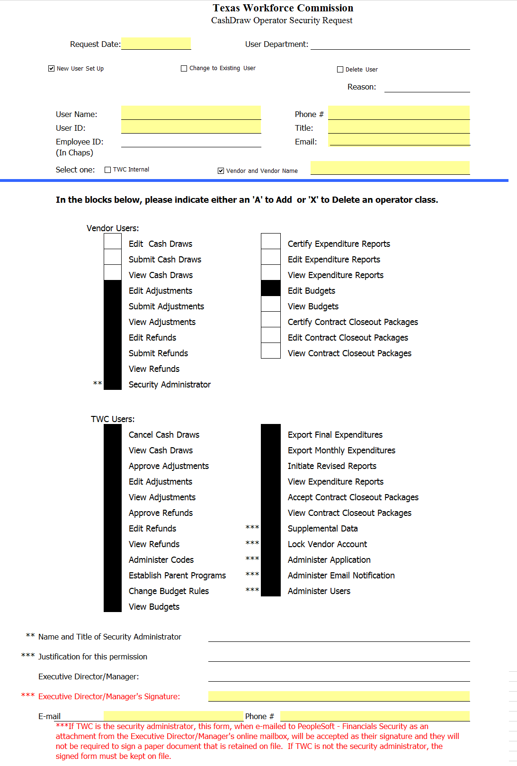
CDER Access Request

Slide 42
WHAT & WHEN TO REPORT IN CDER
Monthly Expenditures
DUE on the 20th of each month by 11:59pm CT
Mandatory for All twc grantees
EXPENDITURES: Monthly expenditures by required reporting categories located in CDER
OBLIGATIONS: Legally binding financial obligations or liabilities agreed through subcontracts or financial MOUs.
PROGRAM INCOME: Gross income received by grantee.
Contract closeout package
Due by the 60th day from the grant end date
For questions regarding closeout: payables.cder@twc.state.tx.us

Slide 43
Scavenger Hunt – Fifth Question

Slide 44
Where in the grant is the following stated?
The Grantee assures that the performance rendered by all Subcontractors shall comply with all the terms and provisions of this grant award as if the performance were rendered by the Grantee, and shall require such Subcontractors to comply with all requirements, as covered in this grant award.

Slide 45
ANSWER 4
General Terms and Conditions Section 11

Slide 46
Subrecipient Contracting Best Practices
1. What does the Agency ask of you? 2. What are you doing to ensure you are getting the same information from your Subrecipients?

Slide 47
What might be included…
Legal sufficiency (competent parties, signatures, consideration, etc.)
Amount and type of funding
Reporting requirements per funding stream
Budget
Targets
Deliverables
Expenditure limitations
Flexibility and authority to de/obligate money and targets based on performance
Allocation plans
Program Requirements
Documentation procedures including treatment of Personally Identifying Information data
Monitoring plans

Slide 48
Emailing TWC…
Submitting Deliverables:
TO: aelcontracts@twc.state.tx.us
CC: Grant Manager & Program Specialist
SUBJECT: Grant Number & Deliverable Name
Submitting Specific Inquiries:
TO: Grant Manager & Program Specialist
SUBJECT: Grant Number & Subject

Slide 49
BREAK FOR LUNCH! ☺

Slide 50
Expenditures and Reporting
What to report and why accuracy matters

Slide 51
You are required to report the amount spent per funding steam in each of the following categories…
Administrative
AEFLA Federal, AEL State GR, EL Civics, & TANF
Admin Costs: For All, as applicable
Infrastructure Costs: Only for AEFLA Federal & AEL State GR
Program
AEFLA Federal, AEL State GR, EL Civics, TANF,
& *Professional Development
Program Costs: AEFLA Federal, AEL State GR, EL Civics, TANF, & PD
Training Costs: AEFLA Federal, AEL State GR, EL Civics, & TANF
Corrections Costs: AEFLA Federal & AEL State GR
Infrastructure Costs: Only for TANF (if applicable)

Slide 52
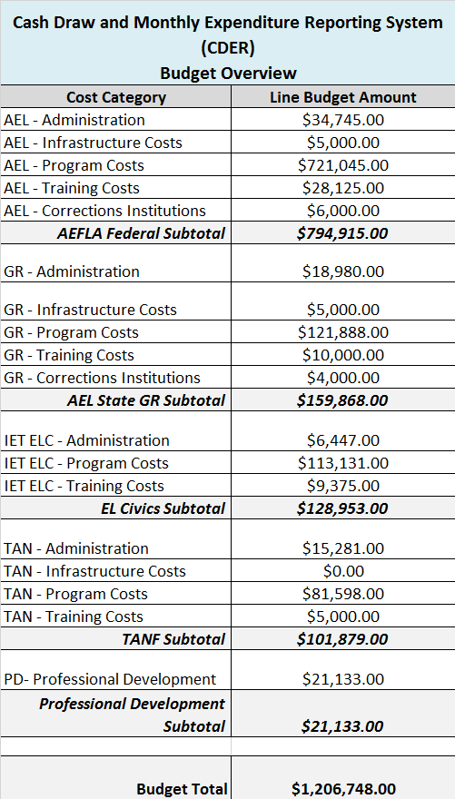
CDER Budget Overview

Slide 53
What TWC Reviews Every Month…
Enrollments vs expenditures
Expenditures vs grant time elapsed
Expenditures of each required reporting category
Obligations (if grantee has subs)
Remaining Balances
Expenditure patterns
Comparison between projections and actuals
Deliverables
TAPs / CAPs
Pending issues/ status from previous meeting/ calls

Slide 54
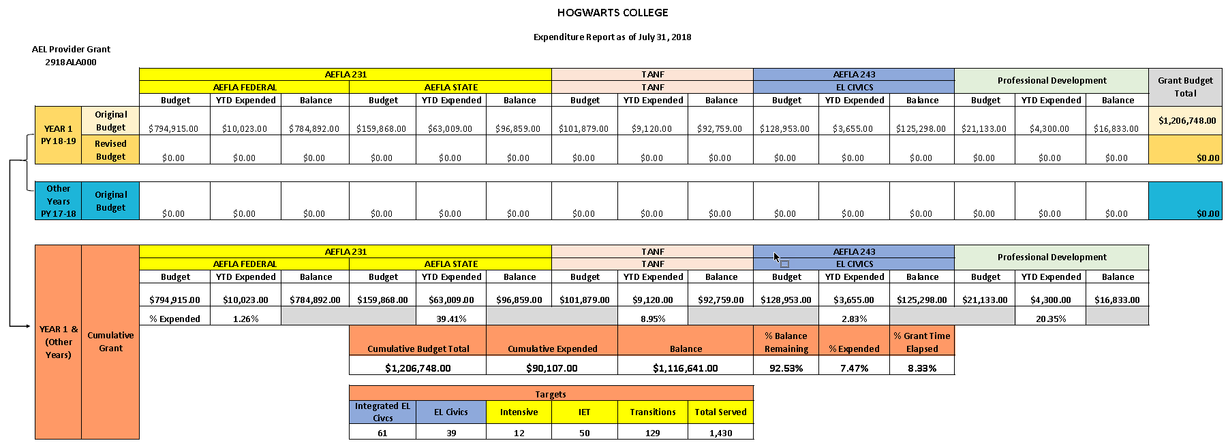
Monthly Expenditures

Slide 55
Grayson College On Fiscal Organization for Cash Draw & Reporting Expenditures in CDER

Slide 56
TABLE ACTIVITY & DISCUSSION

