Slide 1
What Does the SOP Say?
Hard to Know if It’s Just Sitting on the Shelf
Notes:
NOTE:
To change the image on this slide, select the picture and delete it. Then click the Pictures icon in the placeholder to insert your own image.

Slide 2
Session Objectives
Learn about a program’s experience with revising SOPs
Get general information on creating an SOP
Learn how to utilize an SOP
Get additional SOP resources

Slide 3
Meet the Presenters
Jauneen Maldonado, AEL Director, Workforce Solutions for Tarrant County Consortium
Wayne Crandall, PD Specialist, Train PD @ TCALL
Krista Mosher, PD Specialist, Train PD @ TCALL

Slide 4
QUESTIONS WILL BE HELD TILL THE END

Slide 5
standard Operating procedures (Sop)
Presented by: Jauneen Maldonado, AEL Director, WSTC Board

Slide 6
What we will cover…
Importance of having an SOP
How the SOP creates seamless service design across the program
How an SOP can help keep you off of a TAP

Slide 7
Background
Workforce Solutions for Tarrant County WDB inherited the grant from FWISD on July 1, 2017 along with the TAP.
Lack of updated data collection and data entry processes documented and shared with provider staff
More than 47 staff with Data Entry Rights in TEAMS
Incorrect Fund coding – led to targets not being met

Slide 8
Then… & Now…
Set the Bar High
Rise Up

Slide 9
Next Steps
GET OFF OF THE TAP
Held a 2-day planning session with all of the Partners Admin staff and TCALL PD Specialist to work on Standard Operating Procedures and forms
Started with the CIP and our PD Specialist to ensure that our processes were aligned to meet our goals.

Slide 10
Next Steps (cont’d.)
Broke out into groups to review each SOP:
  Data Management
  PII
  Recruitment and Marketing
  Orientation
Provided each provider with a binder of all of the SOP’s.

Slide 11
Essentials for SOPs
Everyone must be involved
Everyone needs to see the “Big Picture” and understand where we are all headed
Must include requirements from AEL Grant, AEL Guide, and Assessment Guide
Must be willing to make adjustments as you go through the year

Slide 12
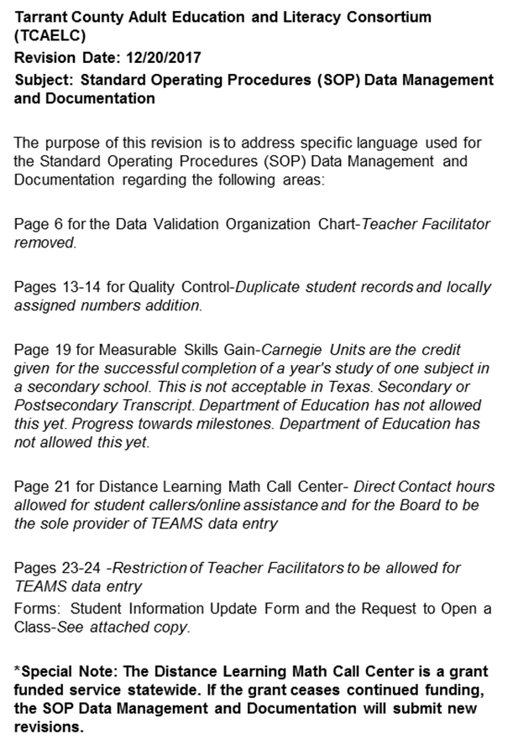
Revisions
Each Revision is documented and distributed to partners
Kept in back of binder until new year SOP is printed and distributed

Slide 13
Data Management SOP
Data Entry Weekly; no later than bi-weekly per Assessment Guide
Designated IET Data specialist (cross-train for backup)
TANF Verification bi-weekly for funding changes
Funding Code Report weekly - Supervisor

Slide 14
Finally…..
WE ARE OFF OF THE TAP!

Slide 15
SOP TRAINING
Ensure Administration is familiar with the SOP
Providers included in their on-boarding
Signed Receipt from Staff
Distribute any Revisions at monthly meetings
SOPs are used in our quarterly monitoring of sub-recipients

Slide 16
SOP’s Created
Data Management and Documentation
Recruitment and Marketing Strategy
Personally Identifiable Information (PII)
Orientation
IET and Intensive
Professional Development

Slide 17
CHALLENGES
7 Providers – making our program seamless
Standardized Forms
Changing Habits – designing a year round service model
Helping Staff understand the long-term benefits of having SOPs

Slide 18
Thank you!
Jauneen Maldonado
817-804-4225
Jauneen.Maldonado@workforcesolutions.net

Slide 19
What is a SOP
Standard Operating Procedures
Presented by Wayne Crandall and Krista Mosher, PD Specialists, TRAIN PD @ TCALL

Slide 20
What we are going to talk about
What is a SOP
Why should you have SOPs
Who should develop the SOP
Who is responsible for implementing SOPs

Slide 21
SOPs
What are they?
The how of what you do
The steps in a process or procedure
Standardized guide to help create consistency across an operation
A way to monitor/control the flow of work
A gauge for accountability
Notes:
Your staff and you do the same processes all the time, but are they done consistently, especially across sites? SOPs allow for consistency in important processes, because everyone will be using the same SOP, including the if..thens that always seem to occur.
Is the process you are currently using the most effective? SOPs can help focus on what is working and what isn’t
Monitors will use your SOPs to assess your processes in action

Slide 22
SOPs
Why do you need them?
Creates a hierarchy of responsibility and accountability
Improves communication with staff, providers, contributing stakeholders, and collaborative partners
A standard reference/ guide for a process procedure
A set of directions for training staff
Documentation of the operational parameters
5 of them are required in your contract

Slide 23
The 5 Required SOPs
Recruitment and advertising
Comprehensive assessment, testing and placement
Orientation
Customer profile data collection
Referral/Co-enrollment across core programs

Slide 24
SOPs vs. MOUs
SOP
Standard Operating Procedures
Is a procedure specific to your operation that describes the activities necessary to complete tasks.
Any document that is a “how to” falls into the category of procedures.
MOU
Memorandum of Understanding
Specify mutually-accepted expectations between two or more people or organizations as they labor together toward a common objective.
Common objectives may lead to shared SOPs referred to or embedded in the MOU
Notes:
Last Krista slide

Slide 25
SOPs
Building them
What is it for?
What is the projected outcome?
Who should create it?
Who will use it?
How does it fit in to the big picture?
What other SOPs affect or are effected by it?
From the “big book” of program SOPs and MOUs
Who will monitor its effectiveness?
Notes:
When making an SOP these are the question that need to be asked

Slide 26
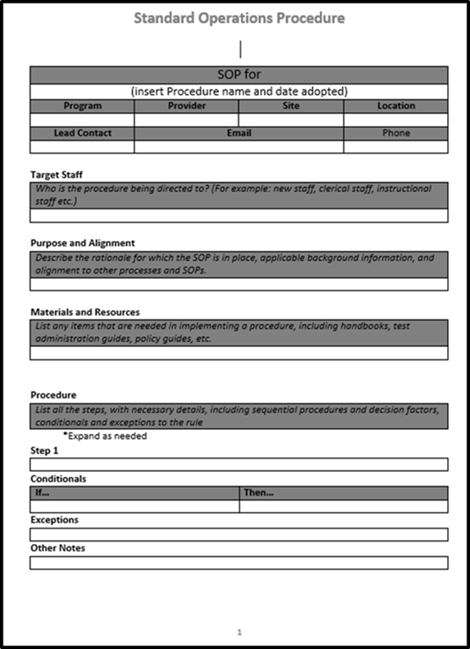
Sample SOP Template
This is a sample template for recording your SOPs.
It is NOT the official form to report your SOPs to TWC.
Notes:
If they ask this form can be sent to them electronically. But it is not the required layout it is just a tool that they can use if they wish to.

Slide 27
SOPs
Building them
From start to finish
From the general to the specific
Define the rigidity/flexibility allowed
Define the conditional sets (if…then…)
Allow for variation
Include exemptions
Publish and distribute
Notes:
This is an outline of the process of building a SOP keeping these things in mind will help create the flow of the process

Slide 28
SOP Checklist see handout
When crafting an SOP you should consider the following:
What procedures are you standardizing?
Who will use the SOP?
What other SOP’s or MOU’s or other processes are affected and how do they work together?
What training or base skills/information is needed to follow the SOP?
What materials and resources are needed?
Have you considered all the rules, policy and guidance (Fed, State and Local) that may apply to the SOP?
Is it general or specific to a partner, location or project?
Are all the steps included?
Are the actions described in enough detail?
Are tasks assigned to roles rather than people?
Are all conditional laid out in an if…then…format?
Are the decision trees laid out clearly?
What is the hierarchy of responsibility and accountability?
Are the exceptions well defined?
How will your review / revise the SOP?
How will you deal with updates to the SOP?
Notes:
This is a check list that can be used to Guide the SOP If the answer to any of these is not in the SOP it should be added.

Slide 29
SOPs
Using them
Every time… All the time
(SOPs only work when you use them)
Availability
( they can’t use it if they don’t have it)
Keep it up to date
(Review at least annually or anytime changes occur in the program)
1st question : “What does the SOP say?”
( if it doesn’t say then put it in there)
Notes:
After the SOP is written it will need to be used these are a few suggestion to help the SOP be employed

Slide 30
SOPs
Adapt & Adjust
Incorporate changes and adjustments
Refining
Things change
Unforeseen circumstances
Notes:
Remind them that SOPs are living documents meant to aid the orchestration of a procedure or set of task in a standardized way As things change the SOP should be changed or modified to accommodate those changes. That being said anytime things change the SOP should be reviewed to make sure it is still vaild

Slide 31
Questions

Slide 32
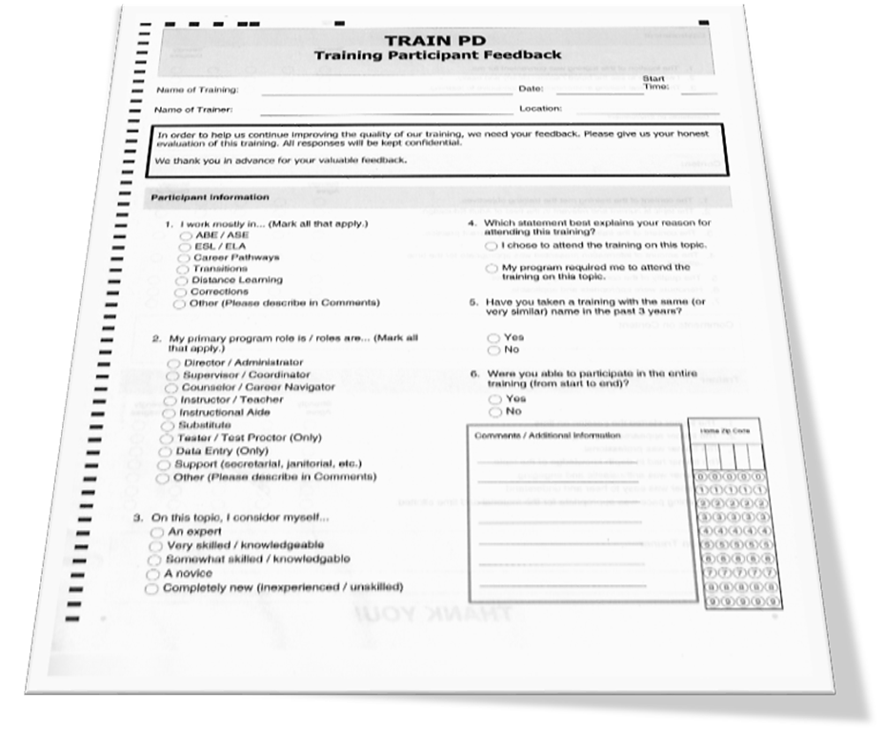
Please fill out the Scantron
You can use either a pencil or a blue or black ink pen.
Remember to bubble.
Don’t forget your home zip code
Please fill out both sides

Slide 33
Please fill out the Scantron

Slide 34
TRAIN PD @ TCALL
THANK YOU!

