Slide 1
MSG’s: How
Measured Are You?
Mahalia Baldini and Carrie Tupa

Slide 2
Part 1: Review of the MSG’s
Measurable Skill Gains
Achievement of High School Equivalency
(Type 2)
Progress Toward Milestones
(Type 4)
Postsecondary Transcript
(Type 3)
Enrollment in Postsecondary Education
in the program year
(Type 1b)
Educational Functioning Level Gain
(Type 1)
Achievement on a Pre-Post Test
(Type 1a)
Skills Progression (Type 5)

Slide 3
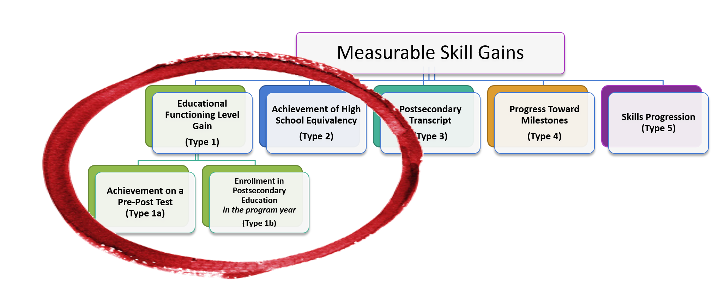
Part 1: Review of the MSG’s
MSG’s that measure basic education
Every participant needs one of these a program year

Slide 4
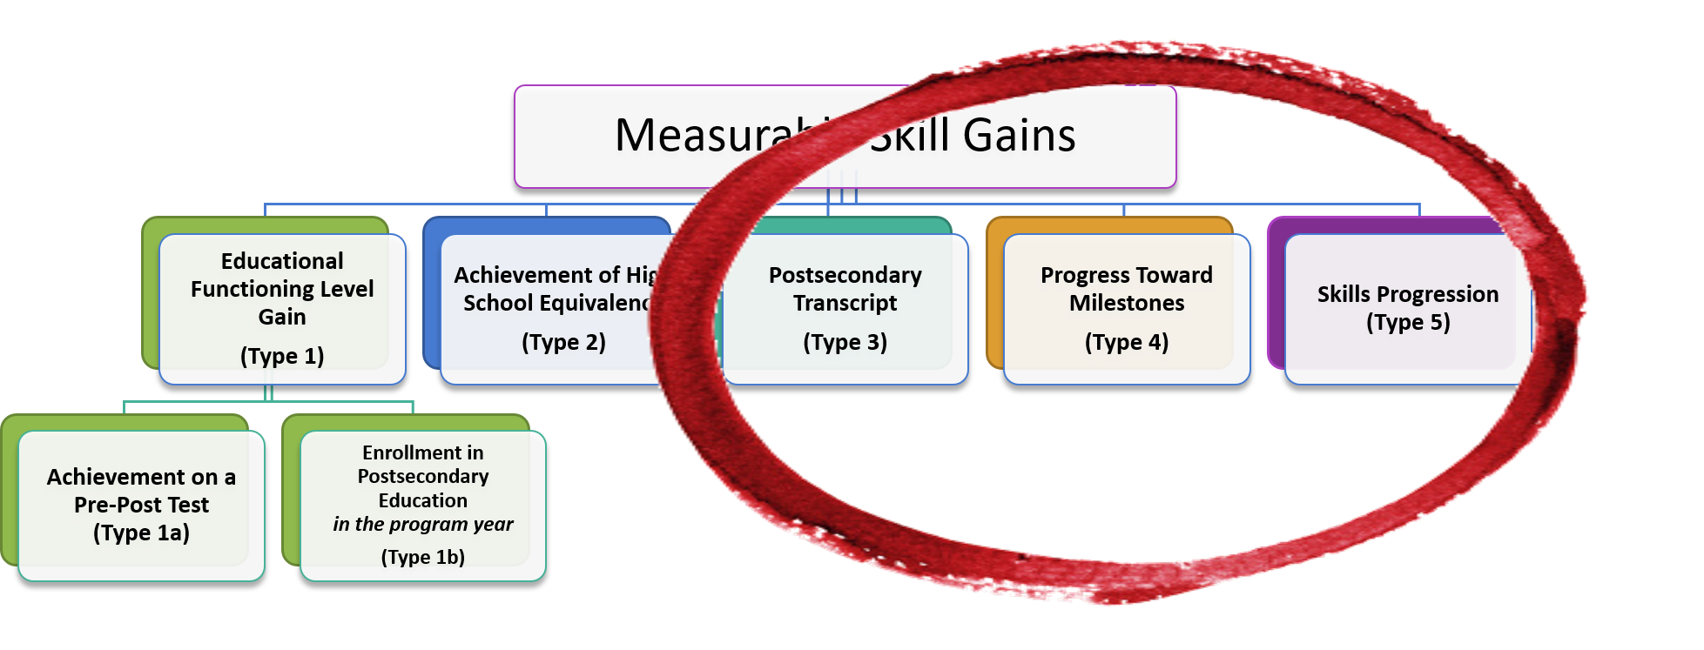
Part 1: Review of the MSG’s (cont’d)
MSG’s that measure workforce training
IET participants need at least one of these a during the IET program of study

Slide 5
Does it count as a basic education gain?
Participant pre-tests in the following levels/domains on their pre-test:
  Math – Level 1
  Reading – Level 3
Participant post-tests in the following levels/domains on their post-test
  Math – Level 1
  Reading – Level 4
YES! A gain in any domain counts under WIOA, not just the domain of significance

Slide 6
Does it count as a basic education gain for PY18-19?
Participant earns their HSE in Texas on July 14, 2019.
NO! To count as a gain, the HSE must be earned by June 30, 2019.
The match needs to show up by the time we measure year-end performance.

Slide 7
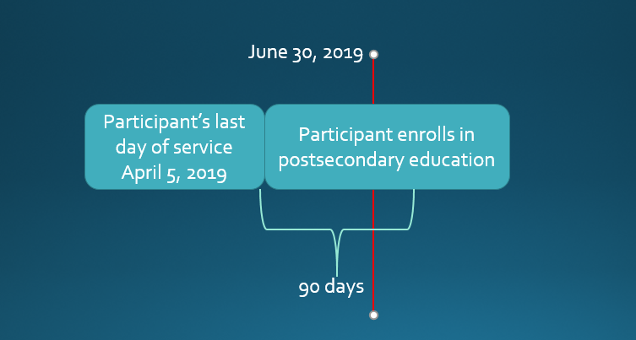
Does it count as a basic education gain for PY18-19?
YES! Participant needs to exit, but they don’t have to wait until after exit to enroll in postsecondary

Slide 8
More on this type of MSG….
For the gain to count for your performance, you need to allow enough time to put in the gain, meaning this example might count, but you’re cutting it close with time to get the documentation and log it into TEAMS.

Slide 9
Remember!
Just log it if you have the documentation
You don’t have to wait 90 days. We will measure exit/entry into post-secondary on the back-end (until all the PoP work in TEAMS is done!)
The participant may not have exited yet at the end of the year. But if you know they are going to exit log it.

Slide 10
Does it count as a workforce training MSG? (example 1)
IET CNA participant passes the written portion of the certification test, but not the oral portion.
YES! Participant can be considered for a Type 5, skills progression.

Slide 11
Does it count as a workforce training MSG? (example 2)
IET participant in non-credit welding completed 60 Continuing Education Units of Welding coursework through Maryfield Community College with a “P” for passing.
NO! Type 3 would require credit coursework. Type 4 and 5 would not be relevant.

Slide 12
Open Q&A

Slide 13
Workforce Training MSG’s
We want to track these so we can push the department of Education to count them for performance
Remember, you only need one per program of study, but if you want to do more, you can!

Slide 14
What we see people doing wrong…

Slide 15
“Matches” for HSE
It’s a match! TEAMS is smart…but not that smart!
  Make sure the DOB matches what the student gave at the testing center
  Make sure the name matches what the student gave at the testing center – spelling counts
  Check the potential matches!!
  Make sure they are a participant!

Slide 16
New information!
TEA is getting “old” test information
If an individual passed the test, TEA is awarding an HSE that will have a current date
In these cases, the test dates matter –we won’t award you performance for an HSE that was actually earned years ago

Slide 17
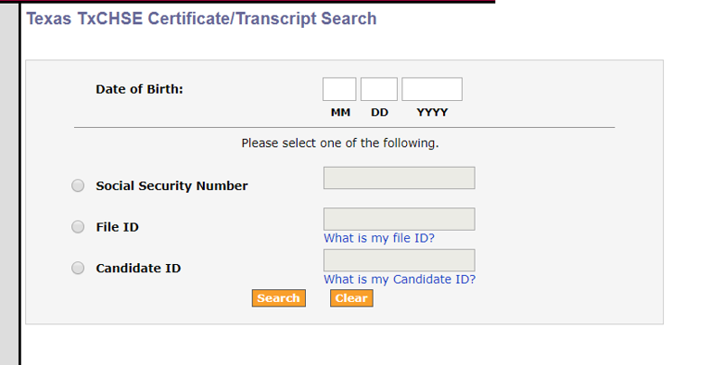
What should you do? (we appreciate it):
Look up the participant in TEAMS
Check to make sure they are actually participants (have a profile – this matters!)
Check in the potential matches for this year and last year
Look up the participant here using the SSN and DOB in TEAMS:
  https://tealprod.tea.state.tx.us/
  Tea.TxChse.Web/Public/Certificate
  Search.aspx
  If you can’t find them, neither will TEAMS!

Slide 18
Once you’ve done all of that
Then you can contact your program specialist with the relevant information
Remember, GED Manager is not the TEA database. We do not match with the GED Manager. We match with TEA.

Slide 19
Type 3,4,5 must be in IET to count
We find people with a Type 5 that don’t have training hours! This means they are not in an IET and therefore won’t count
If you aren’t tracking training hours/services, you’re doing it wrong!

