Slide 1
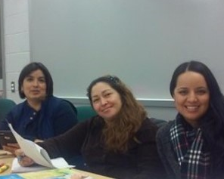
Ya’ll Ready for This?
Who’s Really Ready for IET?
2018 AEL Summer Institute
Facilitators
Olga M. Escamilla, Ph.D., and Fabiana Ramirez
Presenters
Mary Jo Ochoa, Chera Crawford,
Eden Casal, and Cheryl Smith

Slide 2
Session Objectives
Who’s really ready and how do we know?
How can we help you get to the finish line?
You finished the program! …Now what?

Slide 3

Intro to Student Success
Olga M. Escamilla, Ph.D.
PD Specialist,
TRAIN PD @ TCALL

Slide 4
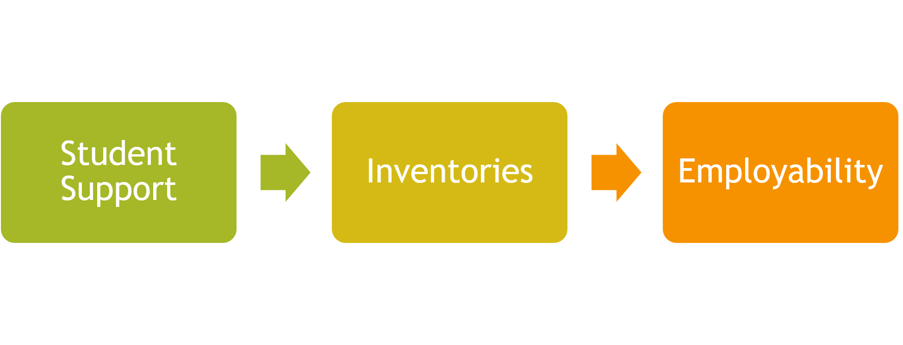
The Formula

Slide 5
Student Support
Comprehensive Assessment
Goal-setting
Offender Reintegration
Constant Contact with Students
Revisit Goals

Slide 6
Inventories
Career Interests
Personality
Barriers to Education and Employment
Career Readiness
College Readiness

Slide 7
Employability Skills
Critical Thinking
Time Management
Communication
Obtaining a job
Retaining a job

Slide 8

Connecting Students to Their Careers
Mary Jo Ochoa
Career Pathways & Transitions Coordinator,
Socorro ISD

Slide 9
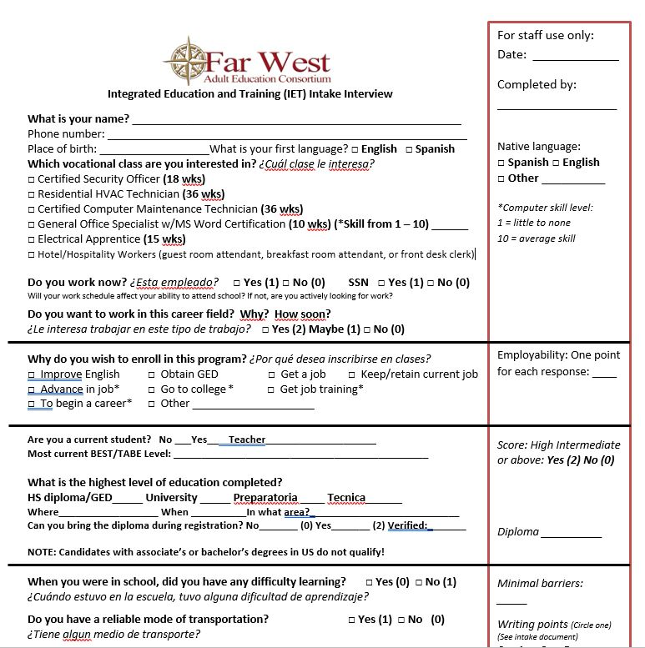
History Lesson: IET Entrance Req’s
Individual Interview
  Collected information on barriers, prior education, “employability”
    Do you work now?
    Do you want to work in this career field?
Academic Assessments
  Minimum reading levels
Must have HS Diploma or GED
Notes:
As the marketing plan was rolling out, we developed our entrance requirements for the IET programs we began with:
Individual Interview
Native language – Integrated EL Civics eligibility
Employability –
Previous education
Barriers
Assessments
TABE Clas E and TABE Reading
Minimum levels required varied by IET course
Must have High School Diploma or GED

Slide 10
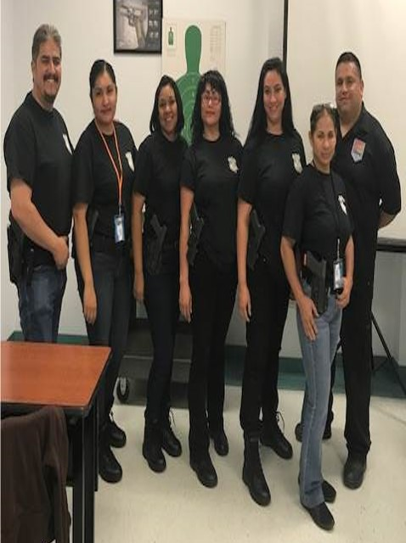
History Lesson: PY16-17 IETs
Marketing plan worked
  Huge telephone response
But, low IET enrollment
  Language skills too low for workforce training and certification exams
  Minimal follow-through from calls to info session to testing to orientation
  Accepted EVERYONE interested and meeting qualifications
Notes:
2016-17
Marketing Plan
Everyone called!! Spanish speakers, degreed, etc.
Low enrollment in IET courses
Language skills too low for workforce training and certification exams
Would not commit
Had to have classes, right? We had were not picky …just come to class!

Slide 11
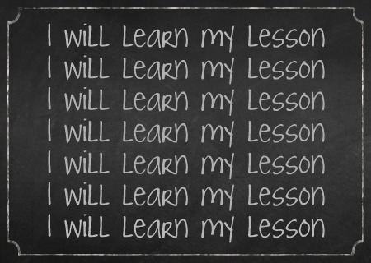
PY 16-17 Lessons Learned
  Changed marketing
    Targeted
  Adjusted Language/Reading levels to meet WF training curriculum
  Incentives
    Classroom materials/tools
    Certification exams
Notes:
Lessons learned
Had to target audience – don’t need Spanish marketing because we need them with a certain English level
Adjusted Language and Reading requirements – increased to ensure they are ready for curriculum
Funds for classroom materials/tools, certification exams

Slide 12
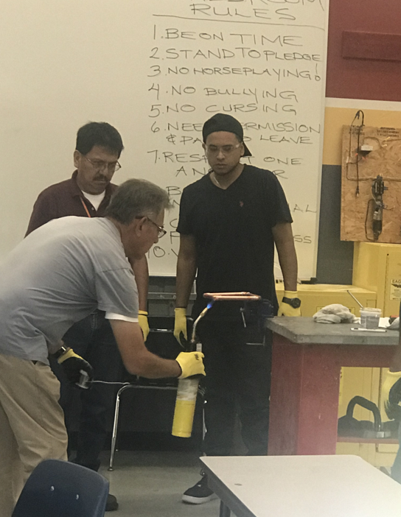
History Lesson: PY 17-18 IETs
Increased interest and follow through
  Former student referrals
  WF Solutions Borderplex referrals
Increased enrollment
  Still accepted everyone interest/met qualifications
  Max class size met!
Notes:
2017-18 started with us reviewing the past year and adjusting to our lessons learned;
Increased interest and enrollment
Marketing – Workforce Solutions and student referrals
Accepted everyone interested and meeting qualifications; we still had the memory of our low enrollment and expected the same so
Maximum capacity of classroom met
Lessons learned
New language and reading levels worked! Everyone who completed program past the industry recognized certifications!
Not everyone ready for employment at completion
Need for entrance requirements related to occupational, i.e., physical, typing, etc.

Slide 13
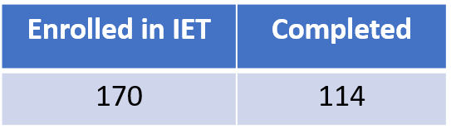

PY 17-18 Lessons Learned
Adjusted L/R levels worked
Problems with job placement
  Can’t physically do the work
  No intent to work – even after assessment
  Happy with current job

Slide 14
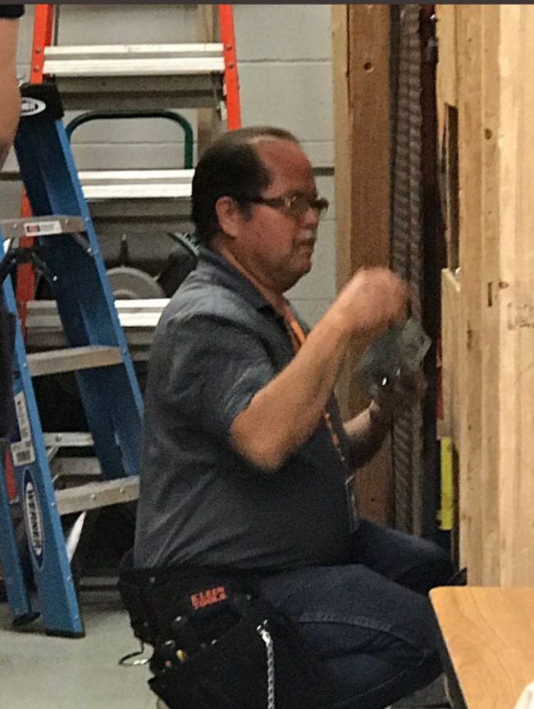
Addressing Past Challenges
New Entrance Req’s
  Physical req’s
  Writing prompt
  Future employment
Notes:
New Entrance Requirements
Vocational/workforce training
Application writing prompt
Future employment in field

Slide 15
More Changes
Career Exploration prior to Enrollment
  Part of Application process
  Added to Orientation stage
Enrollment
  New IET mindset: Accept everyone whose goal is a career
Employment is everyone’s goal!
Notes:
Career Exploration
Part of application process
Added to Orientation stage
Enrollment
Old IET mindset: Accept everyone
New IET mindset: Accept everyone whose goal is to start a career in this field

Slide 16

Future Changes to IET Intake
Secondary session for applicants
  Application process
  Career exploration activities
Individualized interview
  Entrance req’s
  Comprehensive assessment
Orientation
  ITEC plan
  Vocational instructors do Career Orientation
Notes:
Secondary session for IET applicants
Explain application process
Career exploration/awareness activities
Individualized interview
Review of all entrance requirements
Comprehensive assessment – im a believer of that assessment is an ongoing thing; start talking with the potential student
Discuss employment goals
Identify barriers
Orientation
ITEC Plan development
Career Orientation by Vocational Instructors
Additional career exploration

Slide 17
Future Expectations
Target Employment
  WSB program orientations/eligibility
  OJT opportunities
  Support for barriers
  Targeted job fairs
  Electrical IET course ramp-up to Apprenticeship

Slide 18
Expectations on Enrollment
Enrollment
  Numbers might decrease
  Students committed to employment

Slide 19

It’s Okay to Reevaluate
Chera Crawford
Director of Career Pathways and Transition,
Literacy Council of Tyler

Slide 20


The mission of Literacy Council of Tyler is to improve the lives of individuals and their families by eliminating illiteracy through educational services.
“Serving adults since 1990”

Slide 21
Timeline of Career Pathways
2011
  Accelerate Texas
2012
  CMA, Phlebotomy Tech, Dental Asst.
2015
  Added Industry-recognized certificate for welding

Slide 22
More of Our History
2015
  TJC Technical for academic support
  Automotive, HVAC, Welding, and Powerplant Tech
2016
  Training offered for students with academic need (already have HSE/diploma)
  Added Medical Admin program

Slide 23
Application Process Req’s
  Complete at least 12 hrs of guided, independent study in computer lab
  LCOT students: Need 40 hrs of instruction and 80% attendance
  Interview
  Once accepted, 4 classes a week

Slide 24
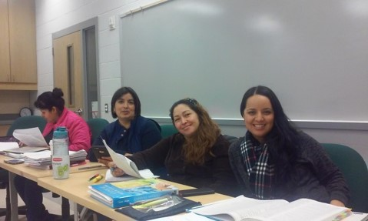
On-ramps for Readiness
6 weeks long
A “try-out”
Taught by GED/ESL instructor

Slide 25
The Results of On-Ramps?
Students did not complete
on-ramp and enter into training

Slide 26

Early Lessons Learned
On-ramps too long
Too many entry points
No personal evaluation by CN

Slide 27

The Fix: Prep Class
1 week/12 hour orientation preparation class
Taught by CN

Slide 28
What the Prep Class Does
In-depth evaluation
Contextualized lesson plans w/ vocab
Evaluate academic readiness, job searching, time management
Opportunities for Career Advancement

Slide 29

More Than Assessing Student
It’s okay to hold the hands of our students.

Slide 30


Lessons Learned
Employability and saturation
Training and skills needed in workplace

Slide 31
Returning Students
Must have worked 6 months in field
Why can’t they find a job?
Address the specific barrier

Slide 32
No significant learning occurs without a significant relationship.
Dr. Ruby Payne

Slide 33

A Support System for Students
Eden Casal
SAIL Project Manager,
Victoria College Adult Education

Slide 34

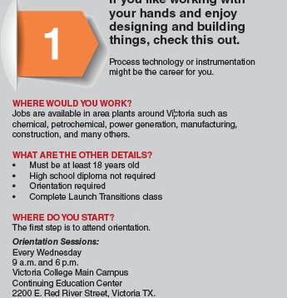
SAIL Program Overview

Slide 35
Initial Screening
Why is this is important?

Slide 36
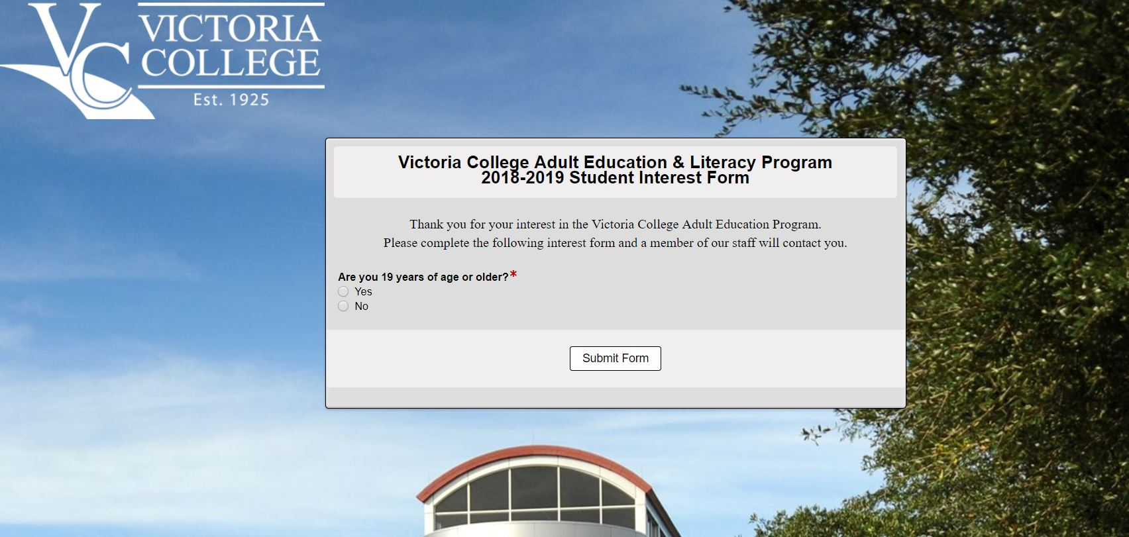
Interest Form

Slide 37

Barriers
Asking the Right Questions
Transportation
Childcare
Work
Probation / Parole
Support

Slide 38

Goals
Beyond your HSE what do you want?
Why are you here?
What do you want to be when you grow up?
College? Cert Program?
Buy house? Buy car?
YOU need to
have GOALS!

Slide 39
Early Education
How far did you go in school?
What happened in life that caused you to leave school?
Learning disabilities?
What can we do to keep you interested?

Slide 40
Support System
Do you have a support system at home?
Does your family know you plan to attend school?
Do you feel like they will be supportive?

Slide 41
Basics of Advising
Go over test scores with student
Go over barriers and goals with students (*you will get new info)
Create a student schedule that is going to work for the student
Do they have any questions? (They will!)

Slide 42

How to Be a Good Advisor
Make the student feel comfortable
Smile!

Slide 43

More on Good Advising
Don’t use big words
Don’t dress to impress
Relate, relate, relate!

Slide 44
Being a Support System

Slide 45
Communication is Key
Be a familiar face
Phone calls regarding attendance
Remind.com
Open door policy

Slide 46
Checking in
Be there the first day of class
Midway check-in
Meet at end of on ramp/transitions/prep class

Slide 47

Support from Classmates
Transportation
Missing class
Study groups
Very important!

Slide 48

Pulse Checks
Same goals?
How is work?
How is class?
Need anything?

Slide 49
It’s Our Job – You Can Do This!
Be supportive
Understand there is no typical student
Make our students feel comfortable and open with us
Realistic goals
Relate to the students
Be that sounding board
Be understanding
Celebrate milestones!
Do what you say you’re going to do

Slide 50
When it gets tough….
NOT everyone is going to be successful
YOU can only do so much
The student has to want it more than you
You have to cut the cord

Slide 51

Getting Students Jobs
Cheryl Smith
Career Navigator/Assistant Director AEL,
Howard College Concho Valley

Slide 52

Communication
Training teacher and support teacher, at least once a week
Data collection and the training teacher in addition to support teacher
Departments and AEL
The students

Slide 53
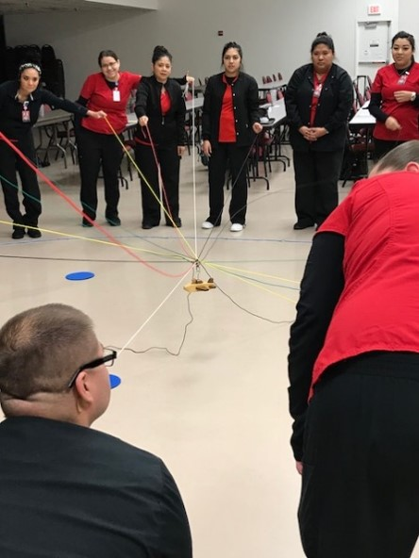
Support Class
Emphasis on “soft skills”
Notetaking
AVID
Problem-solving

Slide 54
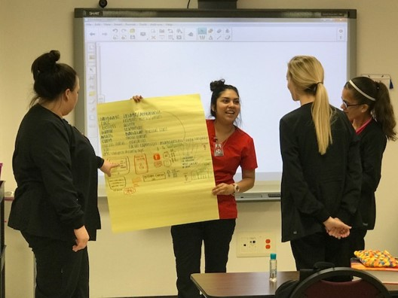
Flexibility in Support Class
Student needs change during semester
Support needed during entire class!

Slide 55
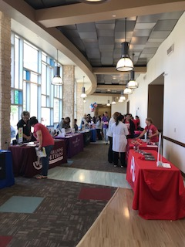
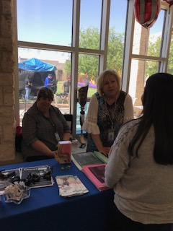
Employability
What do Employers Really Want?

Slide 56
CMA Board Meeting
Meeting with employers
  Shannon Hospital
  Shannon Clinic
  La Esperanza Clinic
  Community Hospital
  Community Clinic
  ISDs around the region
Former and current student included
Occurs once a year

Slide 57
What’s Discussed in Meeting?
Employers’ specific needs
Helps employ current students
Nearly every student has a job prior to graduation
License test is a requirement to pass last class

Slide 58
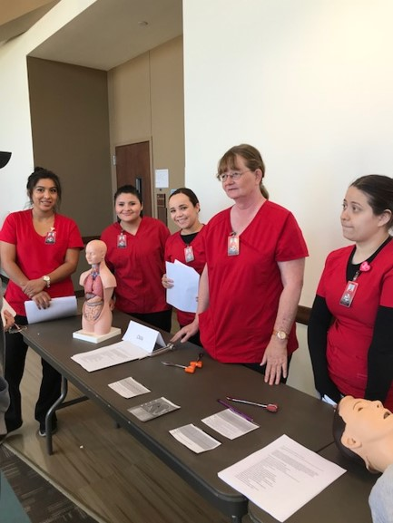
Extracurricular Activities
Students volunteer for community projects
High visibility in community
Results in job offers

Slide 59
Questions?
Contact us!
Eden Casal, Eden.Casal@victoriacollege.edu
Chera Crawford, ccrawford@lcotyler.org
Olga M. Escamilla, Ph.D., olga.escamilla@tamu.edu
Mary Jo Ochoa, mochoa16@sisd.net
Fabiana Ramirez, fabiana.ramirez@twc.state.tx.us
Cheryl Smith, Casmith@howardcollege.edu

