Slide 1
Employer Engagement: Designing Quality Programs
An AEL Panel Presentation

Slide 2
Session Objectives
Sharing different perspectives on successful employer engagement
Getting information on how to go about getting that type of engagement in your local area
Continued learning
Enhancement of peer-to-peer engagement
Notes:
May require more than one slide

Slide 3
Guiding Questions
What audience is the strategy best for?
Who are the stakeholders / partners in this relationship?
What goal were you trying to achieve for this employer?
How were they determined?
What is the timeframe to develop this partnership?
What is key for this to be successful?
What are challenges to be prepared for?
Notes:
May require more than one slide

Slide 4
Meet the Panelists
Eliza Diaz, Southwest Texas Jr. College
Shelley Seavers, Adult Education Program Supervisor, North East Independent School District
Angela Johnson, Harris County Department of Education

Slide 5
Questions
Will be held at the end of the presentation

Slide 6
Adult Education and Literacy Program Our Initiative – Partners for Employee Growth and Success: A phase in process Presenter: Eliza Diaz, SWTJC – AEL Director

Slide 7
Partners for Employee Growth and Success
Program Goal: create a collaborative partnership with employers in our community to strengthen employees’ English language skills, critical thinking skills, workplace skills and promote post-secondary education in turn meeting employer needs as well as providing employees with the skills necessary for advancement.
SWTJC
HEB
Backer Marathon

Slide 8
Partnerships
HEB – 2 year Partnership Backer Marathon – Established this year

Slide 9
SWTJC – AEL Program
Services a total of 11 counties
Covers a large area but services approximately 1000 students
Our Workplace literacy program services approximately 60 students primarily confined to 2 counties (our largest sites Del Rio and Eagle Pass)
ESL instruction is provided in the workplace

Slide 10
Implementing our Phase in Process
Phase 1: Establish the relationship and goals for the partnerships
Meet and greet with partner administration designee
Review of program offering
Discussion of schedule and location
Possibility of employee incentives
Recruitment procedure to get program started
Our strong partnership ensured that education and training was aligned to the workplace needs.
Employers have to pay an active role with SWTJC-AEL to influence program design and delivery, shape instruction, encourage attendance and measurable skills gains.

Slide 11
Phase in Process
Phase 2: Develop and implement a recruitment and retention plan; identify employee needs and students needs
On-Site Overview
Flyer/Brochure
Dept. Manager Meetings for Overview and recruitment assistance
On-Site Enrollment Process: Orientation, Enrollment Forms and Assessment
Student and Manager Surveys

Slide 12
Phase in Process
Phase 3: full implementation of instruction working towards increasing student ability to complete
Employees who participated in workplace literacy program were provided instruction in basic reading, writing and math skills.
Instruction integrated employability skills such as digital literacy, working with others, critical thinking skills and identified workplace skills.

Slide 13
Student Benefits
Attended on-site classes
Flexible scheduling
Equipped with tools necessary for advancement such as improved reading, writing and math skills
Empowered students to continue their education and/or training
Opportunities to be recognized by employer

Slide 14
Employer benefit
Increase performance level from employees
Increase productivity and therefore profit
Improved employee retention
Education provided to employees at no cost to employer

Slide 15
Challenges and Keys to Success
Challenges
Flexible schedule to meet employer/employee needs
Recruitment
Retention
Keys
Communication
Visibility
Flexibility

Slide 16
It takes time, effort and lots of communication! It will vary from partner to partner.
August – September: Phase 1
Set up meetings
Discuss program possibilities
Plan logistics
Start recruitment process
October – March: Phase 2
Meet and Greet
Orientation
Class begin
April – June: Phase 3
Meet with partners
Complete surveys
Continue classes
Plan for improvement

Slide 17
Thank you!
Eliza Diaz
ediaz5@swtjc.edu

Slide 18
North East ISD Adult Education & Literacy Proud Partner of ESC 20 Alamo Consortium

Slide 19
Workplace Literacy Program Partnerships
Presenter: Shelley Seavers
Adult Education Program Supervisor

Slide 20
North East ISD AEL
San Antonio
Medium-sized program
1,100+ students served annually
Member of ESC-Region 20 – Alamo Consortium
8 programs in the consortium

Slide 21
TTTX
Manufacturing
NEISD Workplace Literacy Program
ESL

Slide 22
Stakeholders
TTTX Employees
TTTX Leadership
Community
TWC-Workforce Solutions
Alamo Consortium

Slide 23
TTTX Employees TTTX Leadership
Improved on-the-job communication
Safety
Potential promotion / pay increase
Company longevity / loyalty

Slide 24
Community
Employee applicants
Potential promotion / pay increases
Boost economy

Slide 25
TWC-Workforce Solutions Alamo Consortium
Education / Industry Partnerships
Serving our Community
Economy

Slide 26
Phases
Phase 1: Meet and Greet
Phase 2: Stakeholder Survey
Phase 3: MOU
Phase 4: Recruiting
Implementation and Maintenance

Slide 27
How did we know what TTTX needs/wants?
Stakeholder Survey

Slide 28
Stakeholder Survey
Google forms – multiple choice, short answer questions
Contact info
What classes?
What specific workplace skills…?
Math in the workplace; measurement; writing in the workplace; etc.

Slide 29
Questions to Ask
How will you recruit employees?
Will you hire applicants without a HS diploma?
What incentives and stipulations will you communicate employees or applicants?
Pay increase; paid time to attend class; limited time to earn TxCHSE; company will pay for HSE official tests
Rooms; equipment; technology; secure storage
Schedule

Slide 30
Agreement to Services Part 1 Provided
Please understand NEISD Adult Education is grant funded by Texas Workforce Commission. In order to provide no-cost Adult Education classes to your company, employees/students must earn the minimum number of education hours provided to you in a separate document. Additionally, employees/students must take a progress test at the time those educational hours are completed. Our program can lose funding when students stop coming to class without minimum hours and progress test. Check the box to acknowledge your understanding.

Slide 31
Agreement to Services Part 2
Please keep in mind Adult Education registration paperwork and testing is required for all employees/students. ESL testing can be administered at your site. This testing takes 6 hours. This process can be split into multiple days. Once registration/testing period is complete, employees may not join classes until the next testing period. Please check the box to acknowledge your understanding.

Slide 32
Agreement to Services Part 3
Please understand NEISD requires a projected number of employees/students who will participate in an Adult Education class at your work site. We need 5 business days from notification of total ESL number in order to prepare ESL registration and testing teams to visit your site. Newly-hired employees who need HSE must have time before starting work to visit our Ferrari location or Workforce Solutions location to take entrance tests. Please check the box to acknowledge your understanding.

Slide 33
Contextualized Lessons
Safety
Team Working
Workplace Math
Math Measurement
Workplace Writing
Self-Management

Slide 34
Time Line
The time required to develop a partnership like this one varies
We have worked with TTTX since January 2018

Slide 35
Lessons Learned
Their timeline versus ours
Purposeful procedures
On time information

Slide 36
Keys to Success
Stakeholder Survey
Purposeful Procedures
Frequent Evaluation
On-Time Communication

Slide 37
Final Thoughts
It is okay if you have not started Workplace Literacy
It is okay if you don’t know where to start
You are encouraged to reach out

Slide 38
Thank you!
Shelley Seavers
sseave@neisd.net

Slide 39
Harris County Department of Education One Source for All Learners #oneforall Presented By: Angela Johnson, Program Manager, Harris County Department of Education

Slide 40
HCDE Adult Education Demographics
Harris and Liberty Counties
Upwards of 7,000 students
65 service locations
Over 70% of students are speakers of other languages

Slide 41
Presentation Audience
Administrators
Workforce Development Staff
Employer Partners
Teachers

Slide 42
Stakeholders and Partnerships
Tyson Foods
Upward Academy
Team Members (TM’s)
Local Administration

Slide 43
Employer goals
Improve workplace efficiency by improving English fluency
Reduce barriers in personal lives of Team Members
Reduction in barriers is good for business
Support citizenship initiative
Improve relationship between managers, supervisors, and line workers
Create a supportive workplace culture

Slide 44
Development of employer goals
State leadership
Planning meetings with Upward Academy
Needs assessment survey
Distributed company wide
One-on-one meetings with TM’s

Slide 45
Project Timeline
December 2017 – Initial Site Visit
January 2018 – Disseminate Survey to TM’s
February 2018 - Registration
Class Development
March – First Day of Class
March – 3 Week Survey
April – Distance Learning Training
June – Progress Tests
June – Formal Survey
June – Last Day of Class

Slide 46
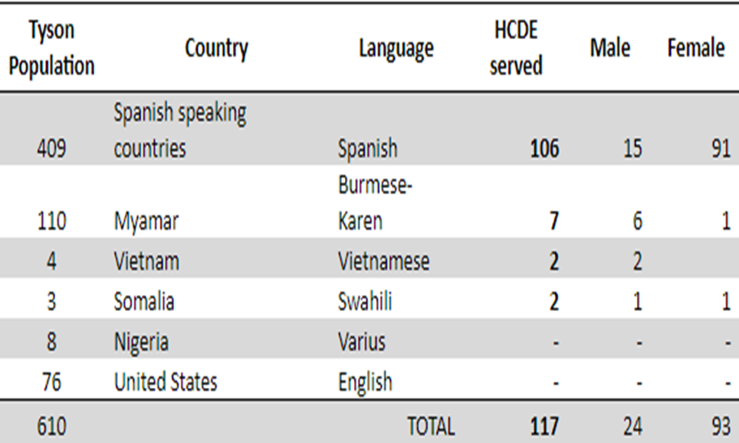
Enrollment

Slide 47
Keys to Success
Flexible approach
Build relationships with intention
Where possible, classes should be:
located onsite at Tyson Foods
Scheduled immediately before or after existing shift
Support from human resources, chaplain, and management
Access to computer lab
Distance learning – intensify instruction
Curriculum development
Paid planning and development time

Slide 48
Challenges
Buy-in from Tyson staff (all levels)
Nontraditional Schedule
Shift work
Early start
Shorter class periods
Challenge to progress test with required hours
TM’s desire to socialize
Distraction in class
Requests to attend class with friends/co-workers
Occasional interference with conflicting work schedules
Significant commitment of resources
25 % of TM’s were enrolled in AEL services

Slide 49
Thank you!
Angela M. Johnson
ajohnson@hcde-texas.org

Slide 50
The End
QUESTIONS?

Slide 51
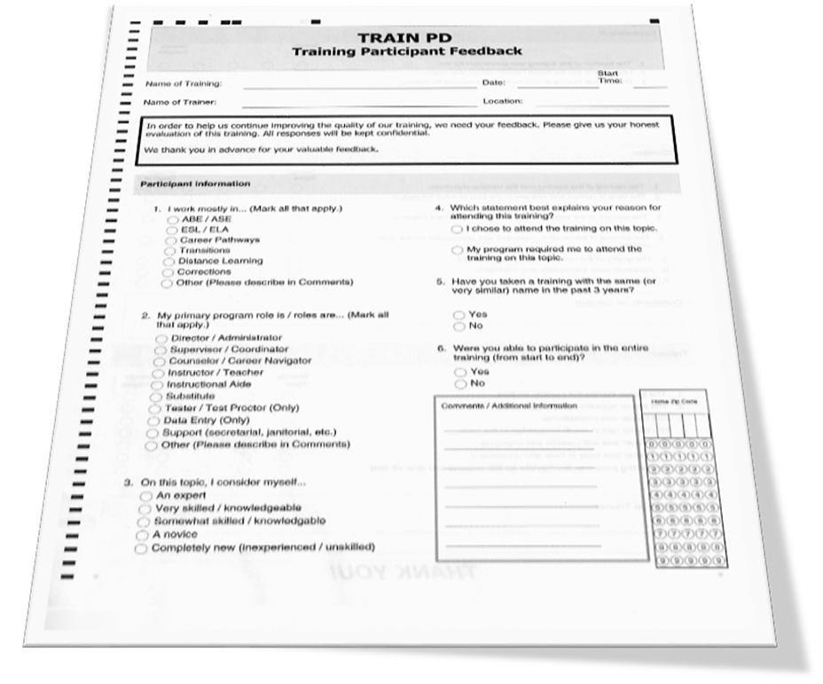
Please fill out the Scantron
You can use either a pen or a blue or black ink pen
Remember to bubble
Don’t forget your home zip code
Please fill out both sides

Slide 52
Thank You For Your Participation!

